Slide 1
CompuCLean
Building a Managed Post-Pandemic Cleaning Program

Slide 2
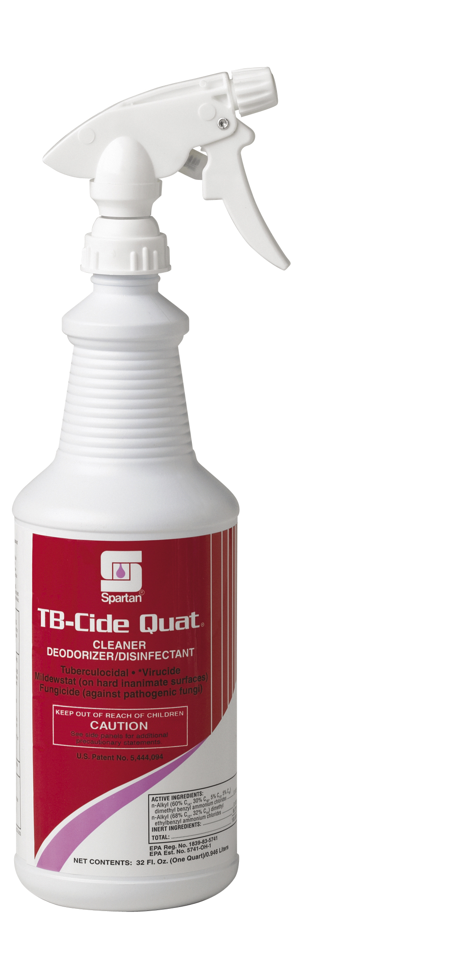
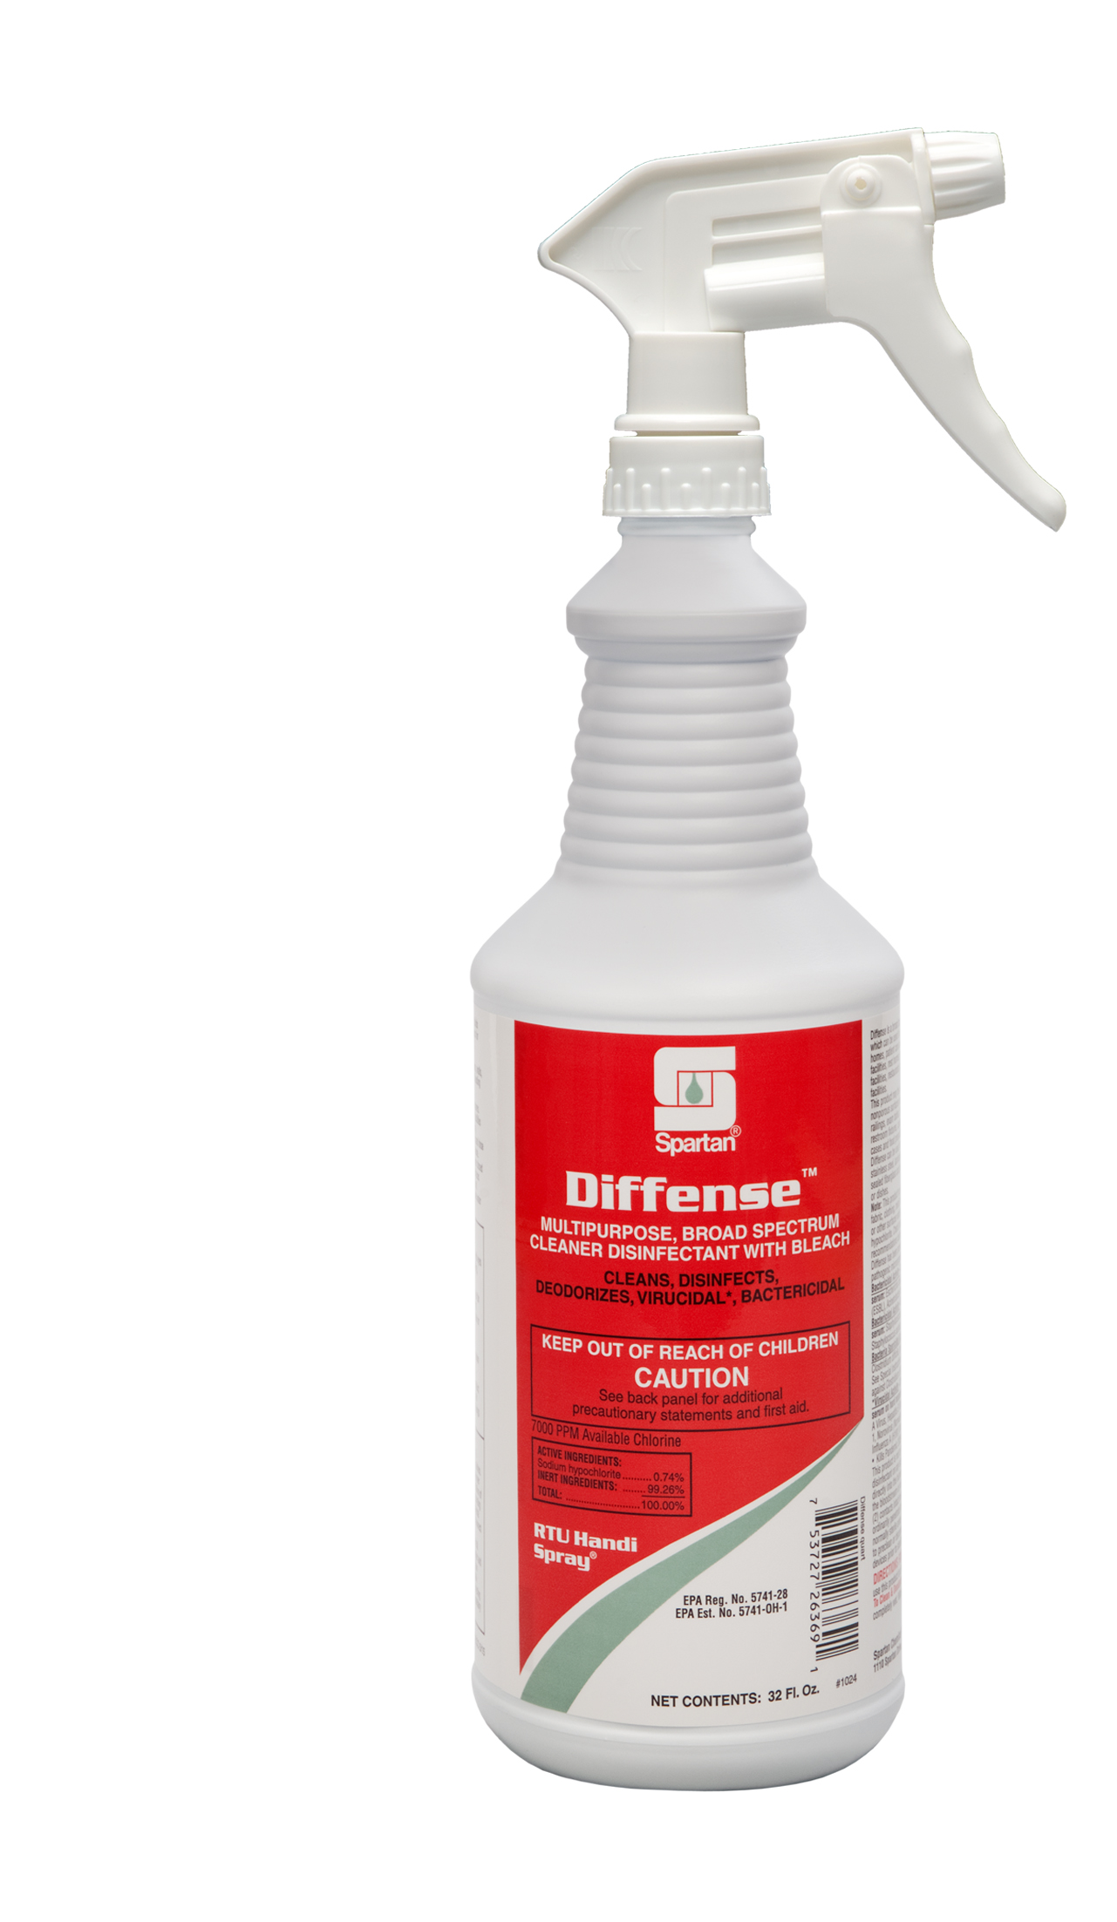
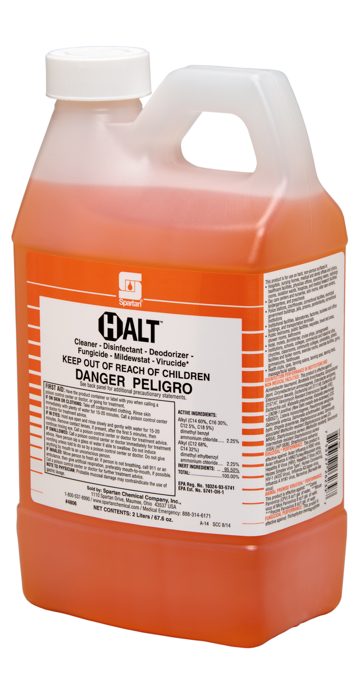
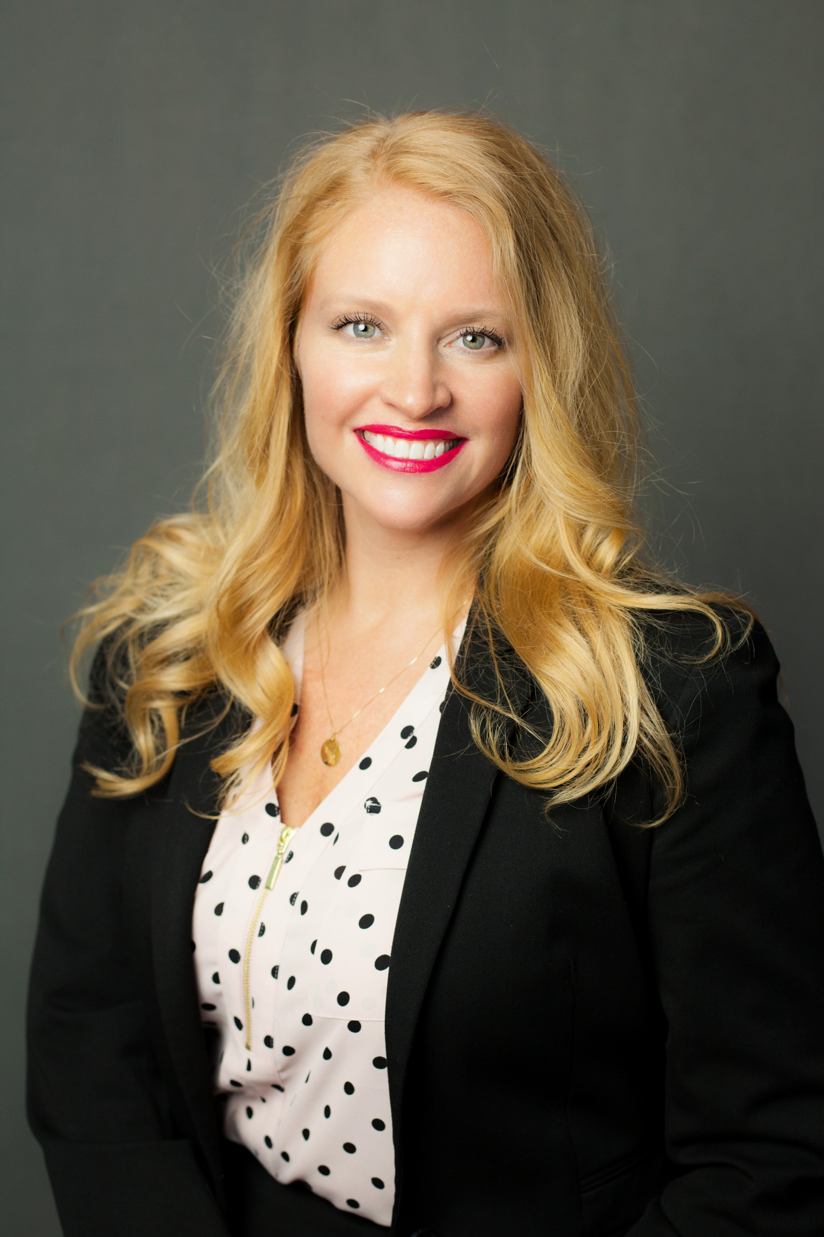
Building a Managed post-pandemic cleaning program
Compuclean®
Welcome!
Cali Sartor, Vice President, Marketing & Advertising

Slide 3
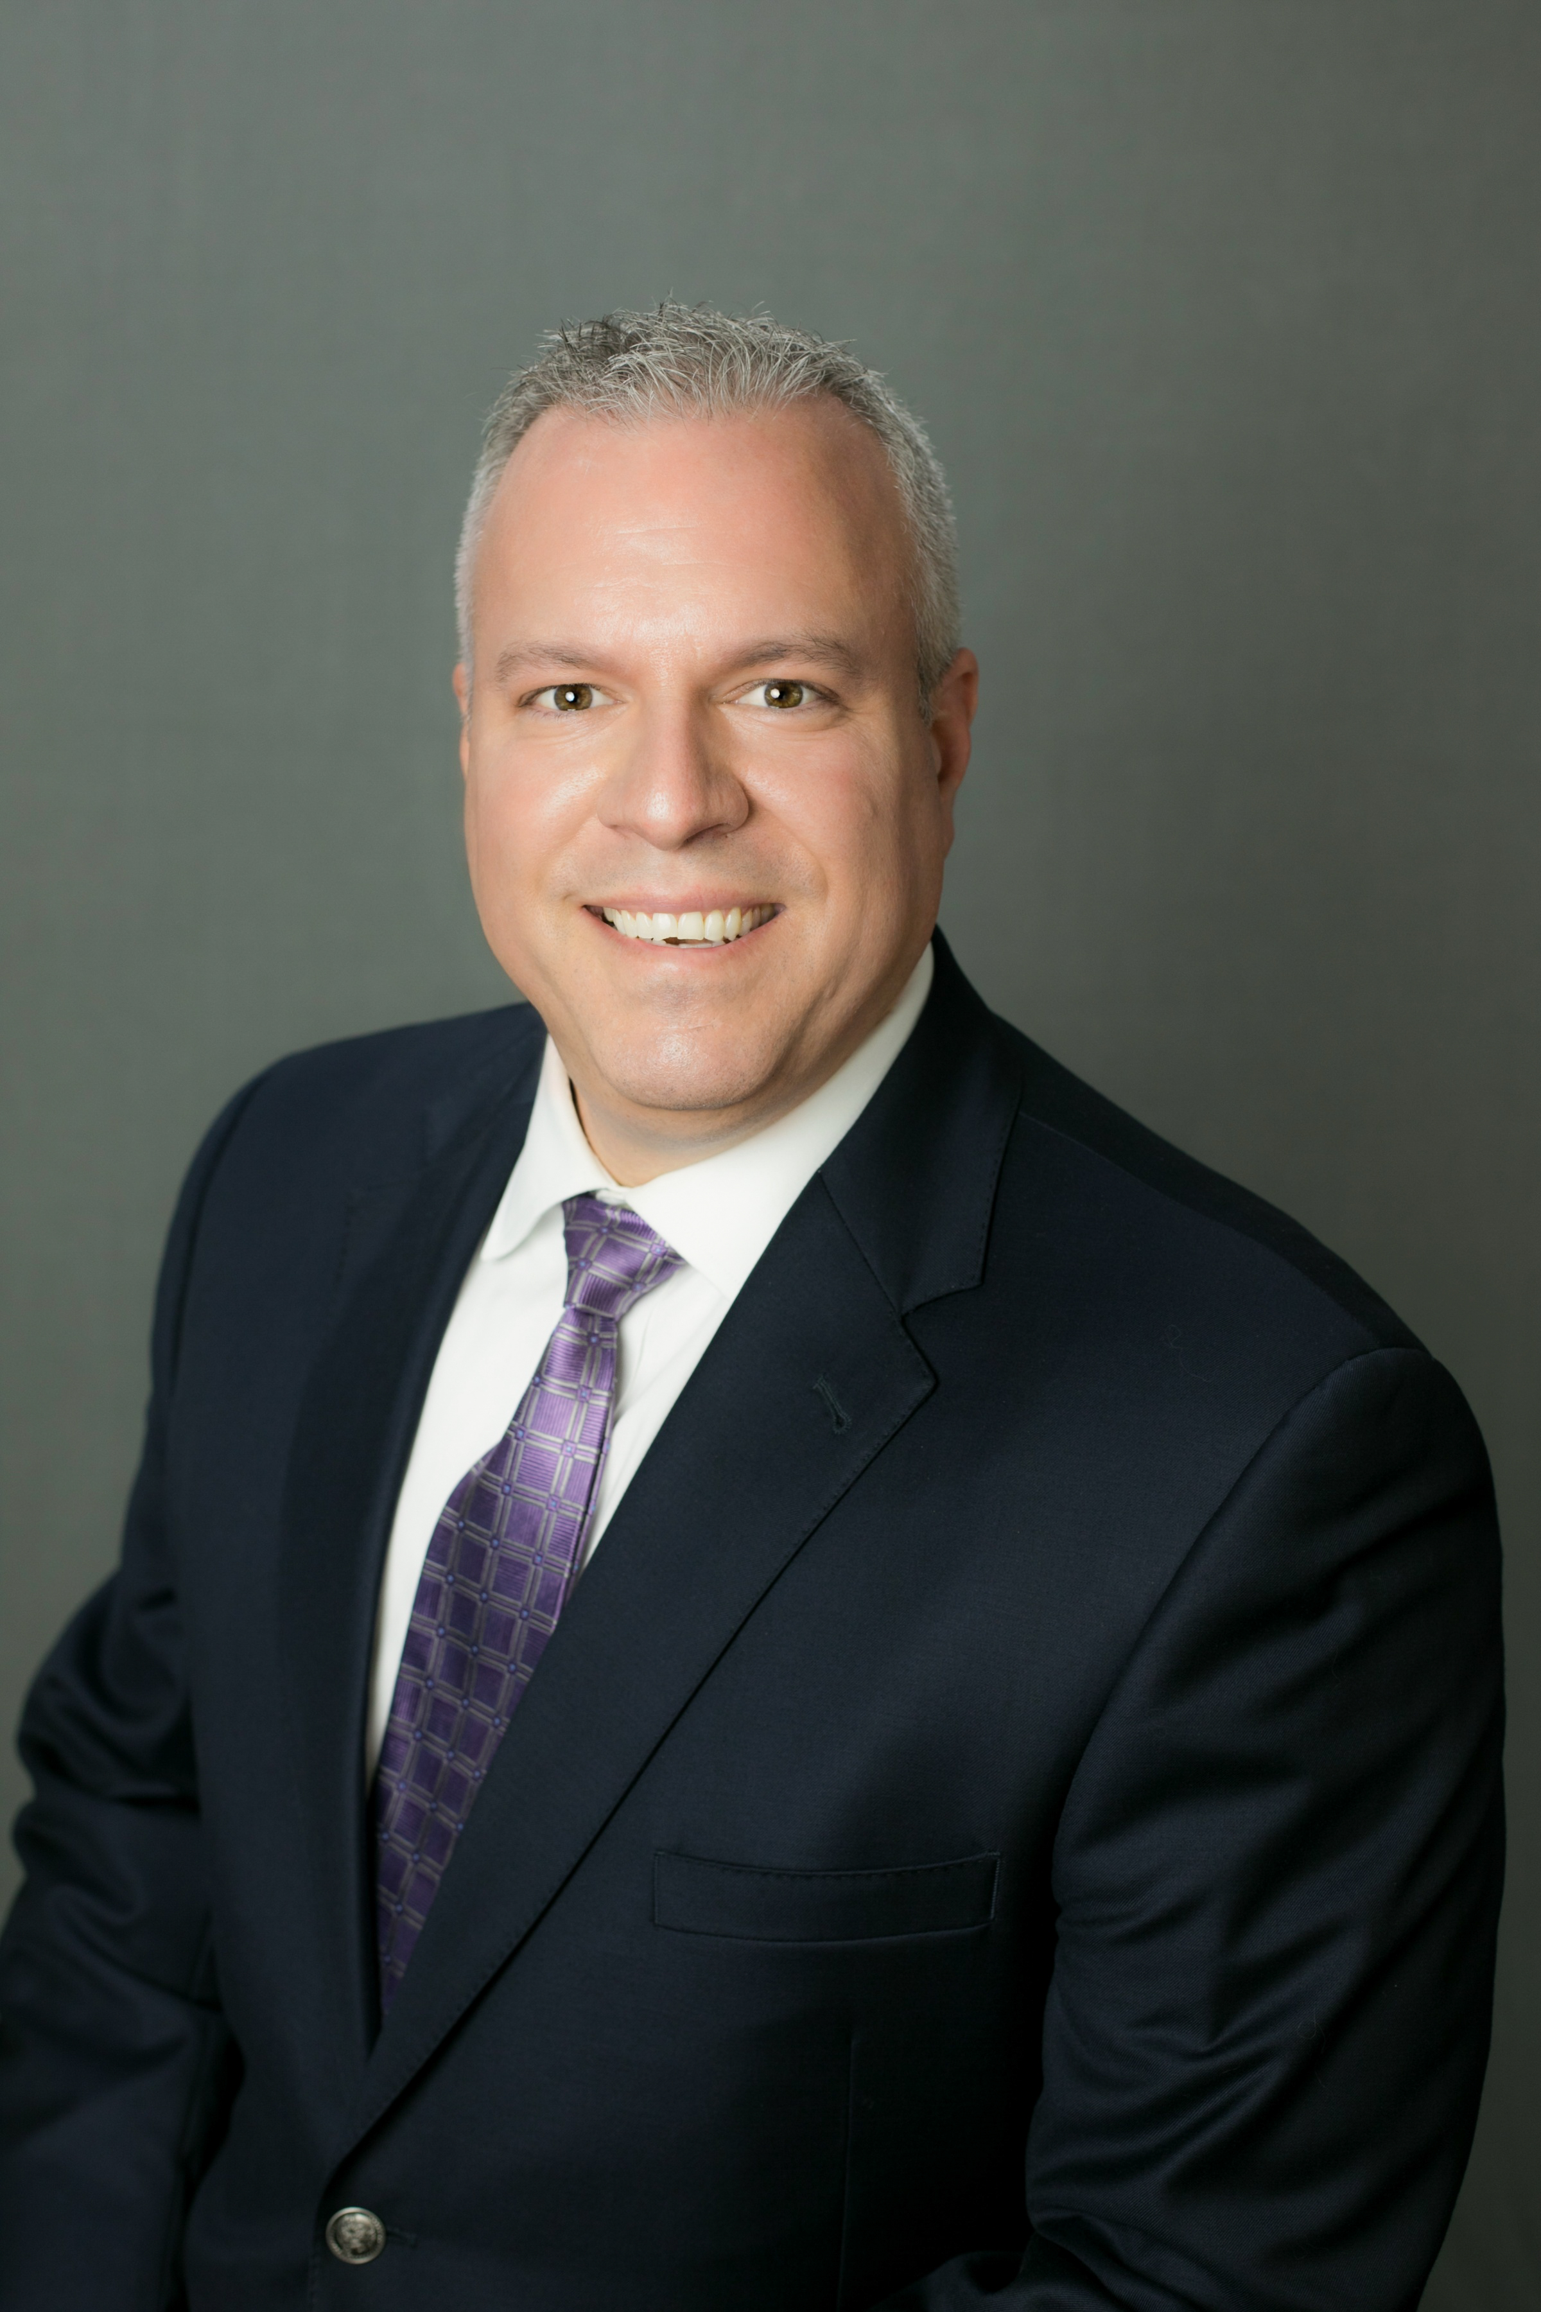
Building a Managed post-pandemic cleaning program
Compuclean®
SPEAKERS:
Mike Fabian, CompuClean Manager

Slide 4
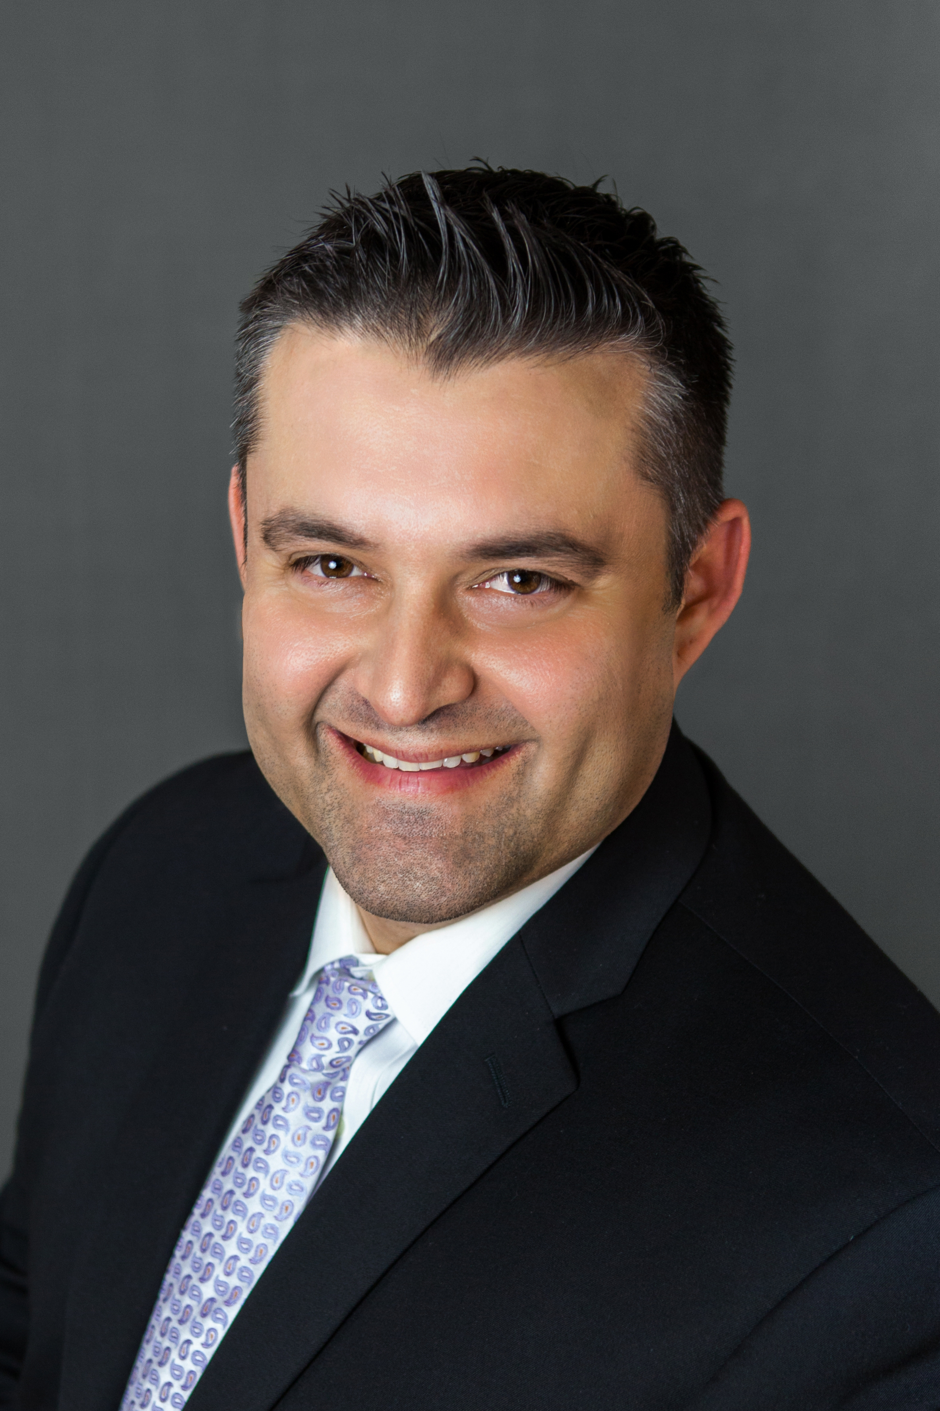
Building a Managed post-pandemic cleaning program
Compuclean®
SPEAKERS:
Jerred Attanasio, Director, Building Service Contractor Programs

Slide 5
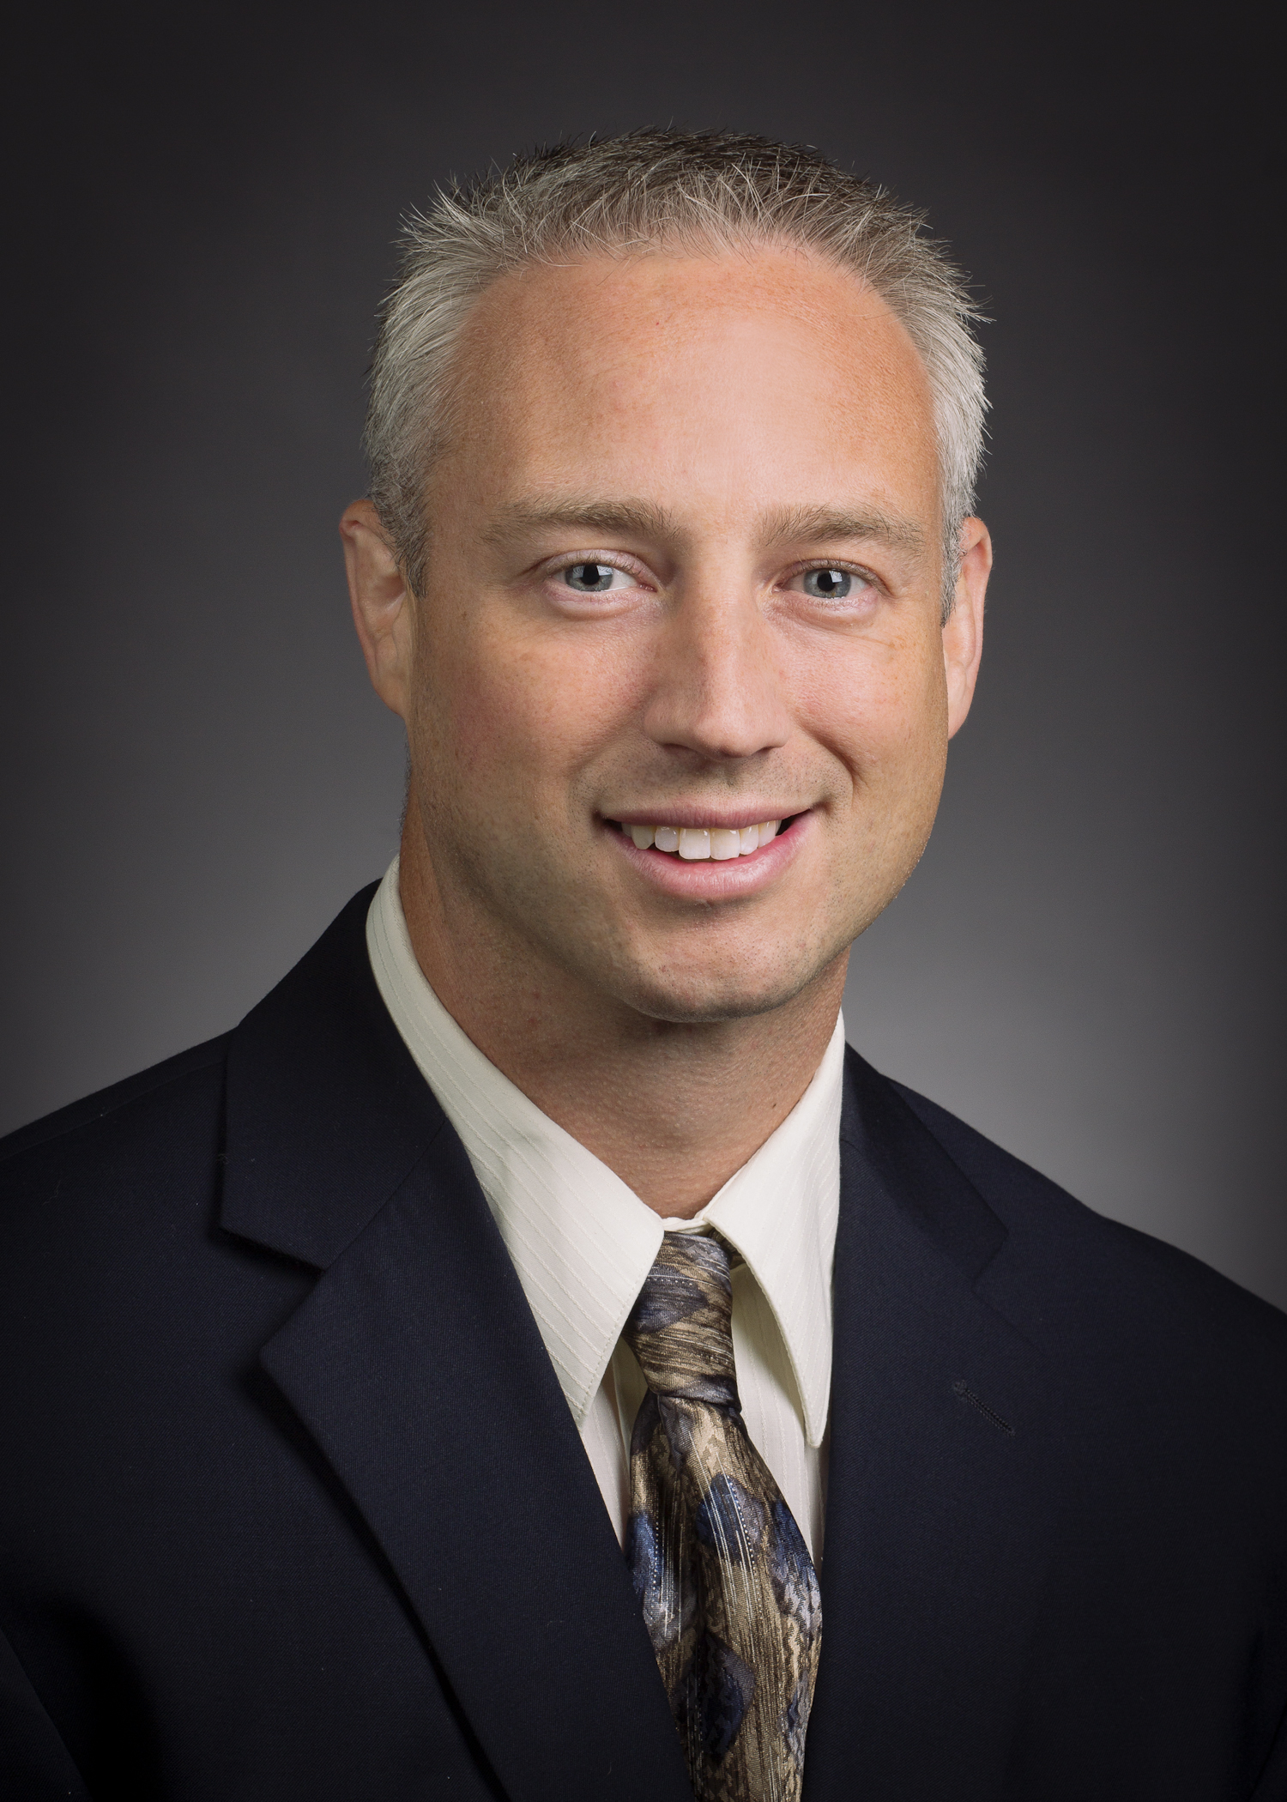
Building a Managed post-pandemic cleaning program
Compuclean®
SPEAKERS:
Jason Welch, Microbiologist

Slide 6
Building a Managed post-pandemic cleaning program
Compuclean®
Broadcast Details:
The format will include a 30-minute presentation and 30-minute question and answer session.
During the broadcast, you will be able to submit a question through the Q&A panel on the right of your broadcast window.
We will do our best to address all submissions and if yours is missed we will also do our best to follow up after.
Lastly, we will provide this presentation as a download on our COVID-19 Preparedness page on our website and upload a link to view the recording of this broadcast.

Slide 7
www.spartanchemical.com/solutions/covid-19/

Slide 8
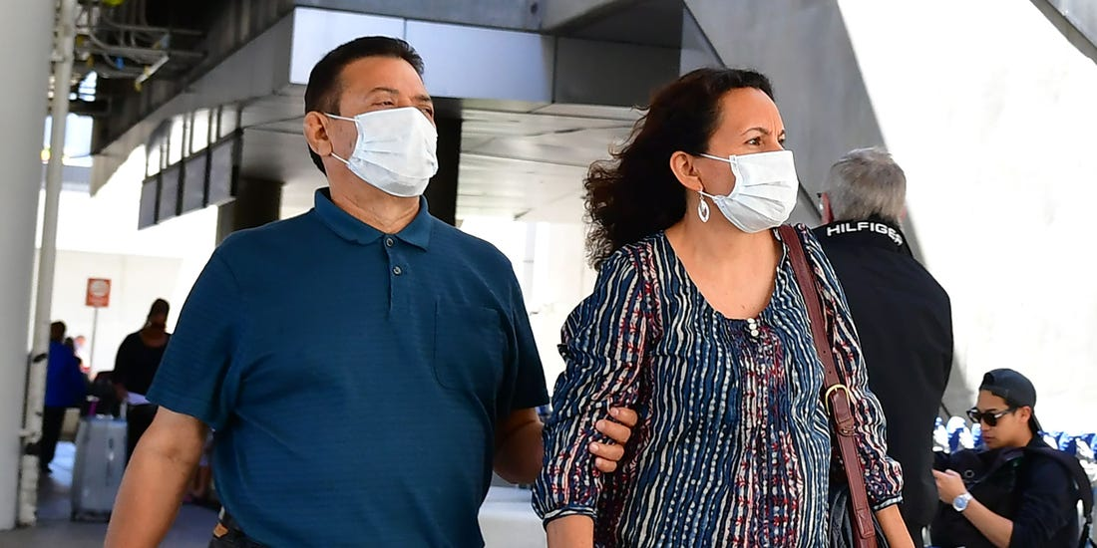
Moving Forward
The New Normal
The entire landscape of the JanSan industry will be altered for the foreseeable future.
Continued social distancing
Restrictions on visitors and foot traffic
Wearing cloth face coverings
Avoiding touching eyes, nose, and mouth
Staying home when sick
Hand washing and sanitizing requirements
Heightened focus on disinfection and cleaning frequency
Increased reliance on custodial services to keep buildings safe
BSCs required to document and validate processes.

Slide 9
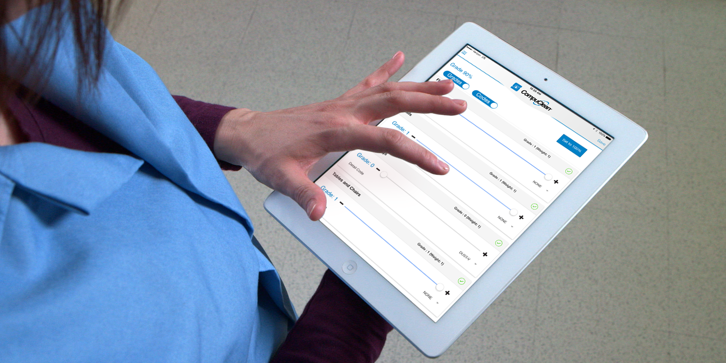
Moving Forward
The New Requirements
Building Service Contractors will be required to increase documentation and management of cleaning and sanitation.
Cleaning Process Documentation
Cleaning Process Validation
Managed and Communicated Work Assignments
Effective Staff Training

Slide 10
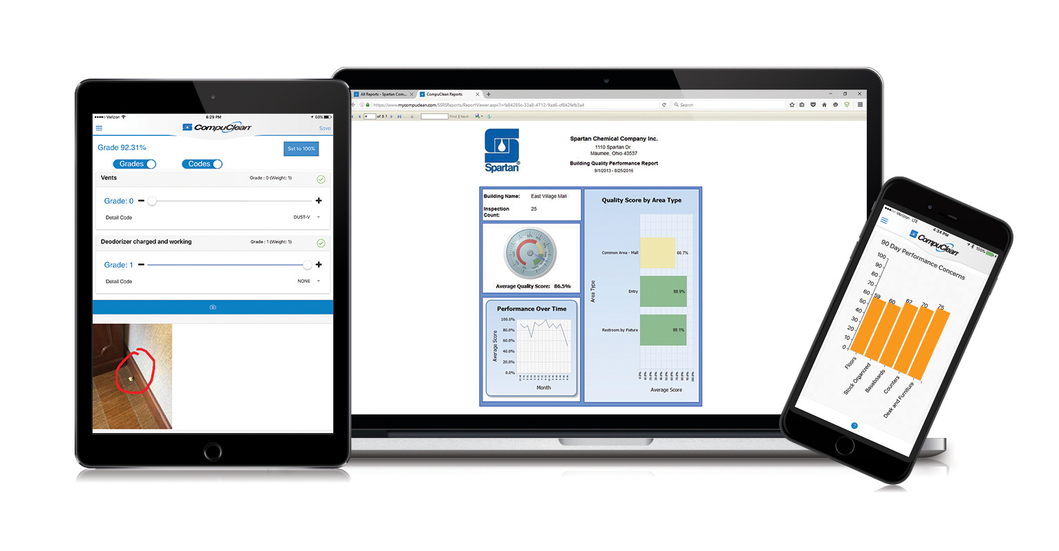
Managed Cleaning
CompuClean Facility Management Software
CompuClean offers a robust, flexible and low-cost solution to meet the challenges of Managed Cleaning
CompuClean is a complete cloud-based custodial data management solution
CompuClean is owned, developed and supported by the Spartan Chemical Company Inc.
Available exclusively to Spartan customers
English, Spanish and Portuguese Language Compatibility
CompuClean Features:
Custom Workloading and Work Management
Inventory Management
Quality Assurance
Capital Equipment Management
Employee Training Tracking
Mobile Apps available for Android® devices and iPad, iPhone and iPod touch

Slide 11
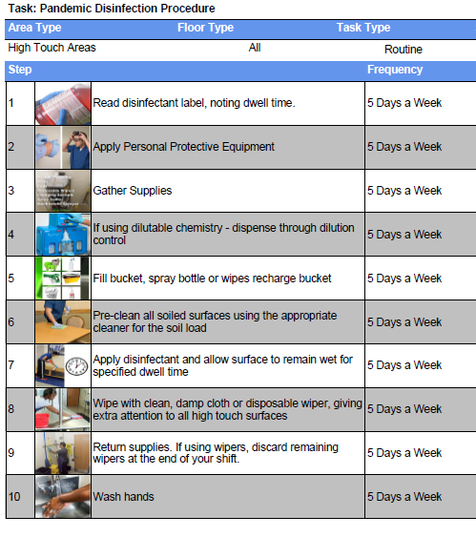
Managed Cleaning
Process Documentation
CompuClean Workloading provides a custom approach to cleaning documentation.
Define clear and concise cleaning procedures.
Update and modify easily
Brand materials for your company
Include specific products and materials
Personalize with images

Slide 12
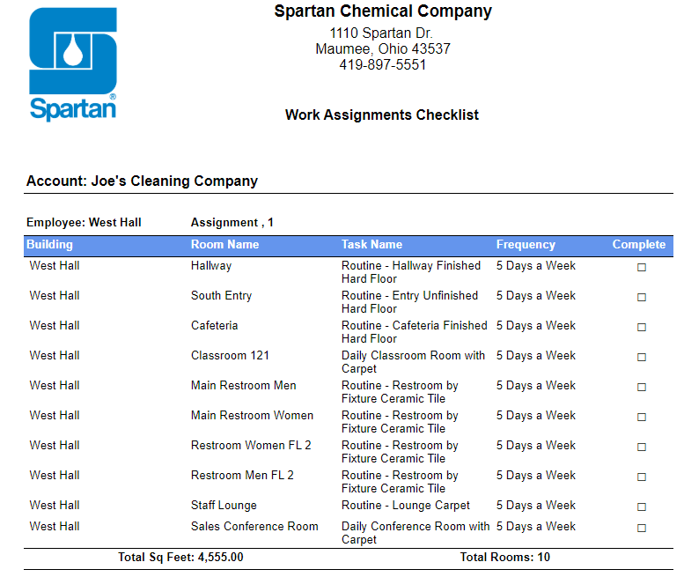
Managed Cleaning
Work Assignments
Create specific work assignments for any facility.
Clearly communicate responsibilities
Assignment checklists for staff
Include productivity metrics
Demonstrate sufficient staffing
ISSA 612 Cleaning Times
Edit and modify Assignments

Slide 13
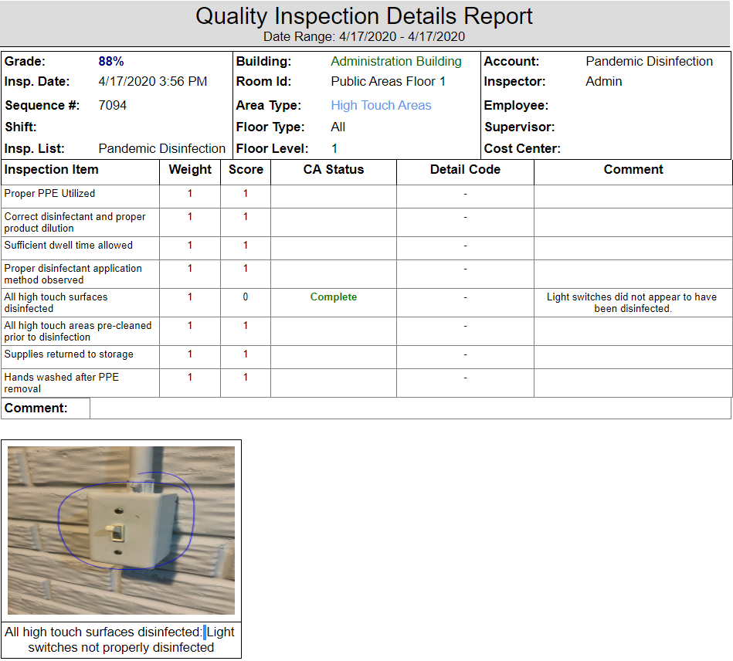
Managed Cleaning
Process Validation
Utilize structured inspections to document performance and identify deficiencies and training needs.
Design mobile inspections to validate routine and pandemic focused cleaning
Track performance by building, employee, supervisor and more
Powerful quality reporting provides detailed results to help maximize the performance of your custodians.
Document issues and track resolution with Corrective Actions
Perform inspections online or offline with CompuClean Mobile Apps.
Capture pictures at all inspection stages

Slide 14
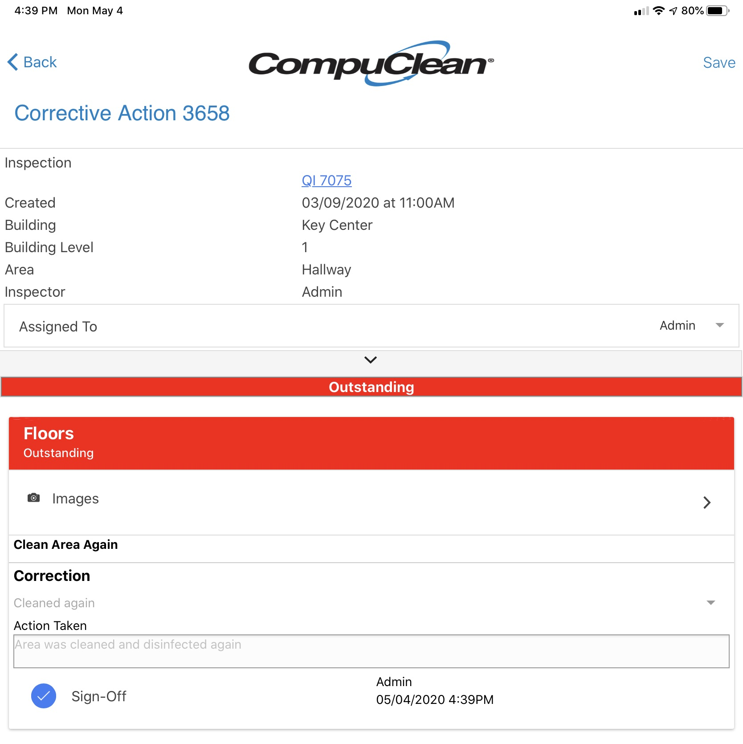
Managed Cleaning
Process Validation
Corrective Actions document resolution of issues in facilities.
Inspector finds issue and creates corrective action
Employee assigned to CA is notified via email or text
Employee makes correction and marks CA complete in App
Inspector verifies completion of CA and marks it in Mobile App

Slide 15
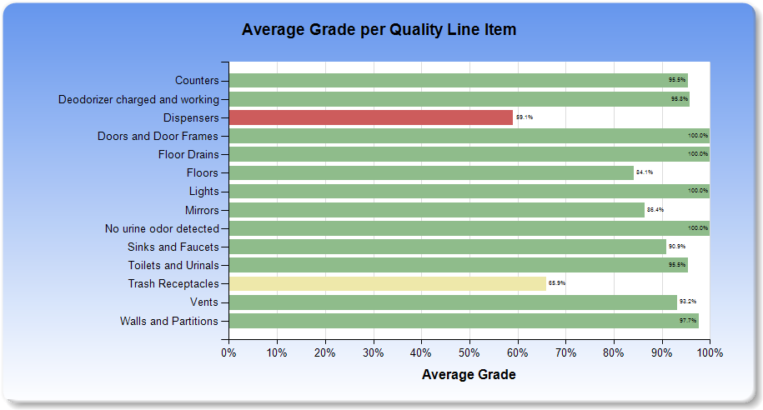
Quality By Line Item Chart
Provides performance metrics for all inspection items to help target training and identify areas for improvement.

Slide 16
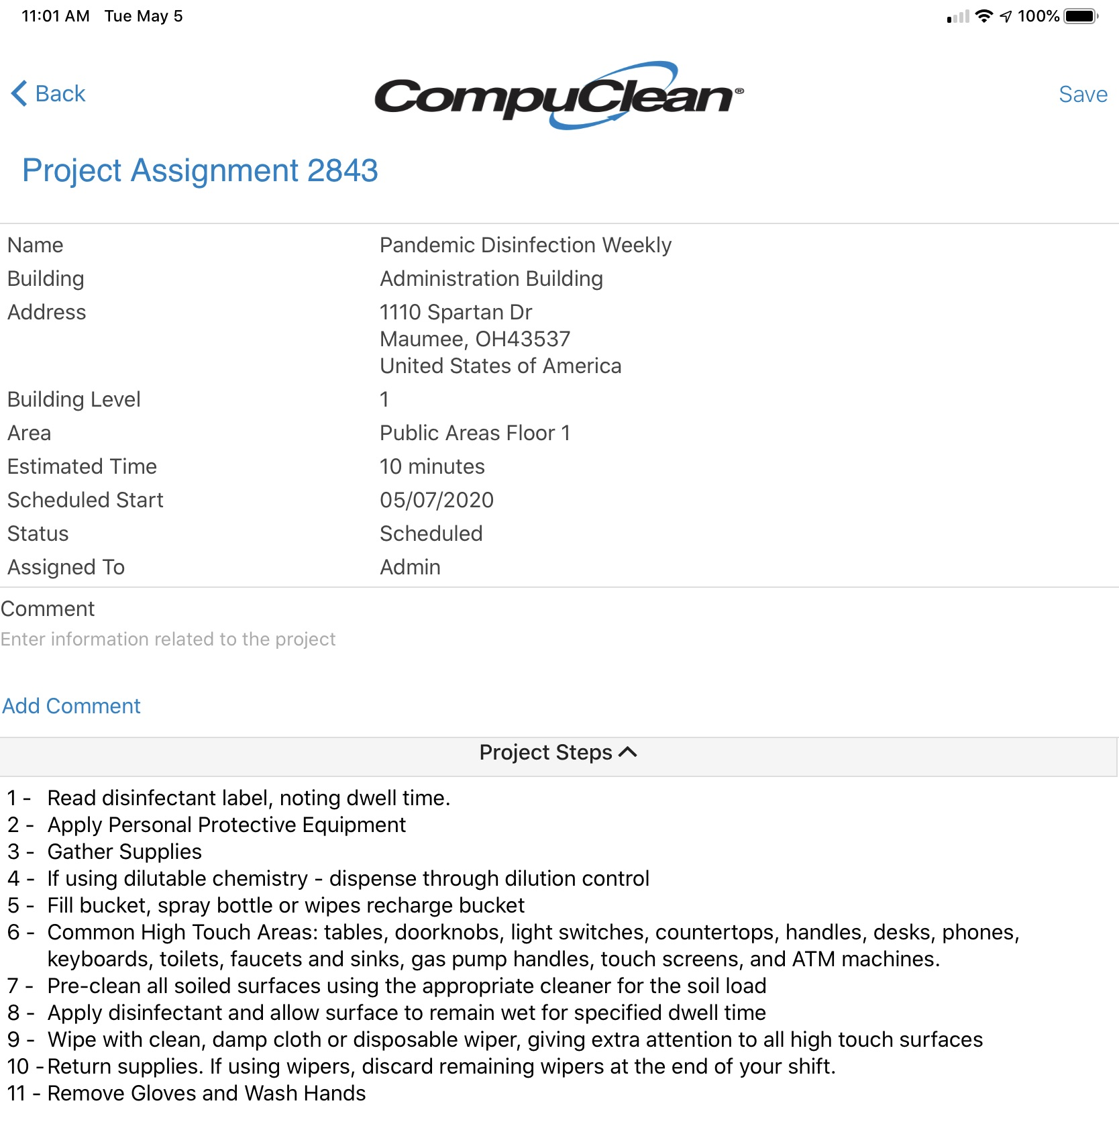
Scheduling Periodic Work
Managed Cleaning
Periodic Project Scheduling keeps low frequency jobs on track
Create, schedule and complete recurring projects
Weekly deep cleans
Ongoing pandemic disinfection
Periodic floor care
Document project steps in detail to make sure employees understand the process
Automatically schedule next instance upon completion
Full mobile Integration with email and text alerts
Weekly upcoming project email alerts

Slide 17
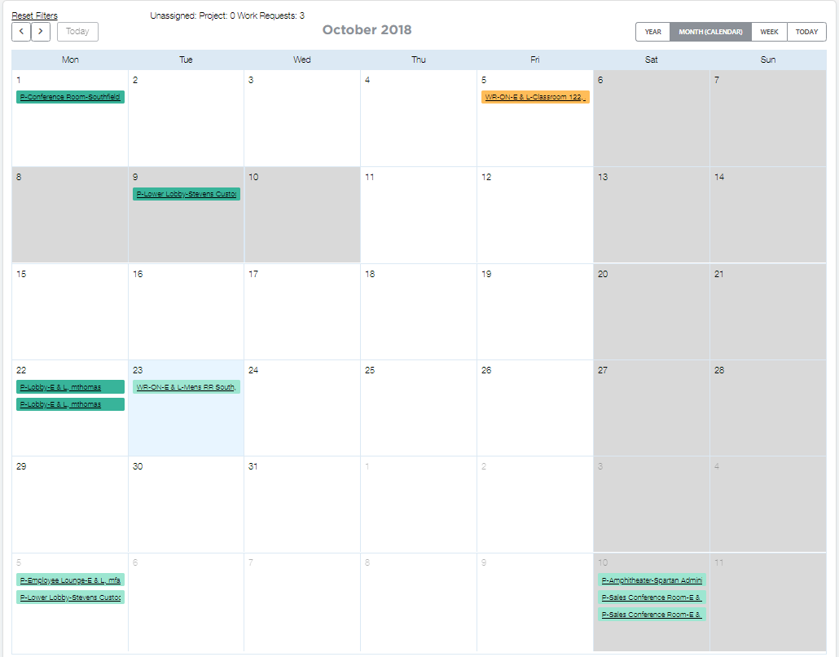
Managing Work Requests
Managed Cleaning
Work Request Management offers immediate access to urgent facility needs
Easily track and complete one-time requests from customers or building occupants
Respond immediately to cleaning emergencies
Assign work orders from your mobile device to staff
Get notified when work is completed.
Create Internal Work Requests and Assign
Online Request Portal
Allow Customers to Submit Requests Online
Branded with your logo
Full mobile integration with email and text alerts

Slide 18
CleanCheck® Training system
Education
Effective staff training provides the knowledge and tools to help stop the spread of harmful viruses such as SARS-CoV-2 through proper disinfection of high touch surfaces to reduce the risk of personnel contacting a contaminated surface.

Slide 19
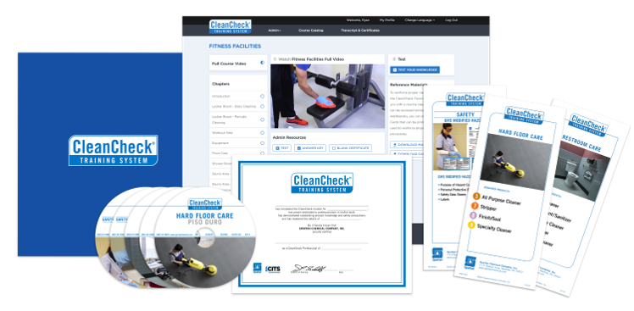
CleanCheck® Training system
Education
Spartan’s CleanCheck Training System will ensure that your employees are properly ​trained on the products and procedures necessary to accomplish the required cleaning ​tasks.
Web or DVD-based video tutorials​
Web or paper-based testing​
Training manuals​
On-the-job cards​
Employee recognition certificates​
New Pandemic Disinfection Training
Meets the requirements for the CIMS-GB Standard as well as CMI Advanced Standards

Slide 20
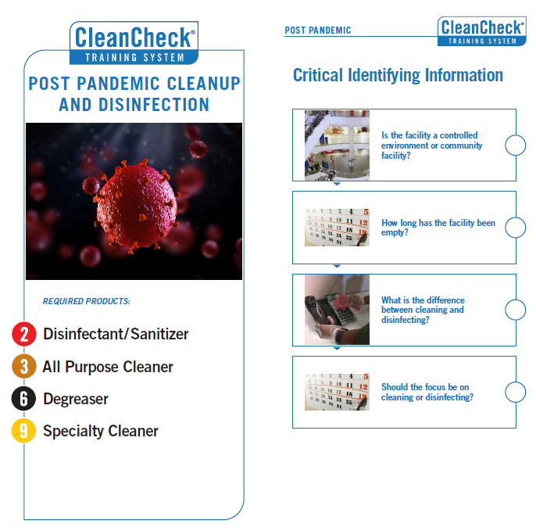
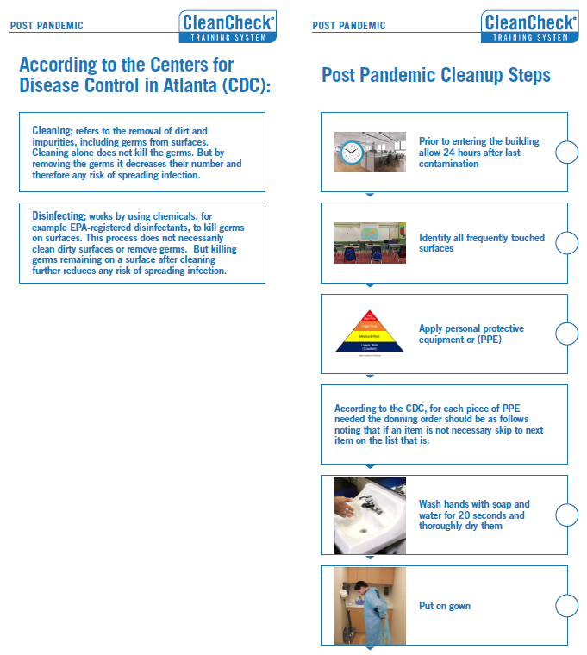
Post-Pandemic Training Cards
CleanCheck

Slide 21
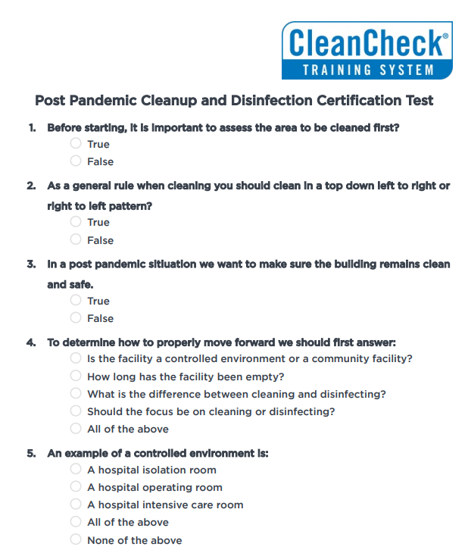
Post-Pandemic Training Test
CleanCheck

Slide 22
CompuClean Pricing and Requirements
Pricing Terms
$420 per year for up to 4 users
$600 per year for unlimited users
90 day no risk guarantee
Cancel at any time without penalty
What’s Included
CompuClean website with unlimited data storage
Backups and free upgrades
Unlimited support
Additional Requirements
Spartan Purchases at an agreed upon level

Slide 23
Covid-19 resources
prevention

Slide 24
Learn More
Spartan Chemical Company
To learn more about Spartan Chemical Company’s chemical, training or software solutions please contact Jerred Attanasio, Director of Building Service Contractors jattanasio@spartanchemical.com 800-537-8990 x439 Mike Fabian, CompuClean Manager mfabian@spartanchemical.com 800-537-8990 X353

Slide 25
Thank you
Jerred Attanasio, Director of Building Service Contractors jattanasio@spartanchemical.com
Mike Fabian, CompuClean Manager mfabian@spartanchemical.com
Jason Welch jwelch@spartanchemical.com
Cali Sartor, Vice President of Marketing csartor@spartanchemical.com

