Slide 1
Xtreme Car Wash Program
Spartan Chemical

Slide 2
Section 1:
  Market data
    Section 2:
      Selling the program

Slide 3
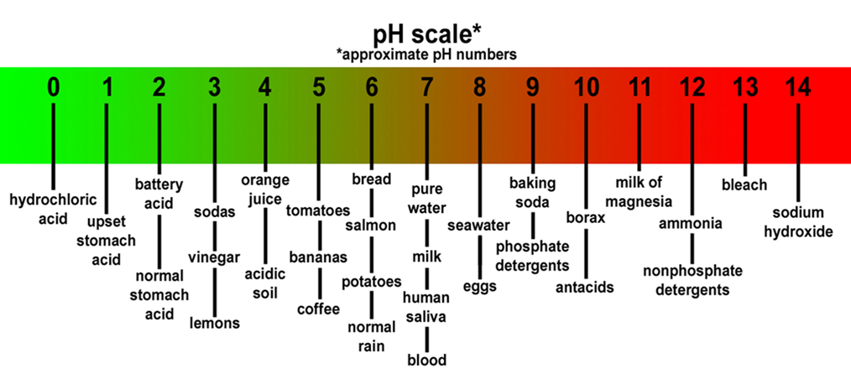
PH SCALE REVIEW

Slide 4
Xtreme vehicle care market data

Slide 5
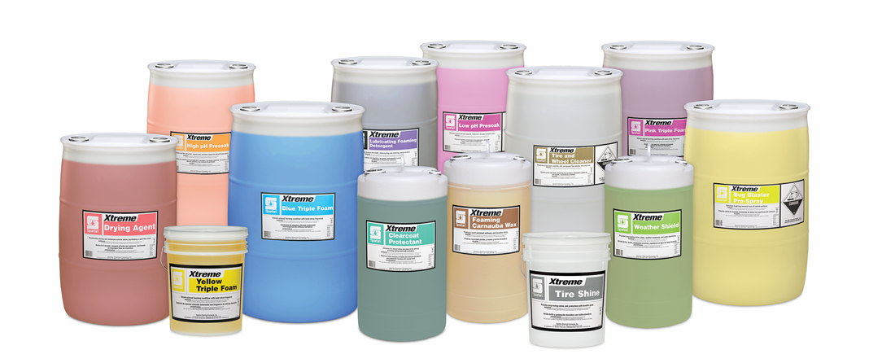
Why did we go down this path?
Car wash program
We did a survey and 80% of our Distributors said they would support it.

Slide 6
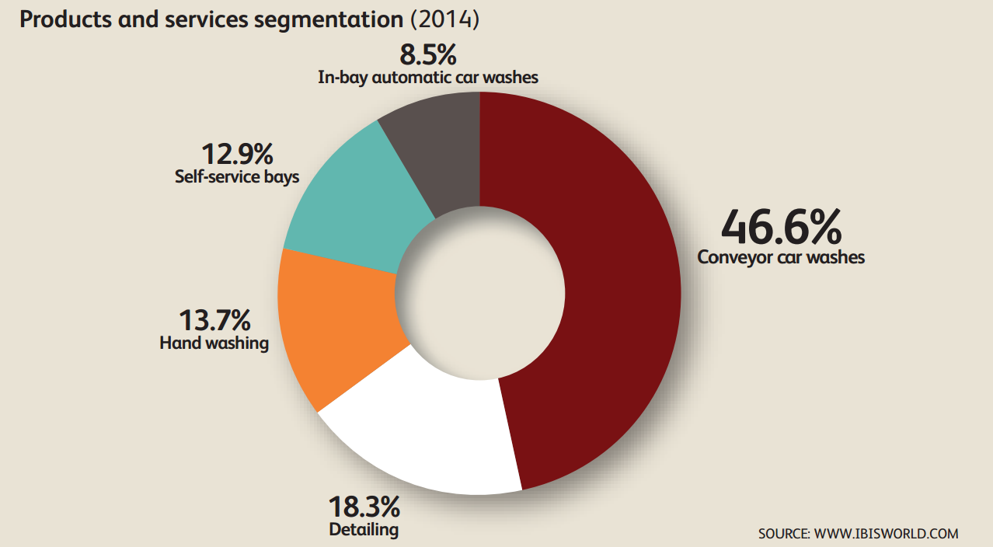
Market overview
Car wash program
According to industry reports, the average annual chemical spend at car wash facilities ranges from $12,000 to $50,000 per year.
Macro Market Drivers
  Growing number of car wash bays
  Expanded number of cars in use
  Trend toward longer ownership of vehicles
  New high-priced automotive finishes are driving growth in the brushless segment which use more complex and costly formulas
Market Annual Growth Rate | 3.7%
Annual Growth Rate: Chemicals | 5.6%

Slide 7
If cars are not getting clean, who do you call?
Car wash operator survey
Typical chain of responsibility for unclean cars:
Individual Car Washes -> Equipment Maintenance Services -> Chemical Providers
If cars are not getting sufficiently cleaned, the car washes generally first check to see if the problem is an equipment or employee-related issue.
If the problem is an equipment issue that is too difficult to repair in house, then would then call an equipment maintenance service to fix the equipment.
If the problem was not related to the equipment or employees, then the car wash would call their chemical provider.
Service
Notes:
If cars are not getting clean, who do you call?

Slide 8
What kind of service do you expect from your chemical provider? How often?
Car wash operator survey
The primary expectation from chemical providers is punctual delivery of quality chemicals when the car wash needs it.
What respondents expect from their chemical suppliers:
Orders and stores chemicals
Punctual delivery of chemicals
Checks validity and dilution of chemicals and soaps
Titrations/adjust dilutions
Provides advice and insight
Expected delivery times (most popular responses)
Next day delivery
2 days
3-4 days
4-5 days
Notes:
What kind of service do you expect from your chemical provider? How often?

Slide 9
How do you buy your products?
Car wash operator survey
How often do you purchase chemicals?
Approximately 54% of respondents rely on sales representatives to purchase car wash products.
The three most common responses were monthly (26.7%), biweekly (20%), and weekly (13.3%).

Slide 10
Xtreme vehicle care selling the program

Slide 11
Types of car washes
Selling the program
Touch-free or Friction
Touch-free systems rely on chemical action and water pressure to remove soils to deliver a clean car.
Friction washes use brushes to assist in the chemical action and therefore can use less chemical per car.
Conveyor or In-bay
Conveyor systems move the car along a tunnel, processing through various stages of the wash process.
In-bay washes move the equipment around the car as the wash process progresses.

Slide 12
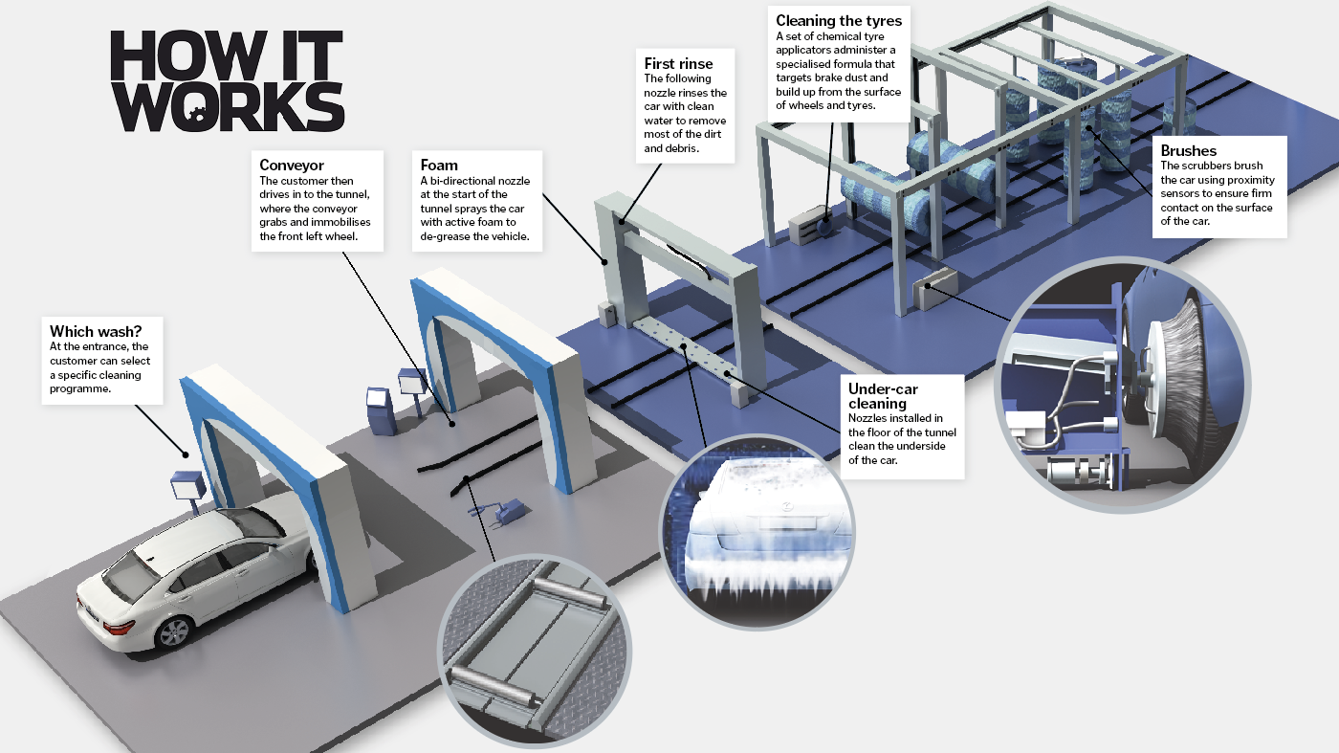
CONVEYOR- TUNNEL

Slide 13


Wash configuration
Selling the program
Exit
Entrance
Tire dressing
Brush applicator
Wax OR
Protectant
Tire and Wheel
Cleaner
High pH pre-soak
Low pH pre-soak
Wheel/rim presoak
Dying agent
High foam polish
Rinse
premium
basic

Slide 14
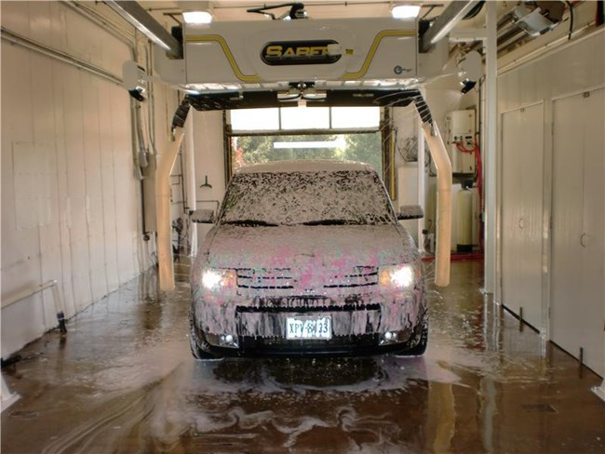
IN BAY TOUCHLESS

Slide 15
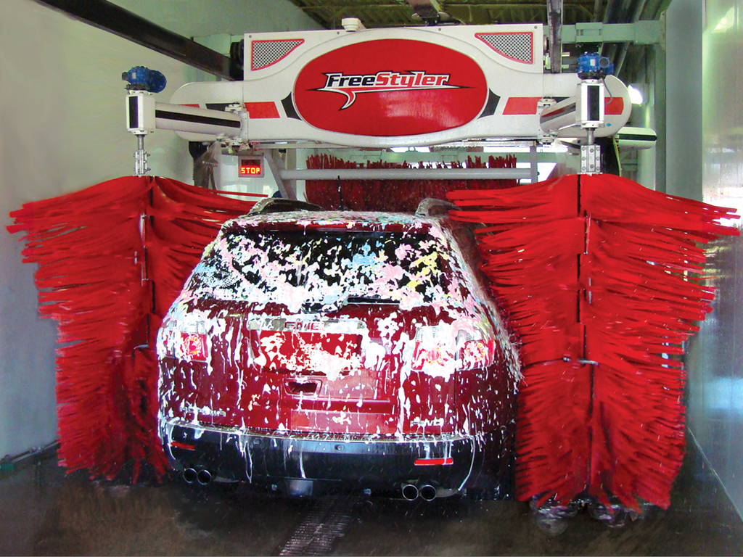
In BAY BRUSH

Slide 16
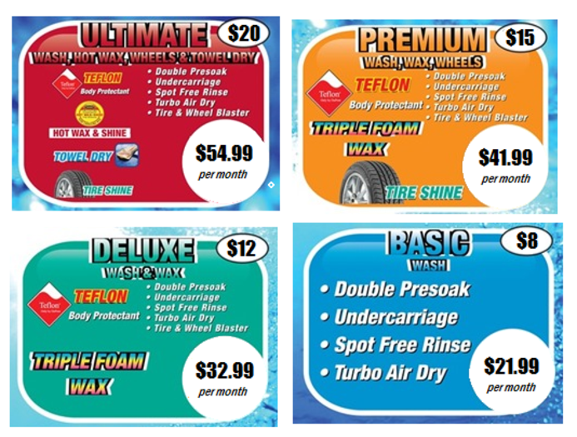
Business model
Selling the program
There are several menu options for the wash process.
Depending on the customer selection, stages are varied/skipped/included.
The car wash operator's key strategy for profitability is by offering varying car wash packages.

Slide 17
Understanding the customer
Selling the program
Top factors owner operators look for to determine if chemicals are satisfactory:
Are we cleaning? As determined by calls and complaints
Cost per car
Seasonality
Winter – This is the busiest season of the year. It is also the most profitable because the major soil (at least up north) is salt, which is easy to wash off compared to the soils in the spring and fall. This allows operators to speed up the wash or dial back the amount of chemical used per car.
Spring and Fall – These are the most challenging seasons to get a clean car. Operators will decrease conveyor speed or increase chemical per car, possibly adding additional options, to improve wash performance.
Summer - Is the second easiest season to get a clean car.
The toughest problems in the car wash are bugs and drying time.

Slide 18







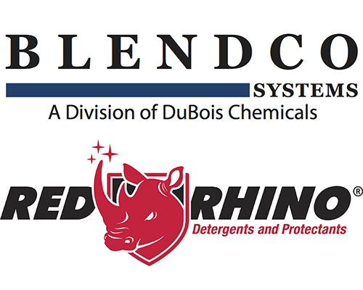


Understanding the competitive landscape
Selling the program
The car wash industry is highly fragmented with many regional chemical manufacturers.
Regional manufacturers will compete based on price and relationship with operators.
There are very few national brands in the market.
We will need to compete based on quality, performance, and efficient cost per car.

Slide 19
Spartan xtreme vehicle care
Selling the program
Our Xtreme Vehicle Care line of products leverages the latest in technology to deliver
performance and efficiencies for car wash facilities.

Slide 20
Xtreme Vehicle care
Car wash program
Description | PACKAGING | Part code
High pH Presoak | Pail, 15, 30, 55 | 2655
Lubricating Foaming Detergent | Pail, 15, 30, 55 | 2656
Low pH Presoak | Pail, 15, 30, 55 | 2657
Drying Agent | Pail, 15, 30, 55 | 2658
Blue Triple Foam | Pail, 15, 55 | 2659
Pink Triple Foam | Pail, 15, 55 | 2660
Yellow Triple Foam | Pail, 15, 55 | 2661
Tire Shine | Pail, 15, 55 | 2662
Tire and Wheel Cleaner | Pail, 55 | 2663
Weather Shield | Pail, 15 | 2664
Clearcoat Protectant | Pail, 15 | 2665
Foaming Carnauba Wax | Pail, 15 | 2667
Bug Blaster Pre-spray | Pail, 55 | 2666

Slide 21
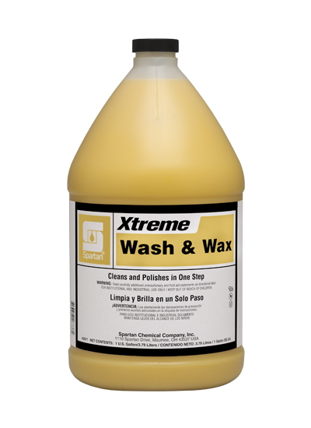
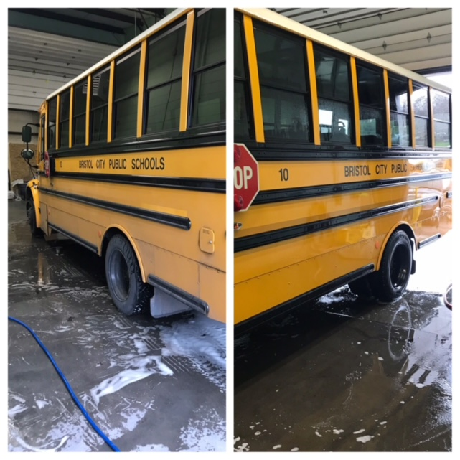
How to get started selling Vehicle care

Slide 22
Value proposition
Selling the program
Our top priority is to help you control costs and provide a clean, dry vehicle that keeps your customers coming back.
Unlike other chemical suppliers that repackage the same chemistry, dilute it out and name it something different the Xtreme Vehicle Care line of products simplifies the ordering process and adapts to the cleaning systems in car wash facilities.
Benefits:
• Efficient cost per car, increase profits
• Minimal chemical dwell time, accelerate wash cycles
• Optimal chemical performance, satisfy customers
• Local support and on-time delivery, minimize freight, lower inventory costs

Slide 23
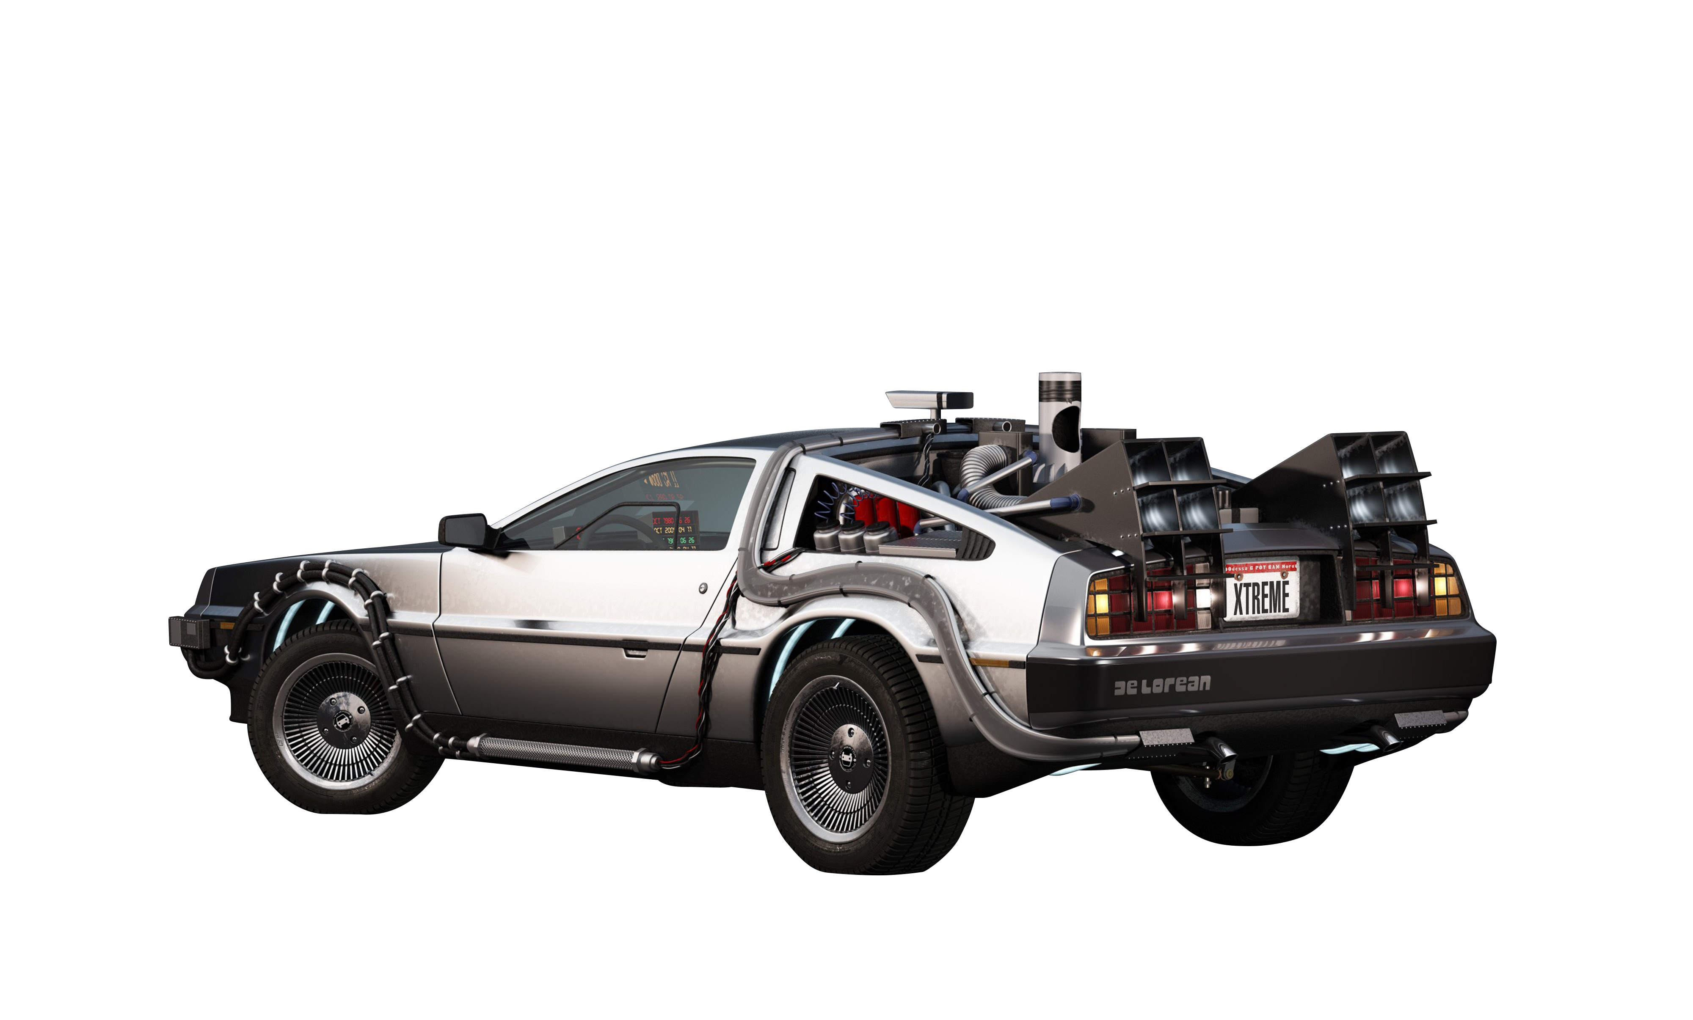
Key differentiation
Selling the program
The key ways you can offer value and differentiation with the Spartan vehicle care line are:
Speed up the car wash – less chemical dwell time required – this is huge
Offer differentiation in shipping and logistics
Full catalog supplier – Spartan distribution can offer a full bundle of items from car wash to detail items, to jan/san and paper to laundry.
Guaranteed products – competitive offerings cannot
ensure consistent quality not guarantee
satisfaction from shipment to
shipment

