Slide 1
The Future of Sustainable Cleaning is Now

Slide 2
Understanding the Journey
Green: Safer for the product user, the people working in the area, and the surrounding environment. Most 3rd party certifiers require the use of concentrates to reduce waste.
BioBased: Uses materials from Renewable (regrowable) resources.
Biological: Living organisms also called probiotics or digesters
Notes:
When putting together our products and programs, we considered three points….
Environmental Impact
Worker Safety
Product Performance

Slide 3
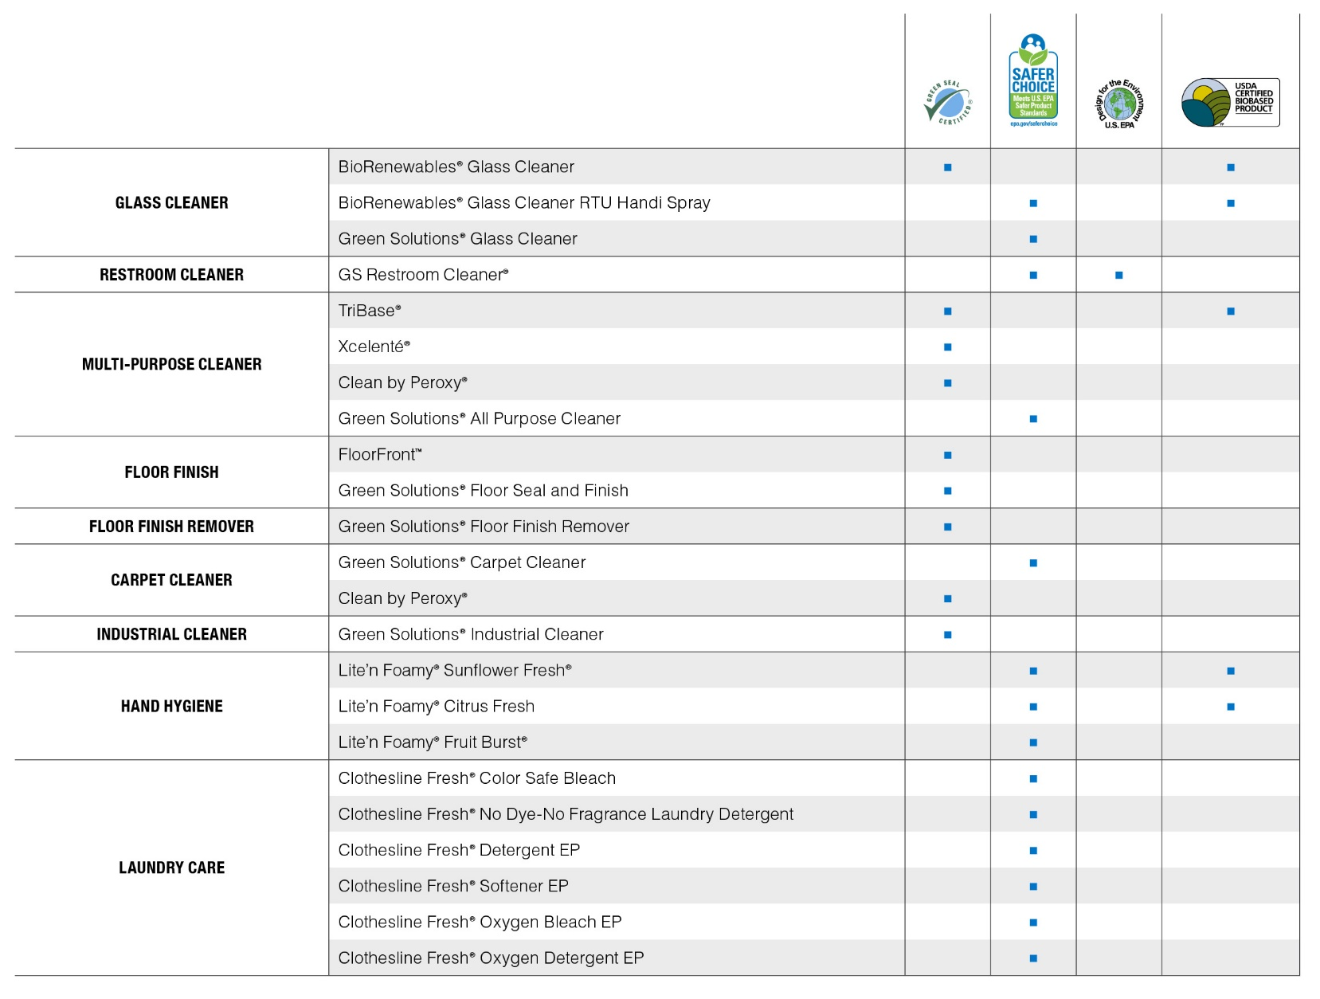
Third party certifications
Understanding the Journey

Slide 4
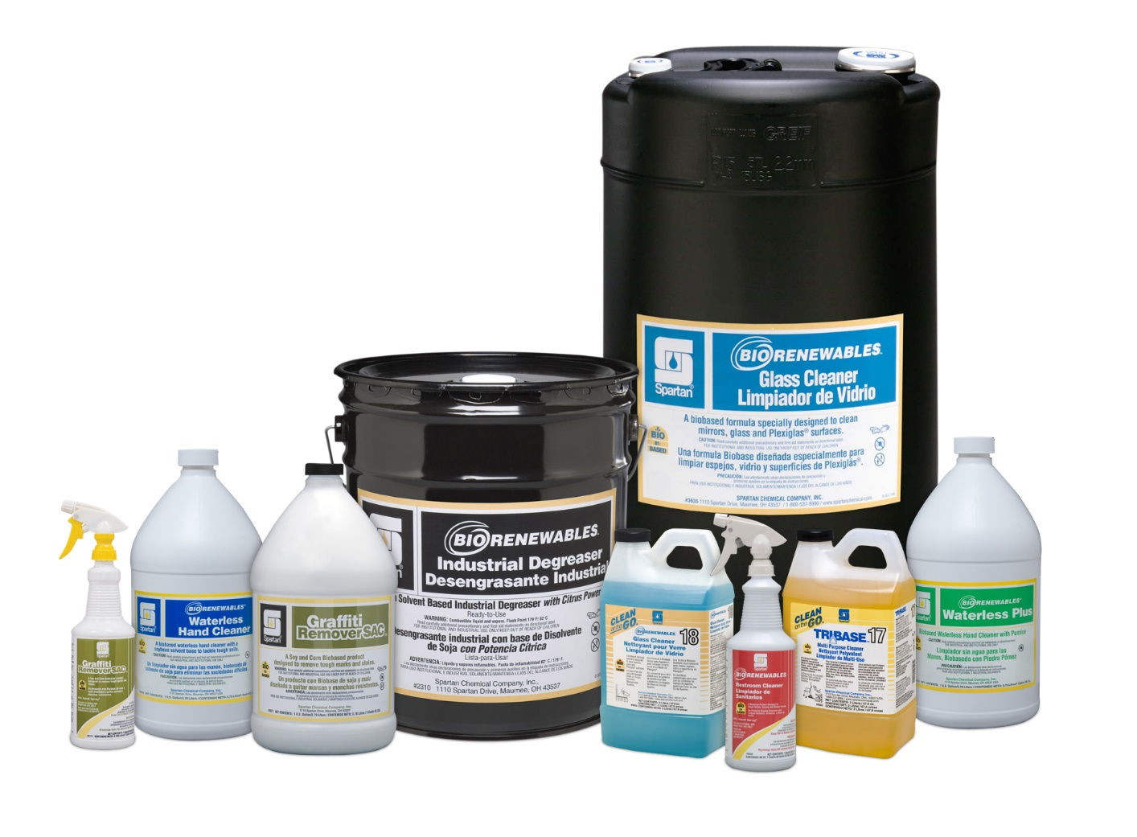
BioRenewables
Understanding the journey

Slide 5
Understanding the journey
Sustainable: Using resources today while having same resources available for future generations to use.
When selecting the best product we want to consider what needs to be cleaned first. Then we need to consider not only the source of the materials but also how much of that material is needed for the application to best remove the soil. This will help you determine if you should select a traditional product, a green product, a biobased product, or a biological to be most sustainable. It will also help you decide if it is more sustainable to use a concentrate or a RTU.
Notes:
Another way to think of it is when putting together our products and programs, we considered these three points….
Product Performance
Worker Safety
Environmental Impact

Slide 6
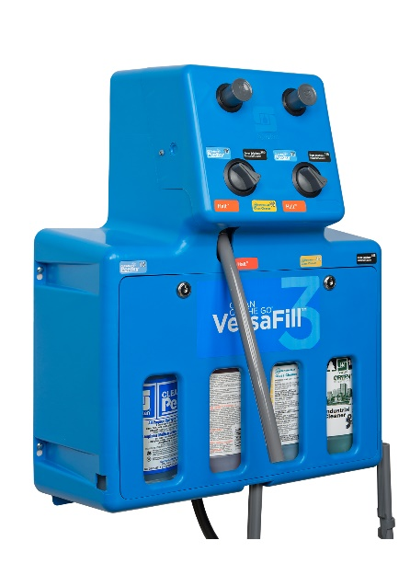
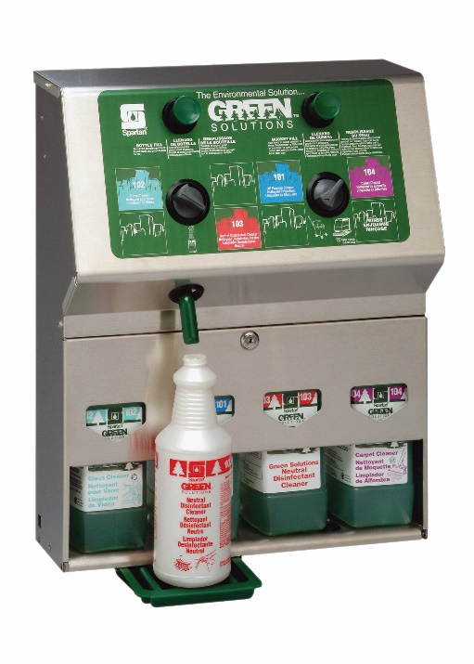
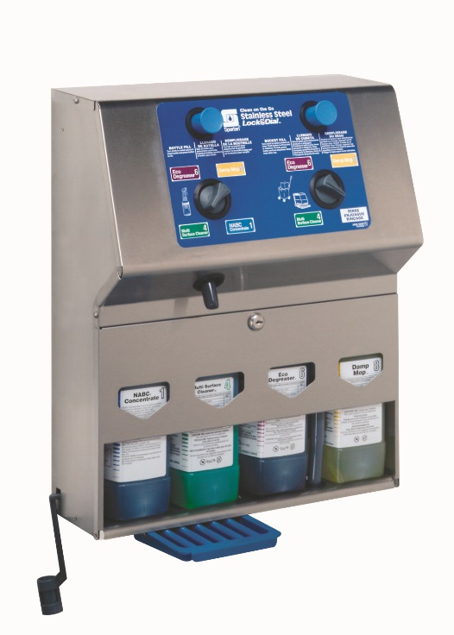
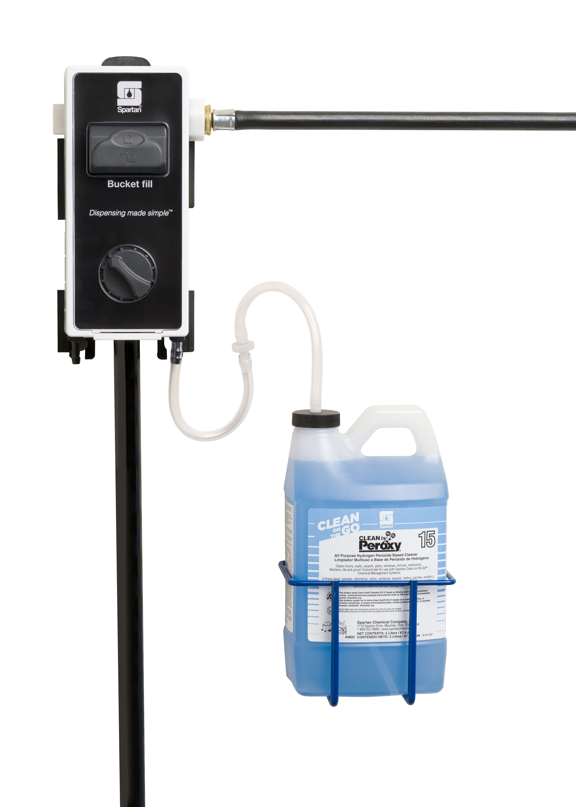
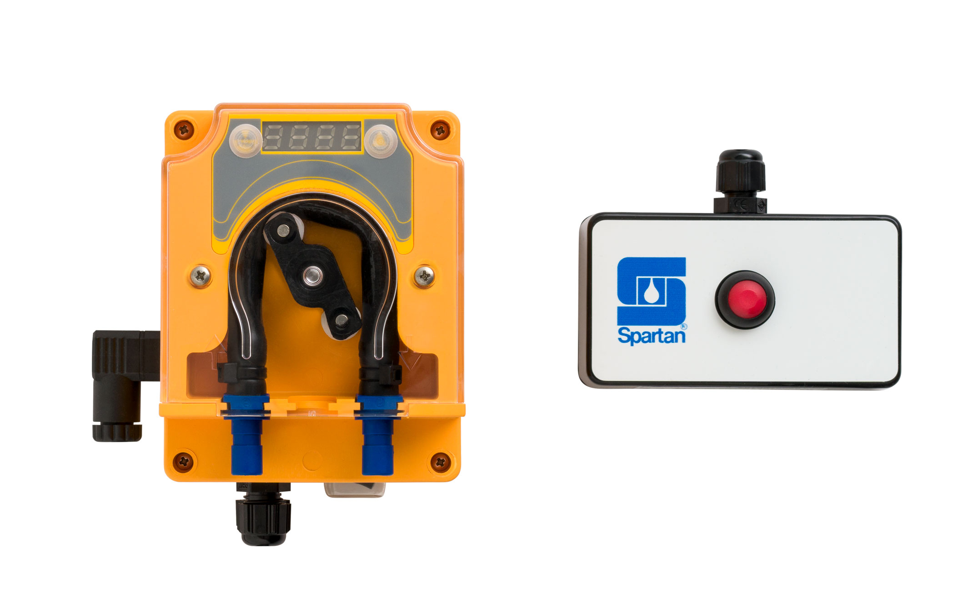
Dispensers

Slide 7
Why?
concentrates
High volume use situations reduces cost per in use gallon
Reduces packaging
Not shipping water
Perceived by some that it is always more sustainable to use a concentrate

Slide 8
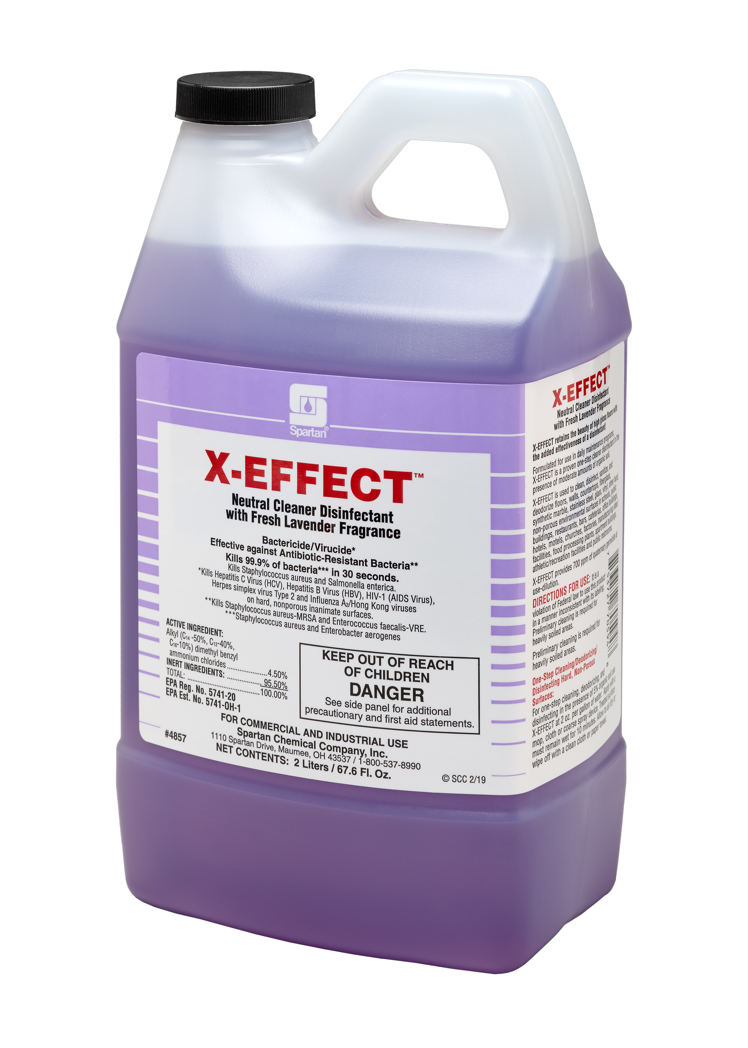
Popular products
Clean on the go

Slide 9
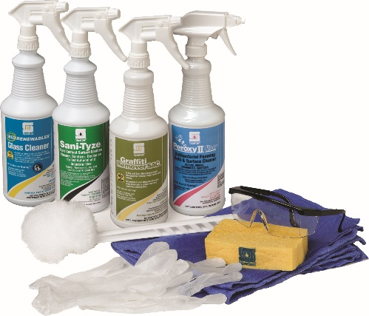
Why?
Ready to use
Guaranteed efficacy
Guaranteed related compliance
Customer Safety
Recyclable packaging
Ease of use and training
Specialized application
Based on volume may be least cost (no dispensing, backflow, no waste).

Slide 10
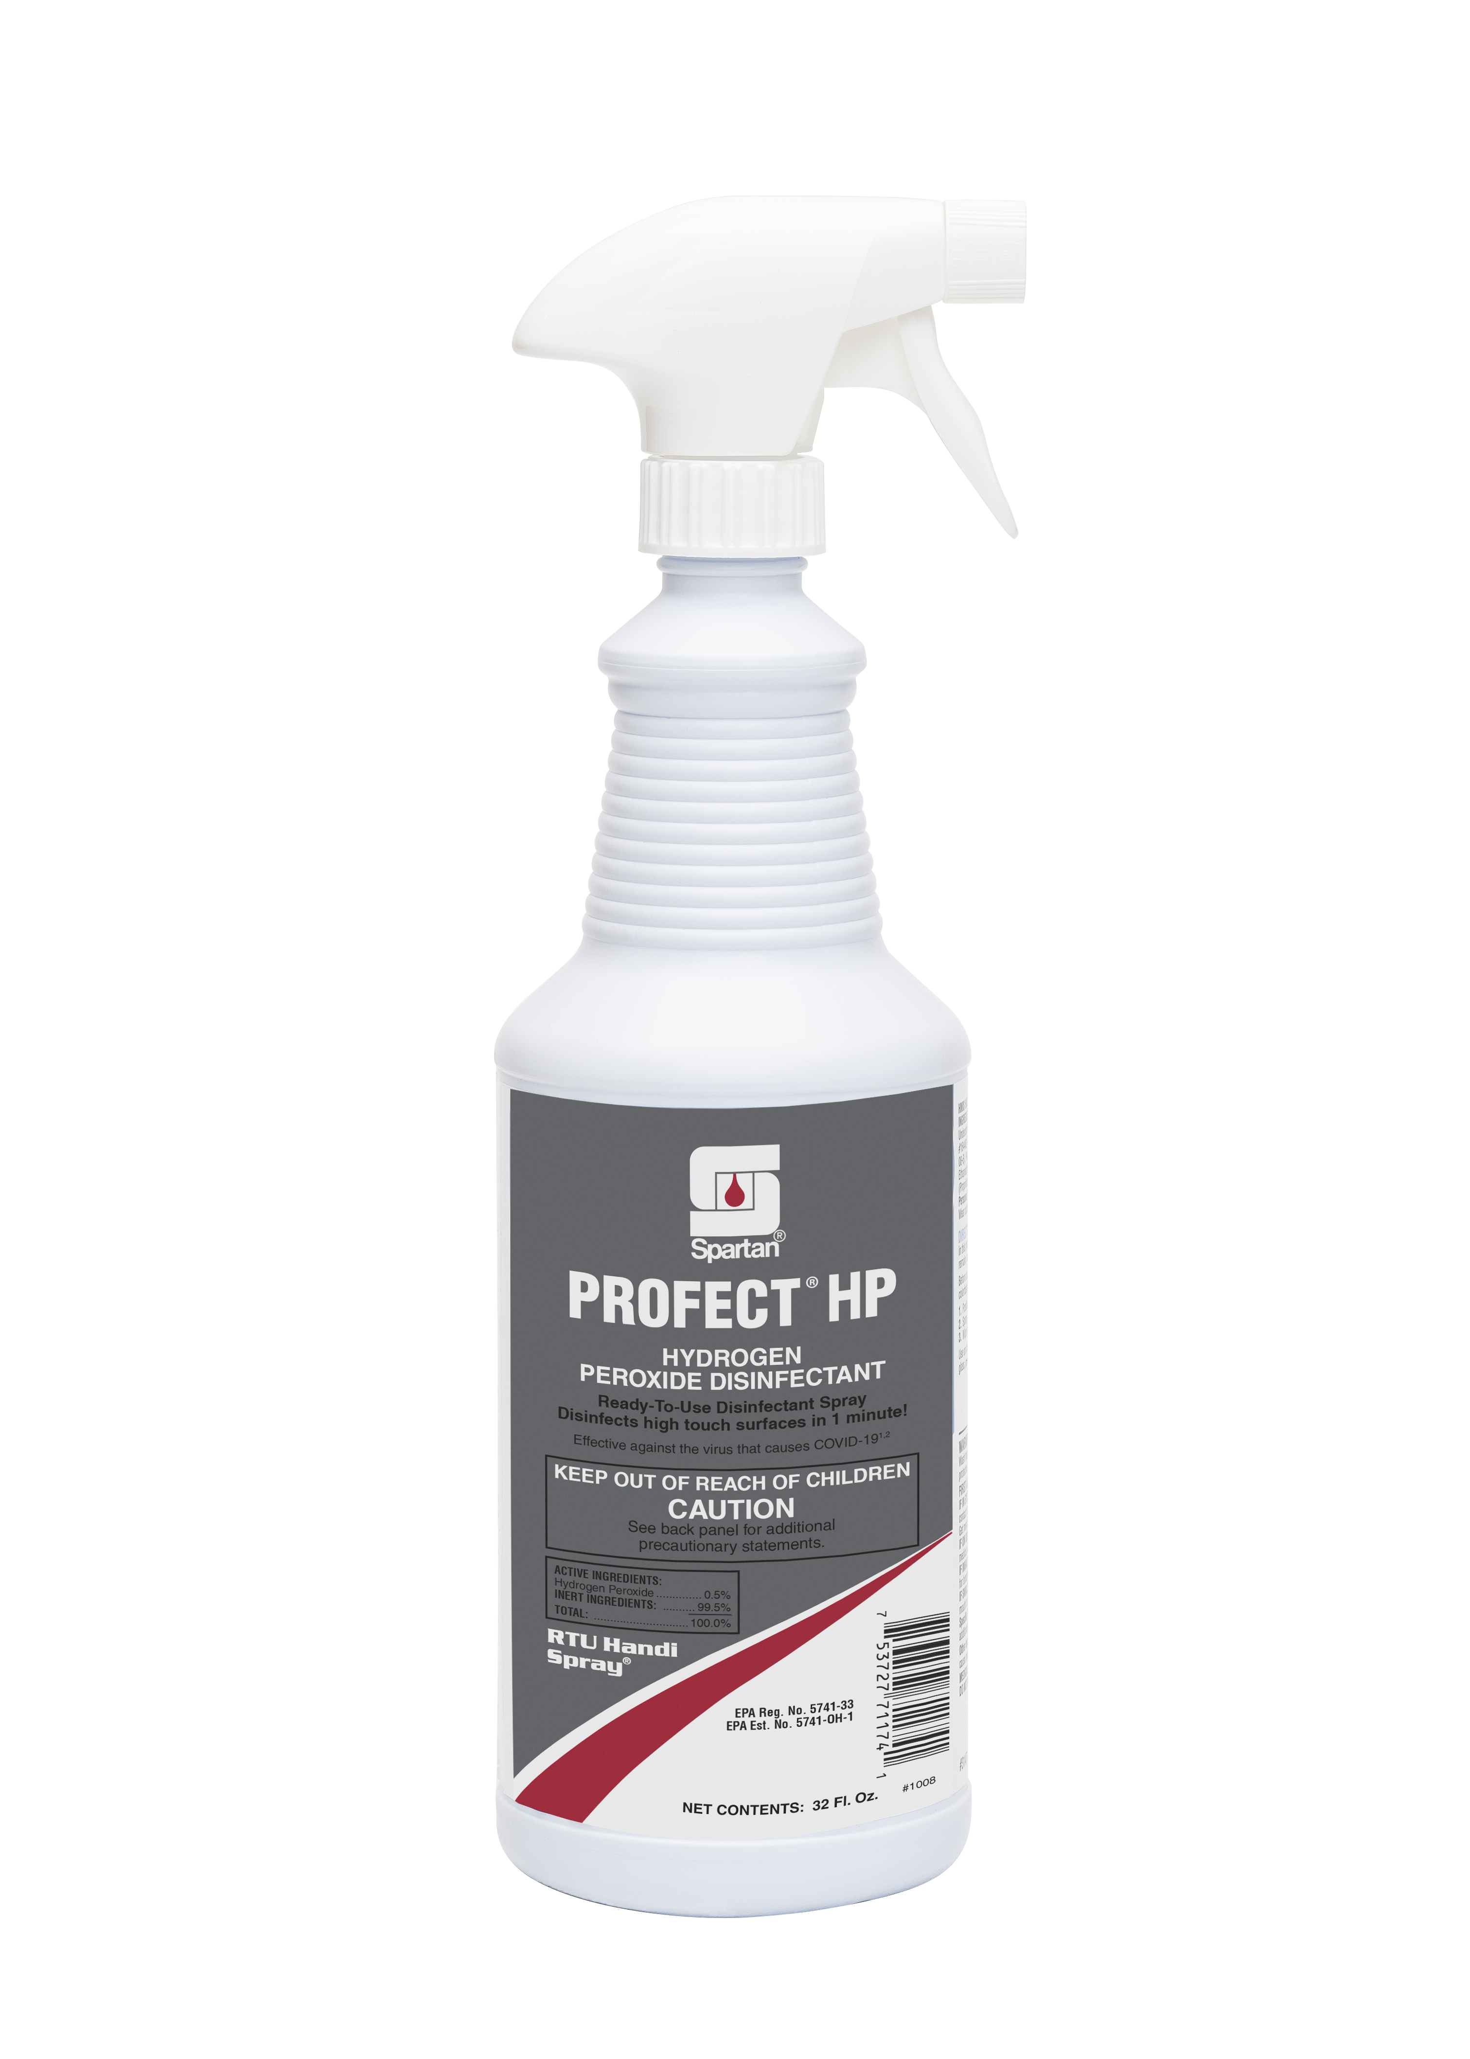
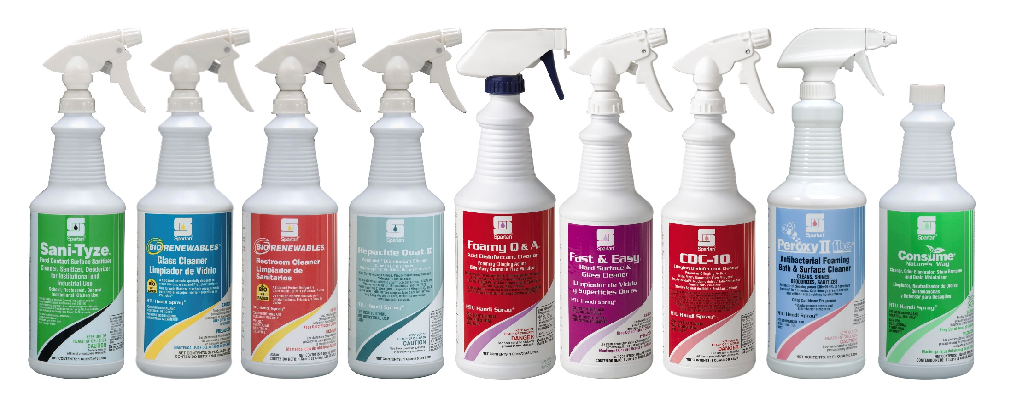
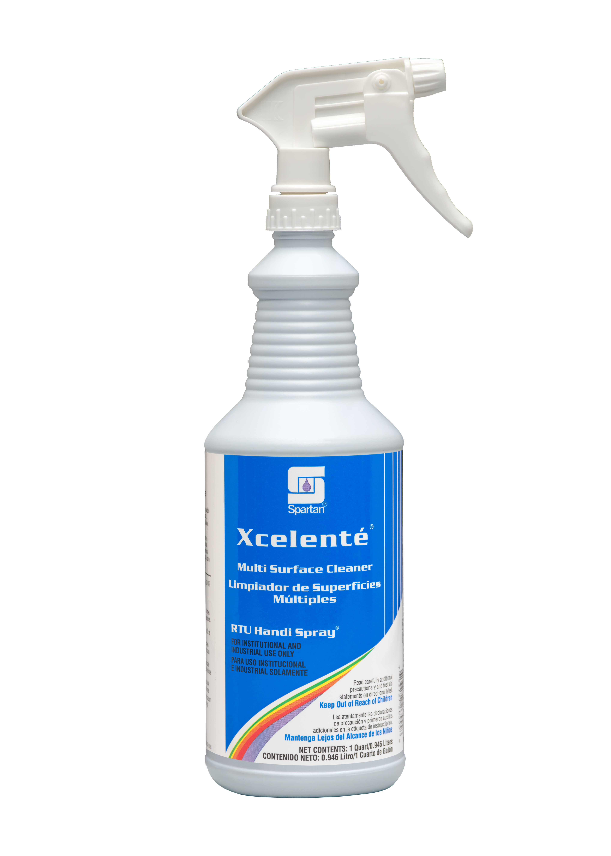
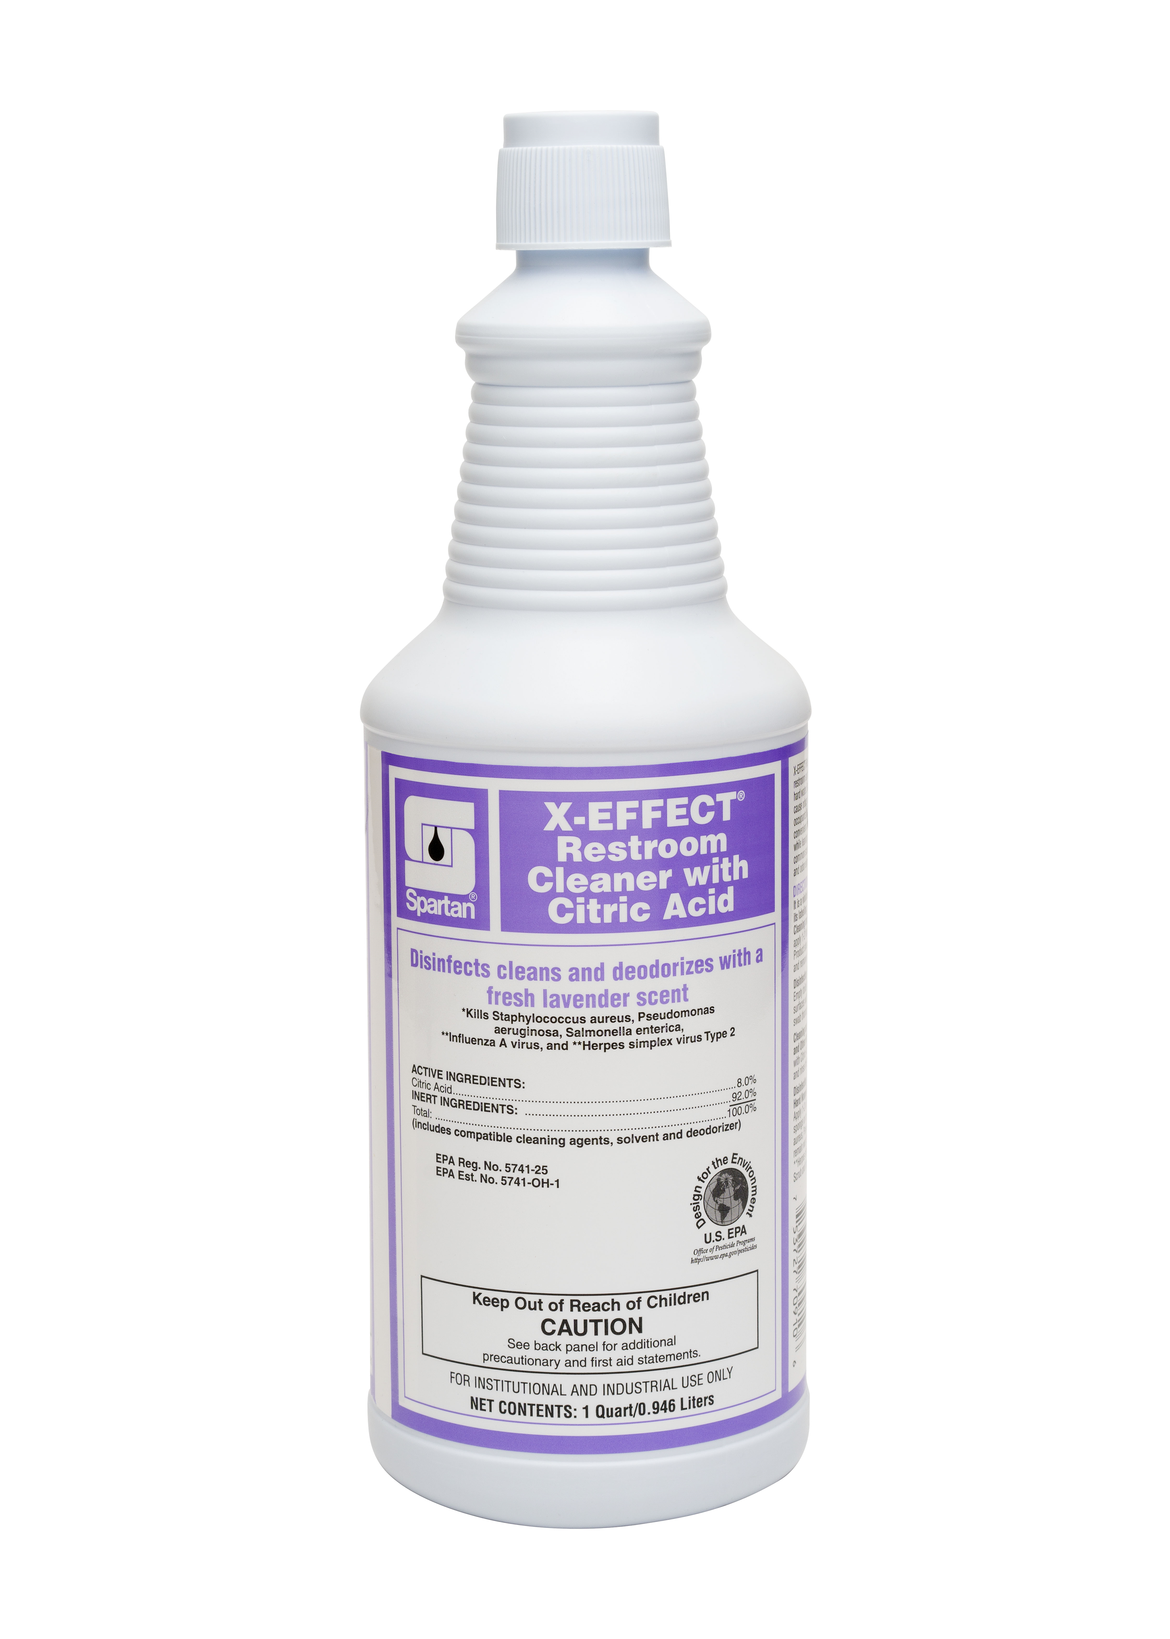
Popular products
Ready to use
Notes:
Additionally WHATs In It For YOU in sales dollars: A case of COG HDQC2 makes 135.27 gallons and sells for $56.55. A case of Hepacide Quat II represents 3 gallons and sells for $33.55. You would use 45.09 cases to get the same user prepared volume and would have $1512.77 in sales. That is a difference of $1456.22. keep in mind an OSHA citation or one injury is going to cost the employer more than the difference in the sales cost.

Slide 11
Profect® HP
Featuring patented hydrogen peroxide technology, Profect HP kills bacteria and viruses in 60 seconds. One minute contact times ensure efficacy and compliance for your most critical disinfection needs. Ideal for daily use on high-touch surfaces.
FEATURES
Kills bacteria, enveloped and non-enveloped viruses, and fungi
Features patented hydrogen peroxide technology
Ready-to-use formula ensures proper ppm required for disinfection
Kills SARS-CoV-2² the virus that causes COVID-19 in 30 seconds
BENEFITS
One minute contact time ensures efficacy and compliance
Offers convenience and broad spectrum kill in one product
Meets the surface disinfection recommendations of OSHA bloodborne pathogen standard
Disinfects high touch surfaces³ in 1 minute
²On hard, non-porous surfaces
³When the use-directions for disinfection are followed

Slide 12
X-EFFECT® RESTROOM CLEANER WITH CITRIC ACID
X-EFFECT Restroom Cleaner with Citric Acid cleans and disinfects restroom surfaces, removing tough stains caused by urine and hard water. Bacteria and viruses found in public restrooms can cause odors and create an unsafe environment for building occupants. X-EFFECT Restroom Cleaner with Citric Acid offers a convenient and effective solution for removing bacteria and viruses while leaving a fresh lavender fragrance.
FEATURES
Ready-to-use disinfectant cleaner
Thick formula coats bowl for powerful deep cleaning
Tough on stains
Formulated for use in daily maintenance programs
BENEFITS
Disinfects, deodorizes, and kills odor-causing germs
Features a fresh lavender fragrance
Ready-to-use formula ensures proper ppm required for disinfection
Pre-labeled, pre-filled quarts offer the ultimate safety and convenience

Slide 13
Clean by peroxy ® rtu Handi Spray ®
Powered by the cleaning power of hydrogen peroxide, Clean by Peroxy quickly removes everyday soils, including greasy residue, on almost any surface. With a fresh fragrance that says “clean”, Clean by Peroxy offers the cleaning performance of a professional all-purpose cleaner in a convenient ready-to-use spray.
FEATURES
Cleaning power of peroxide
Safe to use on carpets, mirrors, glass, and other hard surfaces
Addresses stains and odors caused by urine
Safer Choice certified
BENEFITS
Exceptional cleaning performance of Clean by Peroxy in a convenient RTU Handi Spray
Multi-surface use: Desks, fabrics, carpets, walls—any hard surface
Simply clean: No streaking or residue
Pre-diluted quarts provide superior convenience, worker safety, and compliance

Slide 14
What makes them different?
biologicals
They actually eat the soil (sugars, carbohydrates, proteins, fats).
The single biggest thing that makes them different is they take time to function.
Because they take time to function if the application allows, we add other ingredients to the product to help produce the desired results faster.

Slide 15
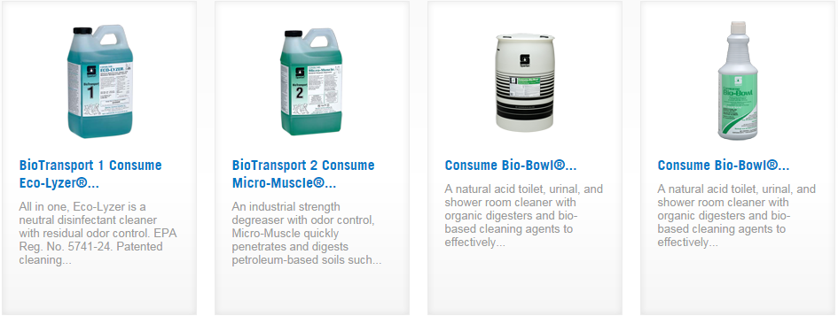
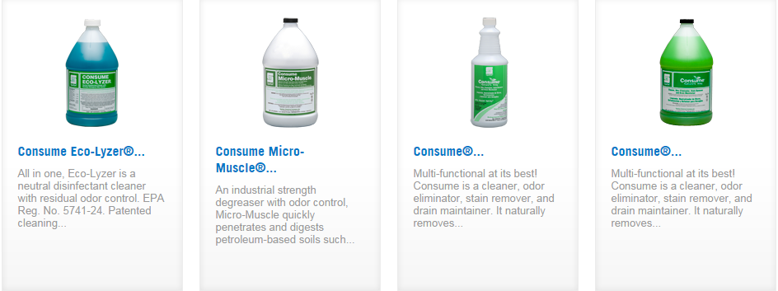
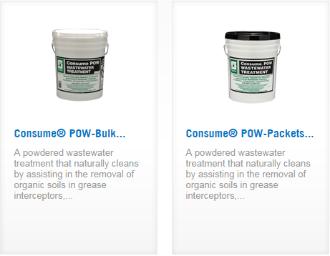
Consume nature’s way
®

