Slide 1
Infection Prevention

Slide 2
Customer needs
Opportunity
Compliant Cleaning and Disinfecting of Environmental Surfaces in Health Care Facilities is often suboptimal
Customers want a silver bullet to kill microorganisms and reduce the spread of infections – i.e. faster disinfectants, vaporizing, or UV carts
The focus has been about ‘WHAT to disinfect with’ rather than ‘HOW to properly clean and disinfect’
Better Hand Hygiene Practices and Cleaning and Disinfecting Compliance are critical first lines of defense to fight the spread of microorganisms

Slide 3
Section 1: About Disinfectants

Slide 4
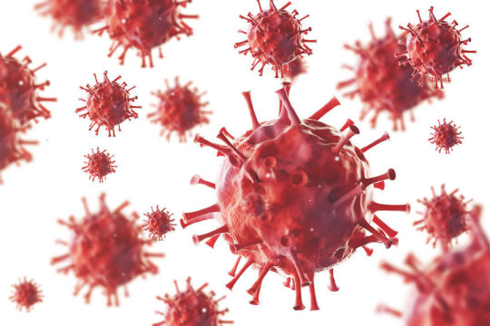
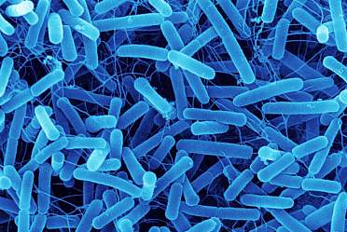
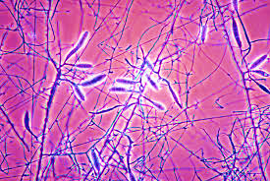
MICROBIOLOGY
What are we trying to Kill?
Virus
Bacteria
Fungi
HBV, HCV, Herpes Simplex, HIV-1, Herpes Simplex Virus Type 1, Influenza Virus Type 2, Norovirus
TB, MRSA, VRE, Listeria monocytogenes, Staphylococcus aureus, E. coli, Pseudomonas aeruginosa
Trichophyton mentagrophytes

Slide 5
Definitions
Disinfection
Disinfection is 100% kill of the claimed organism
A Sanitizer claim is for 99.9% of the claimed organism, or reducing the level of bacteria to a safe and acceptable level
Sterilization is 100% kill of ALL organisms on a surface

Slide 6
Disinfectant requirements
Disinfection
A Disinfectant is only as good as its label says it is https://www.epa.gov/sites/default/files/2017-10/documents/chap-12-nov-2013.pdf
A Hospital Grade Disinfectant requires two (2) organisms to be tested - Pseudomonas aeruginosa and Staphylococcus aureus
A One Step Disinfectant cleaner is an EPA registered disinfectant that has been tested in 5% blood serum
A Tuberculocidal Claim is only used for an indicator of strength - a TB Claim will qualify a product as an Intermediate Level Disinfectant

Slide 7
Environmental Responsibility
Disinfection
Disinfectants work well in controlled environments so use EPA registered disinfectants only when necessary.
All housekeeping surfaces need to be cleaned only with soap and water or a detergent/disinfectant, depending on the nature of the surface and the type and degree of contamination.
Disinfectant/detergent formulations registered by EPA are used for environmental surface cleaning, but the actual physical removal of microorganisms and soil by wiping or scrubbing is probably as important, if not more so, than any antimicrobial effect of the cleaning agent used (taken from the CDC’s “Guidelines for Infection Control”)
Choose disinfectants that contain less harsh ingredients. Consider the pH, VOC and surfactant content.
Most importantly, focus on cleaning things!

Slide 8
Disinfectants have a time and Place
opportunity
Low-level Disinfectants – general disinfecting; hospital-grade disinfecting (kills Staph & Pseudomonas); and, blood borne pathogen clean-up (kills HBV, HCV, HIV-1) – kills most microorganisms, but not TB
Intermediate Level Disinfectants – limited use disinfectants for specialized pathogen control - kills TB
High-level Disinfectants – highly limited use for specialized pathogen control – kills some spores, including C. diff
* Levels from Spaulding’s System of Risk Assessment

Slide 9
Section 2: Key Disinfectants

Slide 10
Disinfectants for General UsE
Building Services
Education
Industrial

Slide 11
PROFECT® HP
GENERAL USE
DESCRIPTION & FEATURES:
Hydrogen Peroxide-based RTU Disinfectant
pH: 1.8 – 2.2
FRAGRANCE: mild
DILUTION: RTU
CONTACT TIME:
For Special Pathogen Concerns: SARS-CoV-2 in 30 seconds; high-touch surfaces in 1 minute; Tb in 3 minutes
AVAILABLE IN: RTU quarts

Slide 12
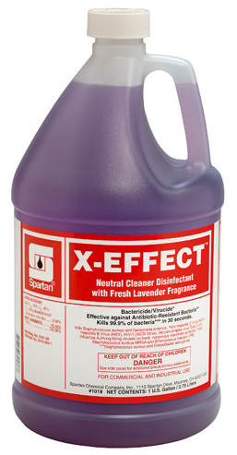
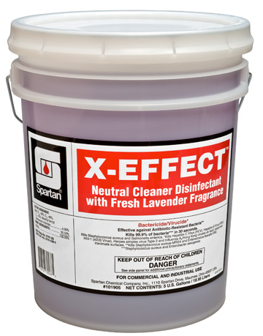
X-EFFECT®
General Use
DESCRIPTION & FEATURES:
Neutral Cleaner/Disinfectant
pH: 6.0 – 7.0
FRAGRANCE: Fresh Lavender
DILUTION: 2 oz./ gallon
CONTACT TIME: 10 Minutes
Excellent Cleaner for Light Duty Cleaning & Disinfecting of Fixtures, Walls, Floors and Other Hard Surfaces
AVAILABLE IN: 1, 5 & 55

Slide 13
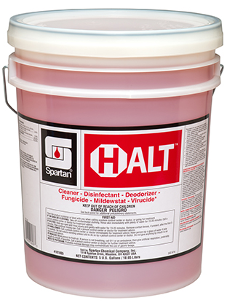
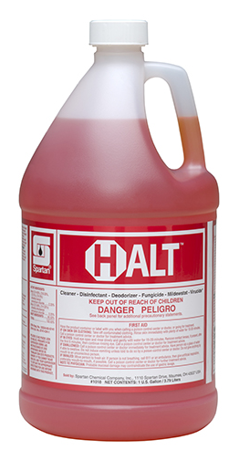
Halt TM
General use
DESCRIPTION & FEATURES:
Alkaline, Hospital Grade Cleaner/ Disinfectant
pH: 11.0 - 12.0
FRAGRANCE: Fresh
DILUTION: 2 oz./ gallon
CONTACT TIME: 10 Minutes; 60 Second Non-food Contact Sanitizing Claim
Kills Human Coronavirus, Norovirus, MRSA, Canine Parvovirus (@ 8oz./gal)
A Versatile Cleaner for Light to Medium Duty Cleaning of Fixtures, Walls, Floors & Other Hard Surfaces
AVAILABLE IN: 1, 5, 15, 30, 55, 275, 330 & COG

Slide 14
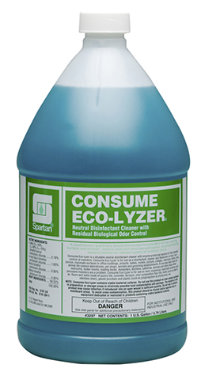
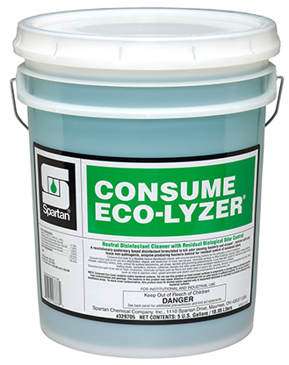
Consume Eco-lyzer®
Specialty
DESCRIPTION & FEATURES:
Disinfectant concentrate formulated to destroy pathogenic and odor causing bacteria and viruses, remove soils and leave natural digesters behind for residual control of nuisance odors.
pH: 6.5 – 7.5
FRAGRANCE: Floral
DILUTION: 2-to-6 oz./gallon
CONTACT TIME: 10 Minutes
A Versatile Cleaner for Floors, Drains & Dumpsters
AVAILABLE IN: 1, 5, 15, 30, 55, 275, 330 & COG

Slide 15
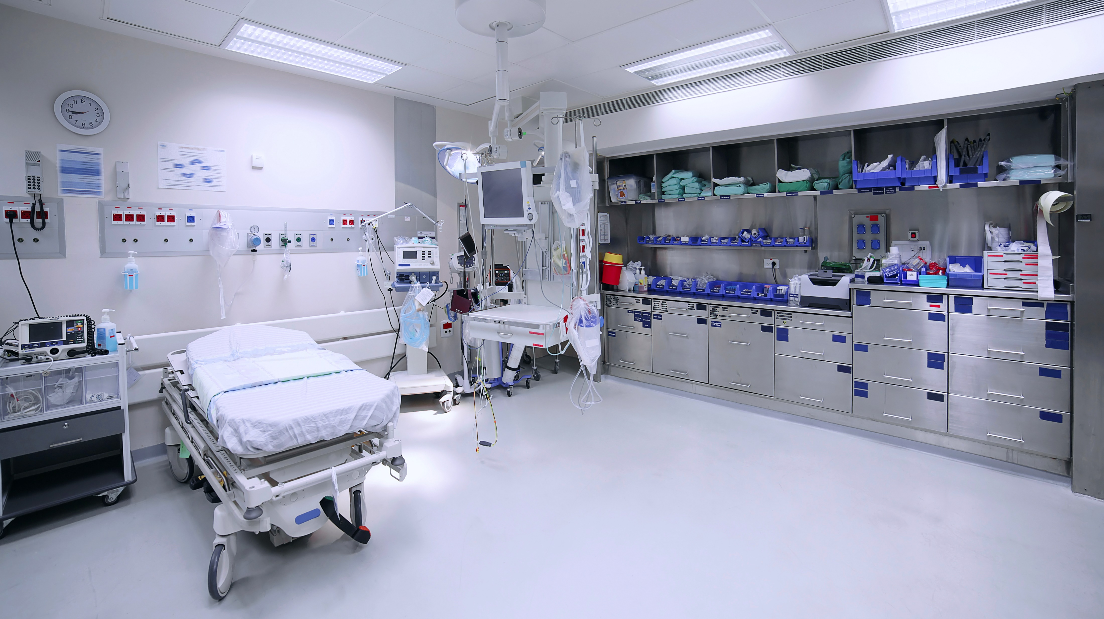
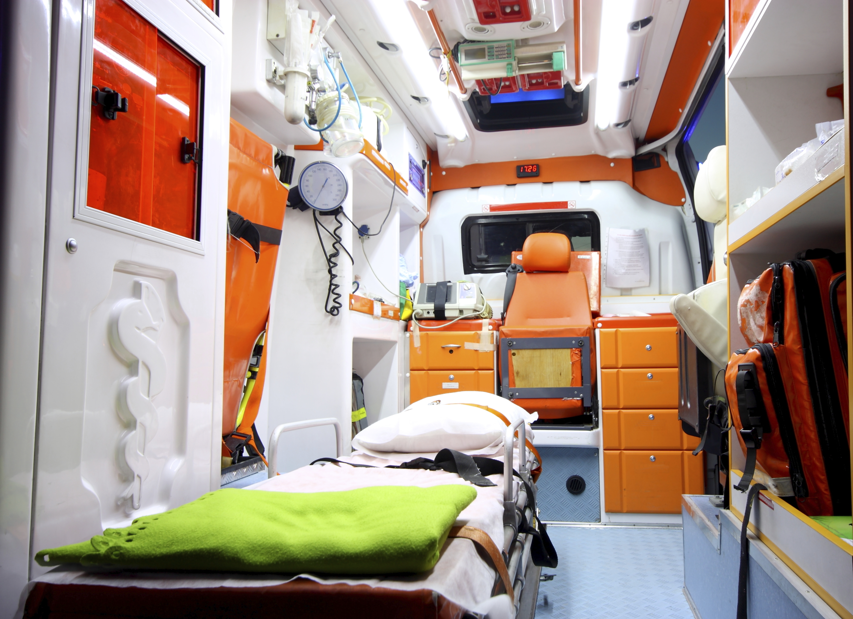
Disinfectants for Healthcare
Hospitals
Long-term Care
Ambulatory Care
Surgery Centers

Slide 16
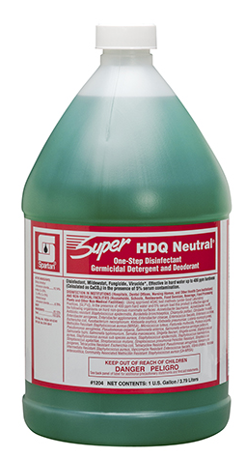
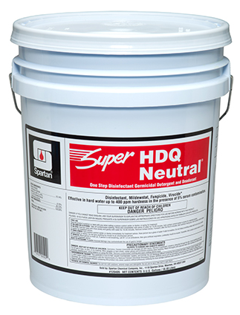
Super HDQ Neutral®
Healthcare Use
DESCRIPTION & FEATURES:
Neutral, Hospital Grade Cleaner/Disinfectant
pH: 7.2 – 8.2
FRAGRANCE: Fresh
DILUTION: 0.5 oz./ gallon
CONTACT TIME: 10 Minutes
Kills Human Coronavirus HBV, HCV, HIV-1, MRSA, VRE, SAR, H1N1, H3N2
Excellent Cleaner for Light Duty Cleaning & Disinfecting of Fixtures, Walls, Floors and Other Hard Surfaces
AVAILABLE IN: 1, 5, 15, 30, 55, TOTES & COG

Slide 17
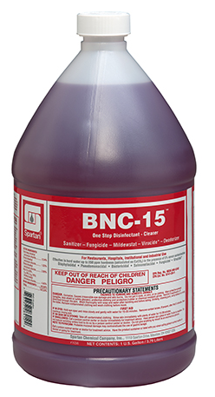
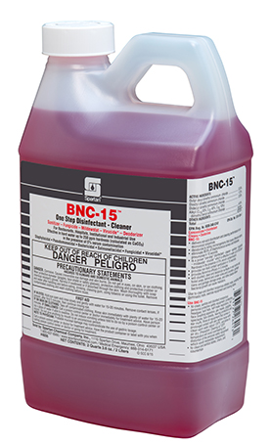
BNC-15®
Healthcare Use
DESCRIPTION & FEATURES:
Alkaline, Hospital Grade Cleaner/Disinfectant
pH: 12.0 – 13.0
FRAGRANCE: Floral
DILUTION: 1 oz./ gallon & 2 oz./ gallon
CONTACT TIME: 3 Minutes; 15 Second Non-food Contact Sanitizer Claim
Kills SARS-CoV-2, HBV, HCV, HIV-1, MRSA, Listeria & Norovirus
Excellent Cleaner for Light Duty Cleaning & Disinfecting of Fixtures, Walls, and Other Hard Surfaces – Not for Use on Floors
AVAILABLE IN: 1 & COG

Slide 18
PROFECT® HP
Healthcare use - Specialty
DESCRIPTION & FEATURES:
Hydrogen Peroxide-based RTU Intermediate-Level Disinfectant
pH: 1.8 – 2.2
FRAGRANCE: mild
DILUTION: RTU
CONTACT TIME:
For Special Pathogen Concerns: SARS-CoV-2 in 30 seconds; high-touch surfaces in 1 minute; Tb in 3 minutes
AVAILABLE IN: RTU quarts

Slide 19
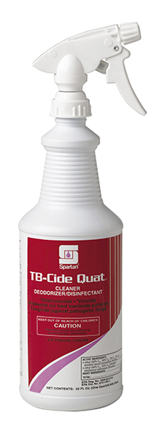
TB-CIDE QUAT®
Healthcare Use - Specialty
DESCRIPTION & FEATURES:
RTU Intermediate-Level Cleaner/Disinfectant
pH: 11.5 – 12.5
FRAGRANCE: Lemon
DILUTION: RTU
CONTACT TIME:
For Special Pathogen Concerns – TB Claim – 10 Minutes
Kills SARS-Cov-2 in 1 Minute
AVAILABLE IN: RTU Quarts, 15, 30, 55 & TOTES

Slide 20
PROFECTTM
^{Healthcare USE - WIPE}
DESCRIPTION & FEATURES:
Intermediate-Level Disinfecting Wipe
72.5% Ethyl Alcohol + 3300 ppm Active Quat at-use
pH: 3.0 - 4.0
DILUTION: RTU
CONTACT TIME: 1 Minute
Kills Pollovirus
Bleach-free, Fragrance-free Formulation

Slide 21
Diffense®
Healthcare Use - Specialty
DESCRIPTION & FEATURES:
RTU High-Level Cleaner/ Disinfectant
pH: 11.8 – 12.8
FRAGRANCE: Clean Floral
DILUTION: RTU
CONTACT TIME:
For Special Pathogen Concerns - C. diff – 8 Minutes
Kills Norovirus in 30 Seconds
AVAILABLE IN: RTU Quarts

Slide 22
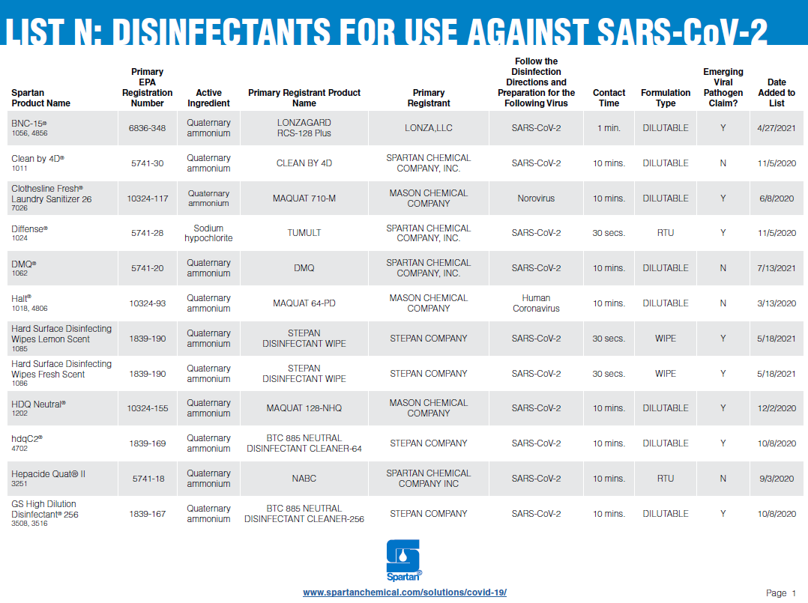
Notes:
What is List N: Disinfectants for Use Against SARS-CoV-2
On March 13, 2020 the EPA published List N: Disinfectants for Use Against SARS-CoV-2. List N includes products that meet EPA’s criteria for use against SARS-CoV-2, the cause of COVID-19. This list includes products with emerging viral pathogen claims and those with human coronavirus claims.
https://www.epa.gov/pesticide-registration/list-n-disinfectants-use-against-sars-cov-2

Slide 23
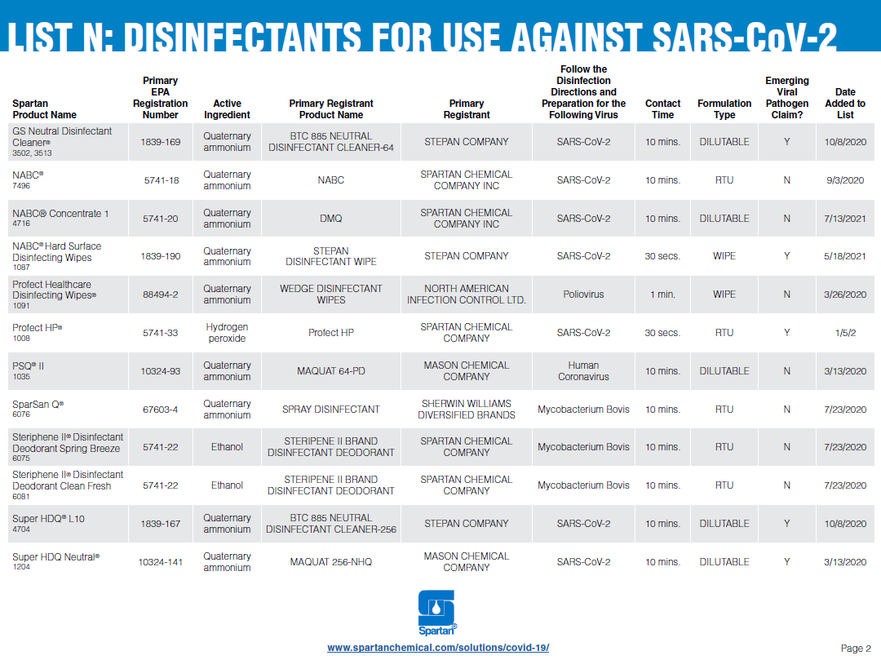

Slide 25
Section 3: dISINFECTING Programs

Slide 26
COnsiderations
Disinfection
Types of microorganisms involved pathogenic or nonpathogenic organisms
Contaminated areas and types of surfaces that need disinfection
Disinfectant concentrations and economics
Product stability, performance and storage conditions
Application method- labor and contact time allowed
Safety Precautions
Environmental Impact

Slide 27
*Low level disinfectants are acceptable for use on these surfaces. *Intermediate or high-level disinfectants may be required if a special pathogen of concern is designated.
High Touch Points
Low-level Disinfecting--
Objects/surfaces which contact intact skin
These items could potentially contribute to secondary transmission by contaminating hands of healthcare workers or by contact with medical equipment that subsequently comes in contact with patients.
Common High Touch Points
Fixtures, Walls, Floors & Other Hard Surfaces such as:
Bed Railings, Carts, Counters, Exam Tables, Gurneys, IV Poles, Stethoscopes, Stretchers, Tables, Telephones, Toilet Seats, Toilets, Bathtubs, Bathroom Fixtures, Shower Stalls, Sinks, Hospital Beds, Traction Devices, MRI, CAT Scales, and Wheelchairs
Common high touch points

Slide 28
Application
Disinfection
In a healthcare setting, bucket solutions should be changed at least every 3 patient rooms, unless solution becomes visibly soiled
When using a quat-based disinfectant, proper mop selection is important to reduce quat build up on floors
If a traditional wet mop is used, it is important to select a rayon cotton blended mop
100% cotton mops or rags should not be used with quat disinfectants
When using microfiber it is important to select a pad that is acceptable to be used with a quat-based disinfectant

Slide 29
CleanCheck® Training system
Training
While hand hygiene is the first line of defense against the spread of harmful bacteria such as SARS-CoV-2, disinfection of high touch surfaces helps reduce the risk of personnel coming in contact with a contaminated surface.
To learn more about CleanCheck® Training System, click here!

Slide 30
Compuclean®
VALIDATION
To learn more about CompuClean® Training System, click here!

Slide 31
Covid-19 resources
prevention

Slide 32
Critical aspects
Disinfecting Programs
People – The Right People & Commitment
Products – The Right Products for the Right Applications
Processes & Training – The Right Structure and Adherence
Validation – The Right Quality & Validation Measures

