Slide 1
SYNERGY THAT CREATES COMPETITIVE ADVANTAGE
FOOD PROCESSING

Slide 2
Food processing sanitation

Slide 3
Food processing sanitation
The market segment that won’t go away
Who plans to stop eating?
An opportunity to differentiate yourself from other day to day business opportunities
Vertical growth within existing accounts

Slide 4
WIIFM

Slide 5
wiifm
Market Segment unique from your “Traditional Competitors”
Vertical Growth within existing accounts
Added “tonnage” to stock orders
Faster turns with current order patterns
Local Distributor
Warehouse on wheels
No expedited freight fees
Distribution
Can replace the distributor, but not the cost of distribution

Slide 6
Protect your brand

Slide 7
Industry/potential market
Meat
Poultry
Fish
Bakeries
Confectioneries
Cannabis
Beverage
Potato Chips/Snacks
Canneries
Produce/ Agriculture / Vertical Farms
Commissaries
The List Goes On

Slide 8
Buzz words
LETTERS OF GUARANTY
Name and address of products supplier
Brand name
Statement of safety and efficacy
Statement of Compliance
Any limits of use or special directions
Signature

Slide 9
Buzz words
CIP (Clean in place)
COP (Clean out of place)
FSMA (Food Safety Modernization Act)
GFSI (Global Food Safety Initiative)

Slide 10
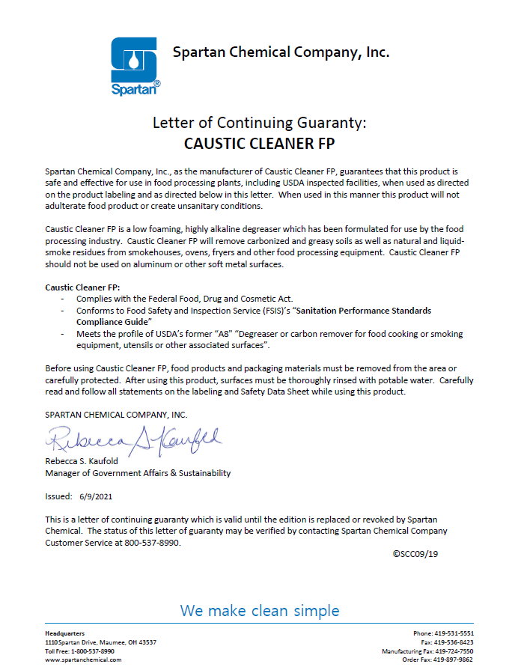

Slide 11
haCcp
Hazard
Analysis
And
Critical
Control
Points

Slide 12
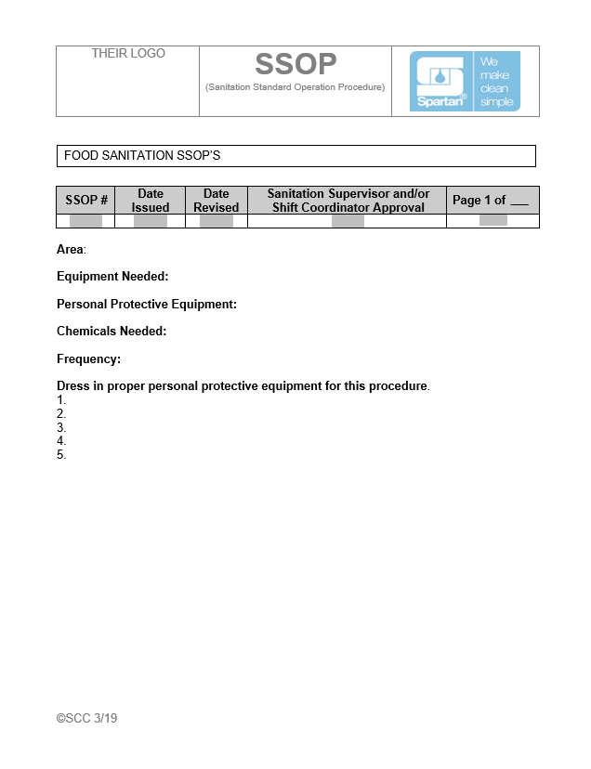

Slide 13
Spartan’s responsibilities
haacp
Write a HACCP plan? – NO
Be familiar with bacteria concerns affecting different markets (i.e., meat, poultry, fish, etc.)
Listeria monocytogenes
E-coli 0157;H7
Salmonella
Campylobacter jejuni
Staphylococcus aureus

Slide 14
“tools” for success
ATP Testing
Is the surface “clean/dirty”
Measurement not specific to LM, E-coli 0157:H7, salmonella, and/or even MRSA!!
Evaluate cleaning efficiencies
First line of defense for CCP’s (critical control points)
Trending report
ATP – simple/affordable
Other Units – Charms, Neogen, 3M

Slide 15
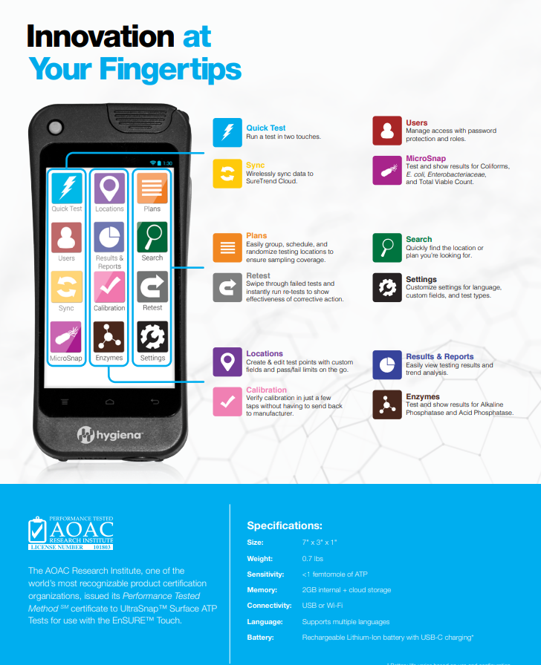

Slide 16
Third party audit
SQF
Safe quality food (Quality Certification Program)
Do what you do… Say what you do… Prove it (GFSI – Global Food Safety Initiative
BRC (British Retail Consortium)
Another 3rd party audit
Tendency to change behavioral patterns
Both SQF & BRC gained tremendous momentum after peanut butter corporation recall and deaths
Primus—Produce

Slide 17
Foaming cleaners/degreasers vs low foam option(s)

Slide 18
Low foam cleaners
Spartan products
LFC - Low Foam Chlorinated
Caustic Cleaner FP
High Acid Cleaner FP
High Performance Alkaline FP
High Acid Cleaner Phosphate Free
Fryer Cleaner FP

Slide 19
Foam cleaners
Spartan products
Chlorinated Degreaser
Chlorinated Plus
Inspectors Choice
Peroxy Protein Remover
Foaming Caustic
Foaming Acid

Slide 20
sanitizers
Spartan products
Sani-T-10 Plus
SparChlor
Acid Sanitizer
PAA Sanitizer

Slide 21
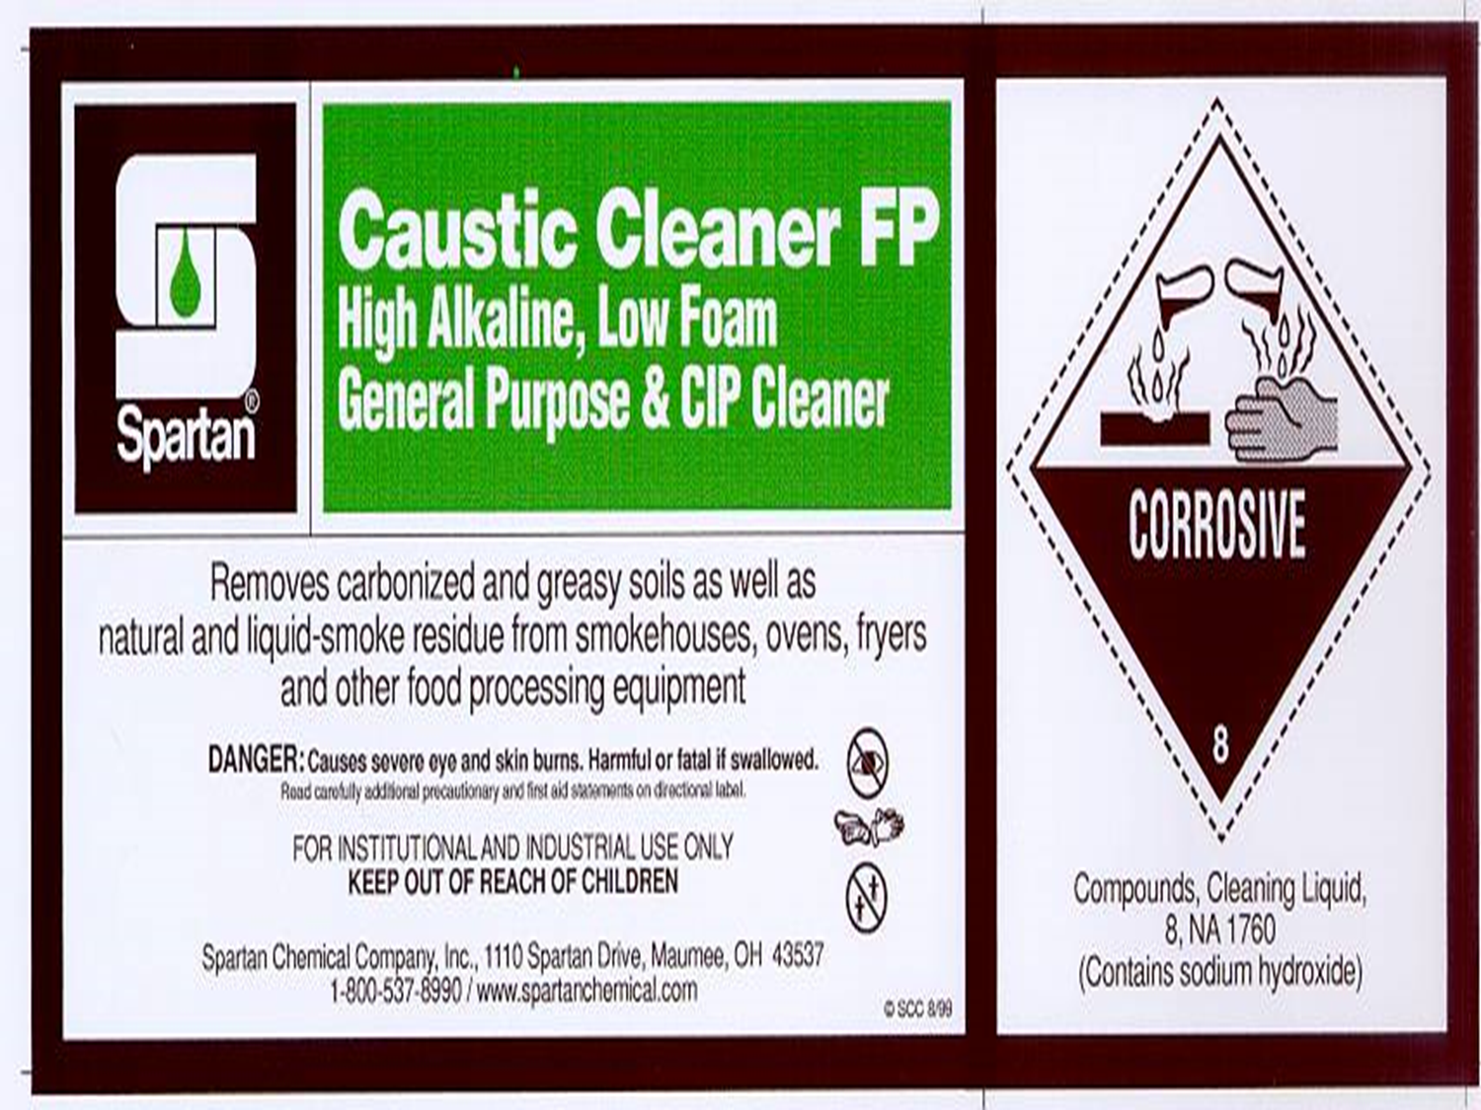

Slide 22
equipment

Slide 23
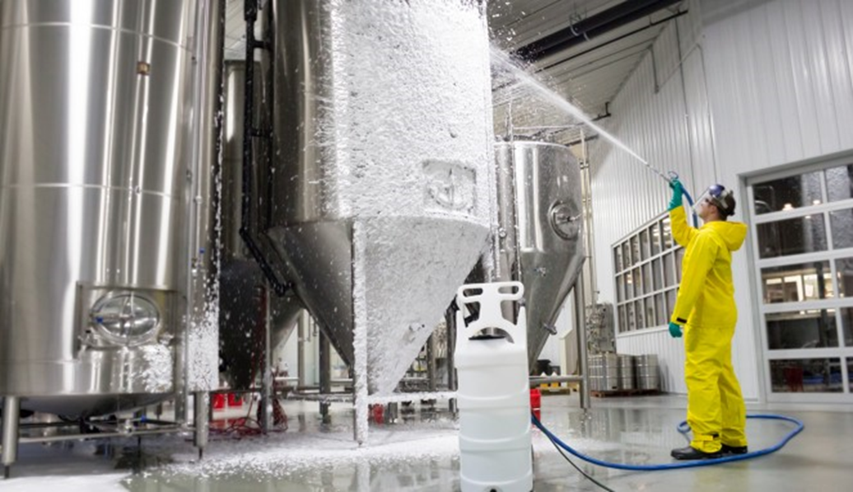

Slide 24
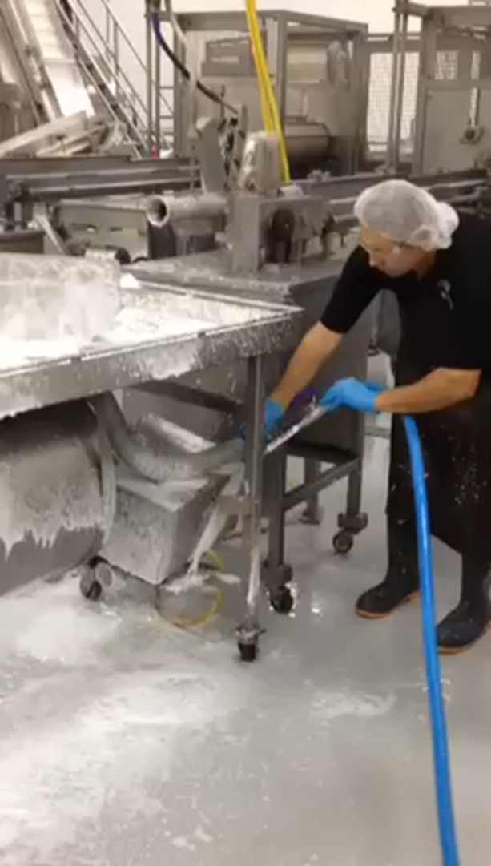

Slide 25
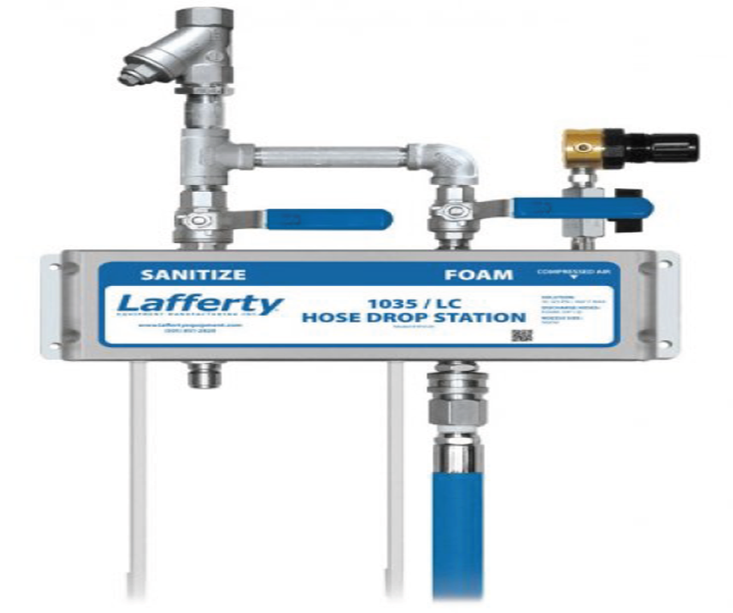

Slide 26
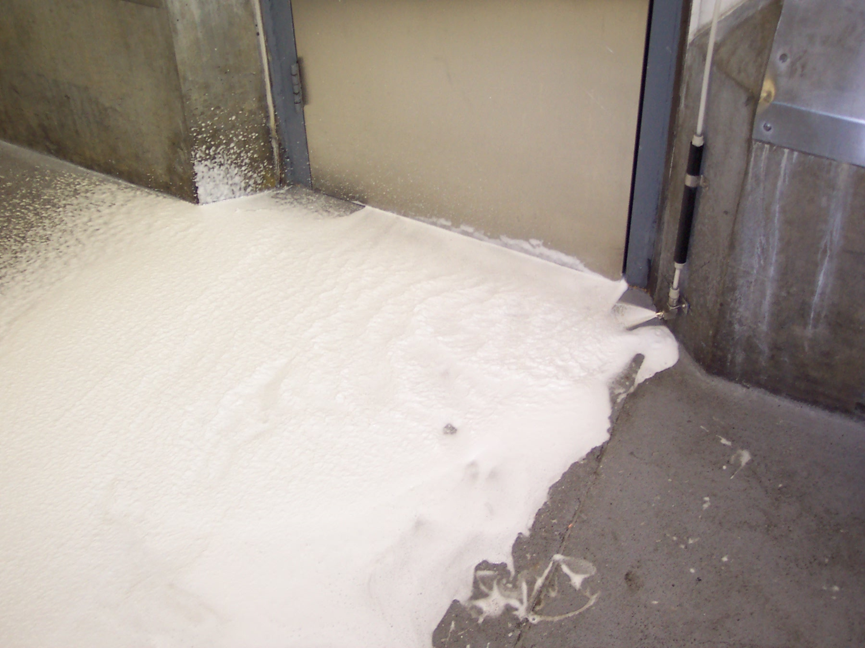

Slide 27
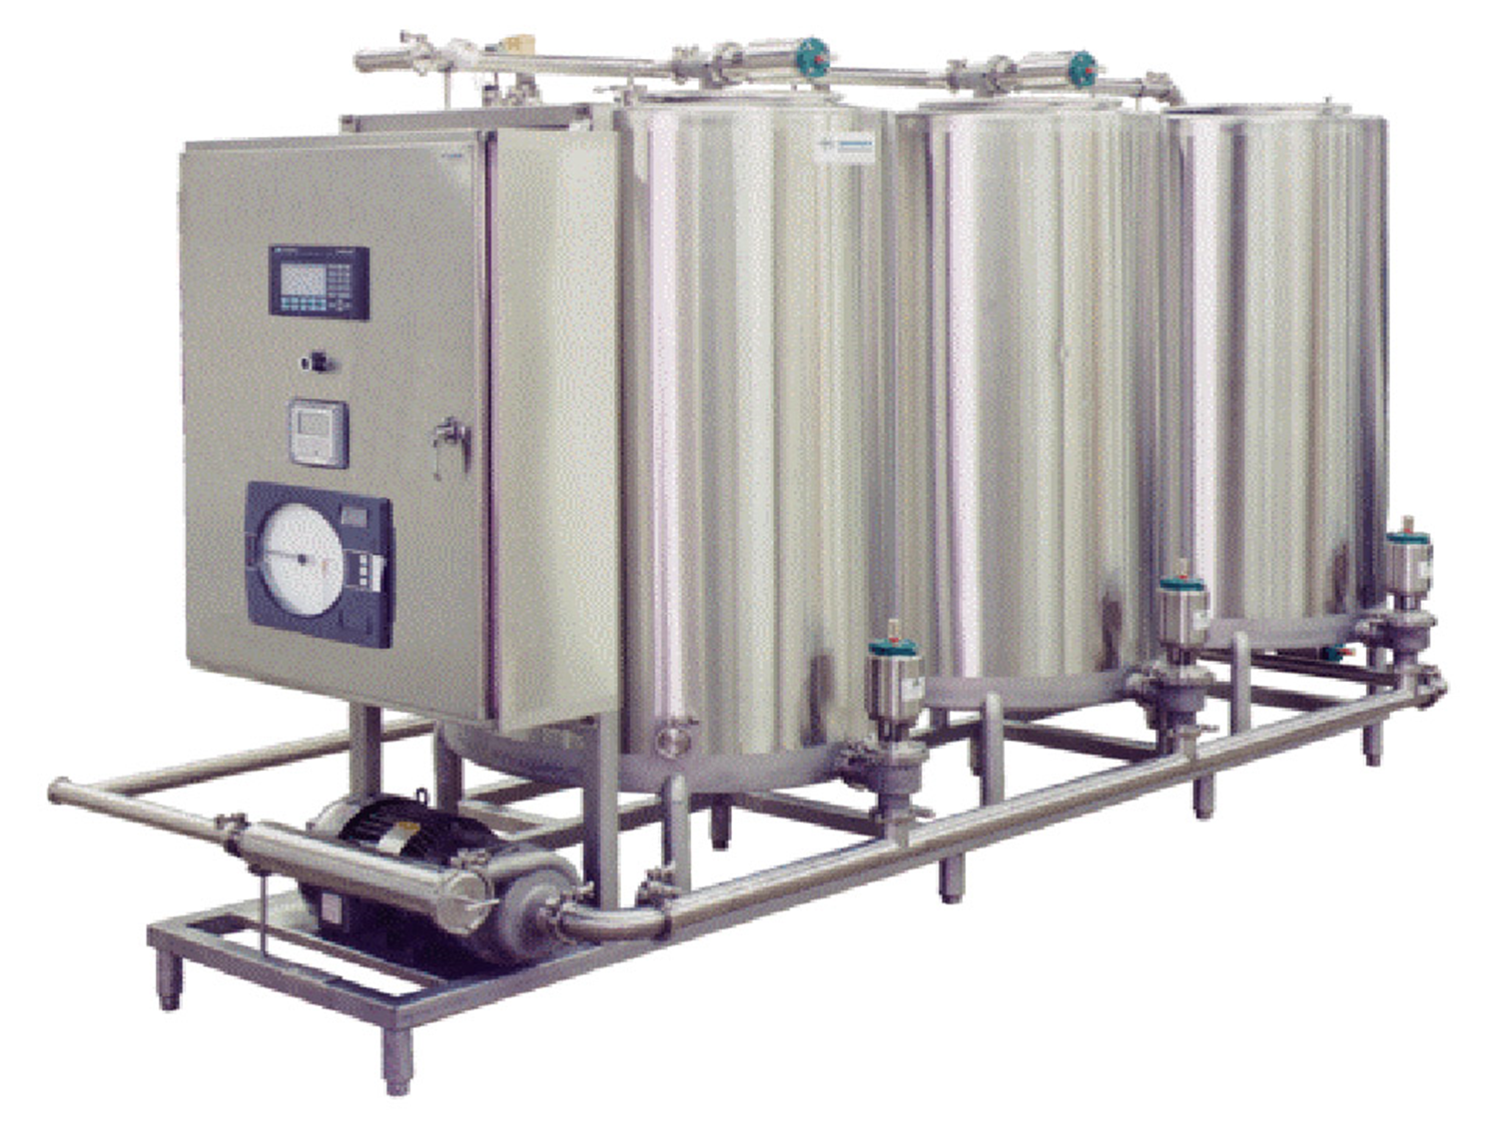

Slide 28
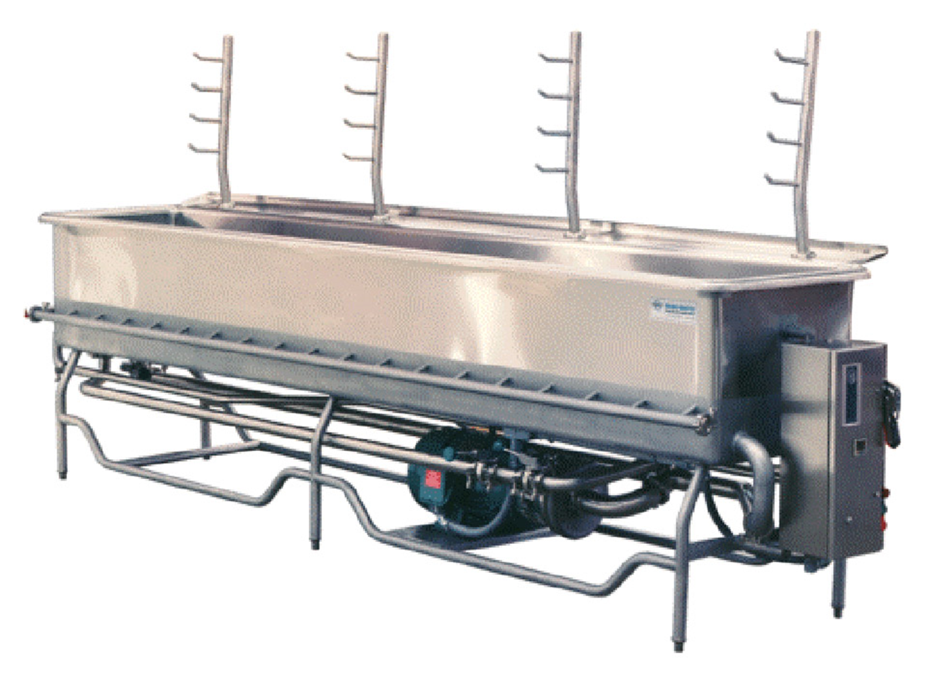

Slide 29
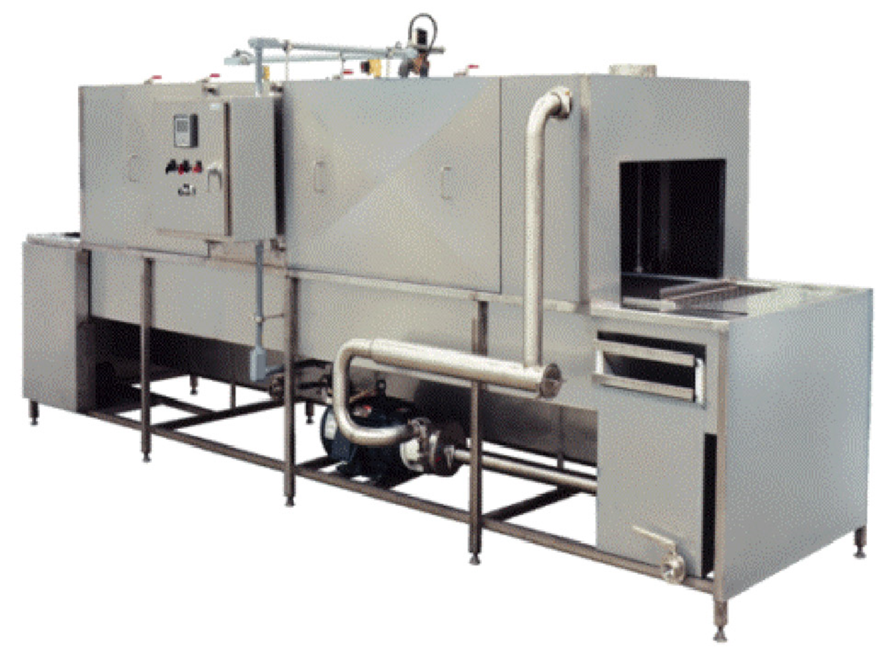

Slide 30
Target accounts
Target accounts/pipeline new business
Focus on Small to Medium Sized Accounts
Google Search
Sales Navigator
Spartan Success Stories
Meat processing/slaughtering (i.e., sausage, bacon)
Poultry
Fish/seafood
Auto scrubber
Produce
Frozen pizza/frozen food
Seasonings
Candy

Slide 31
Target accounts
Target accounts/pipeline new business
Bakeries (i.e., Pop Tarts, donuts)
Cooking oil
Lease truck company (refrigerated trucks)
Cheese (shredded/sliced)
Hood duct cleaning
Dog food
Potato salad
Snacks (i.e., potato chips, taco chips, nuts)

Slide 32
End user calls
Target accounts/pipeline new business
Biggest Challenge
Existing relationships
Equipment
Getting the demonstration
HACCP/USDA
Establish Credibility
Hard water test kit
All stainless steel or some aluminum surfaces

Slide 33
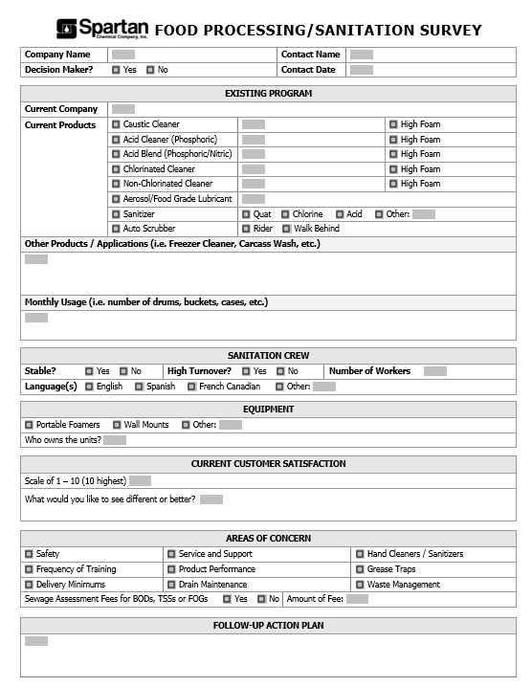

Slide 35
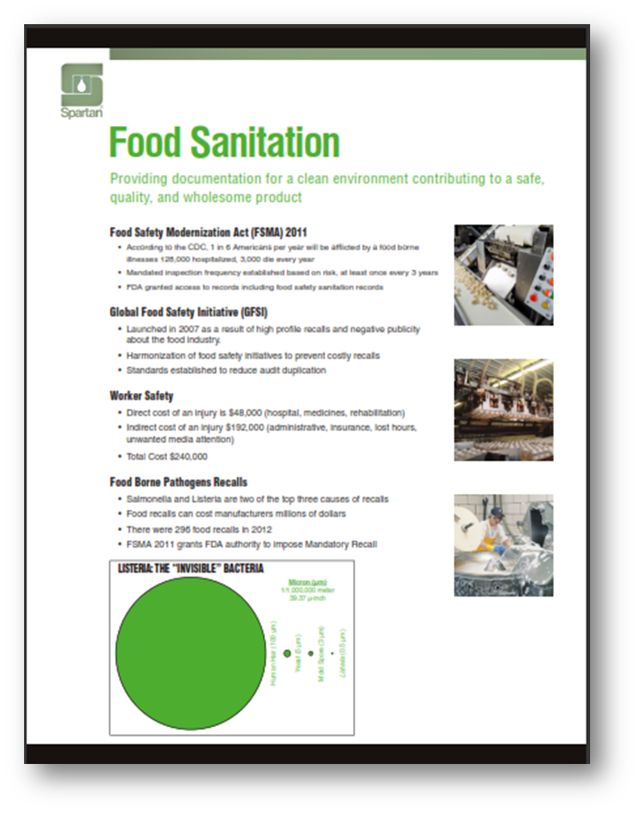

Slide 36
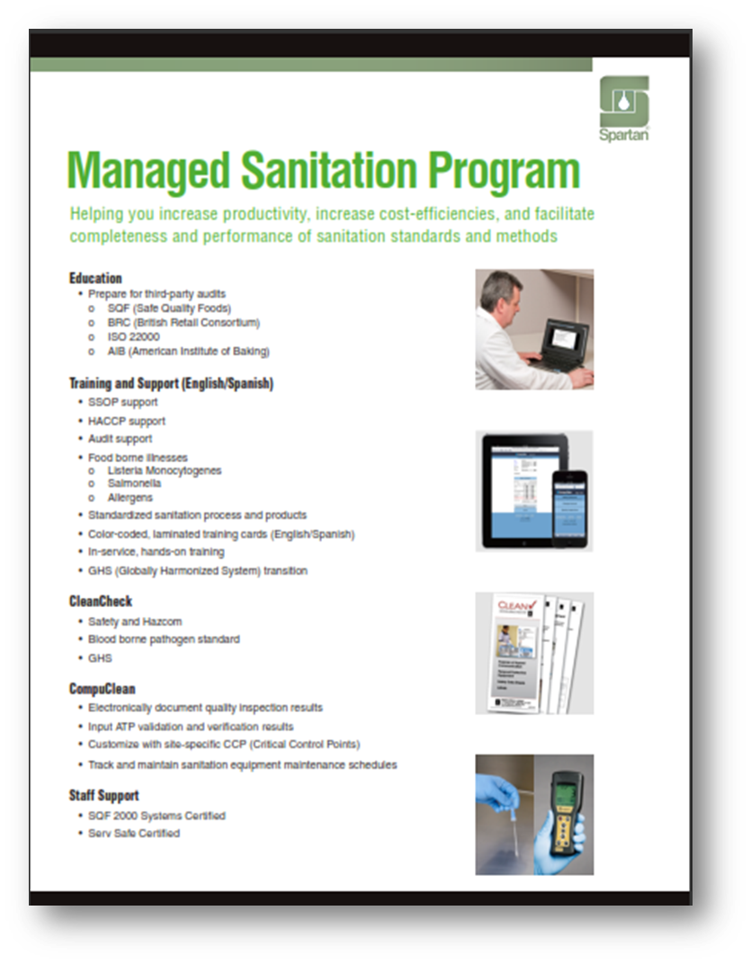

Slide 38
Sales team presentation
Reinforce
Local service/support
Spartan’s ability (i.e., training – cards, SDS, HAZCOM, CleanCheck, etc.)
Distributor's ability (TPC)
Your ability to follow through on promises/commitments
Working together on SSOP’s
Plan B (sanitation contact - no interest, etc.)
Bioaugmentation

Slide 39
Food sanitation objectives
Increase Productivity
Provide Cost Efficiencies
Proportioning equipment (foaming type equipment)
JIT Inventory/Deliveries
Make Everyone’s Job Easier to Perform
Provide Value-Added Service/Support
Training and demos
Troubleshooting Assistance

Slide 40
brewcheck

Slide 41
Where to sell
brewcheck
Seek A Brew
Click on state – all locations appear
Find a U.S. Brewery (Brewers Association)
Search Craft Breweries by State
Use current end users as coach
“Fraternity” of friends
All want to see each other succeed

Slide 42
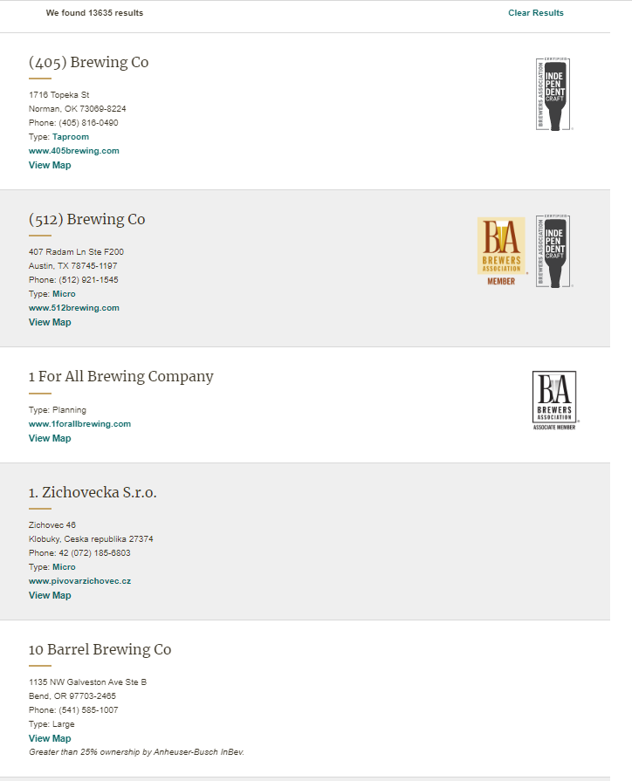

Slide 43
Who is our competition?
brewcheck
Loeffler Chemical (Direct seller – Atlanta, GA)
Five Star Chemicals (Direct Seller – Denver, CO)
ChemStation (Direct Seller – Franchise)
Birko (Direct Seller – Henderson, CO)
Madison Chemical (Direct Seller – Madison, IN)
Shephard Bros. (Direct Seller – La Habra/Anaheim, CA)
Ecolab (Direct Seller)
AFCO (Direct Seller – Chambersburg/Harrisburg, PA)
“Others”

Slide 44
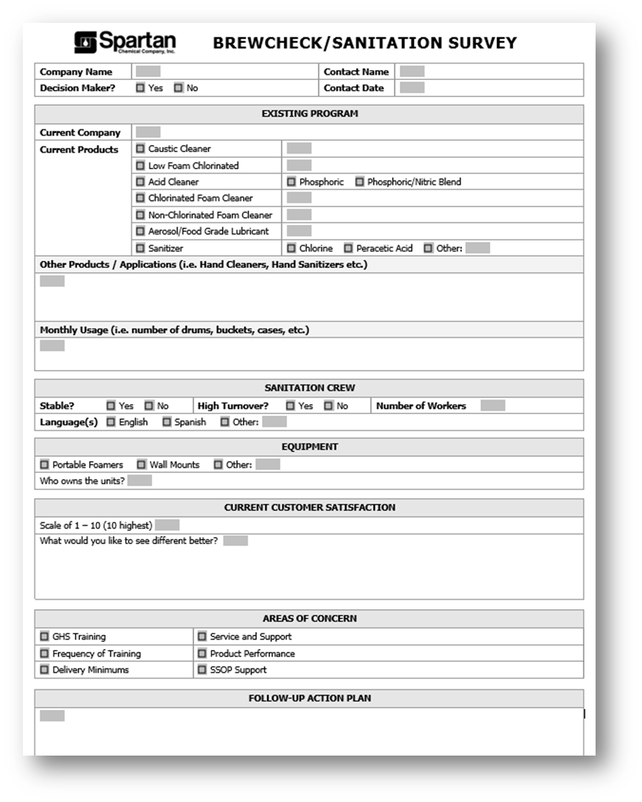

Slide 45
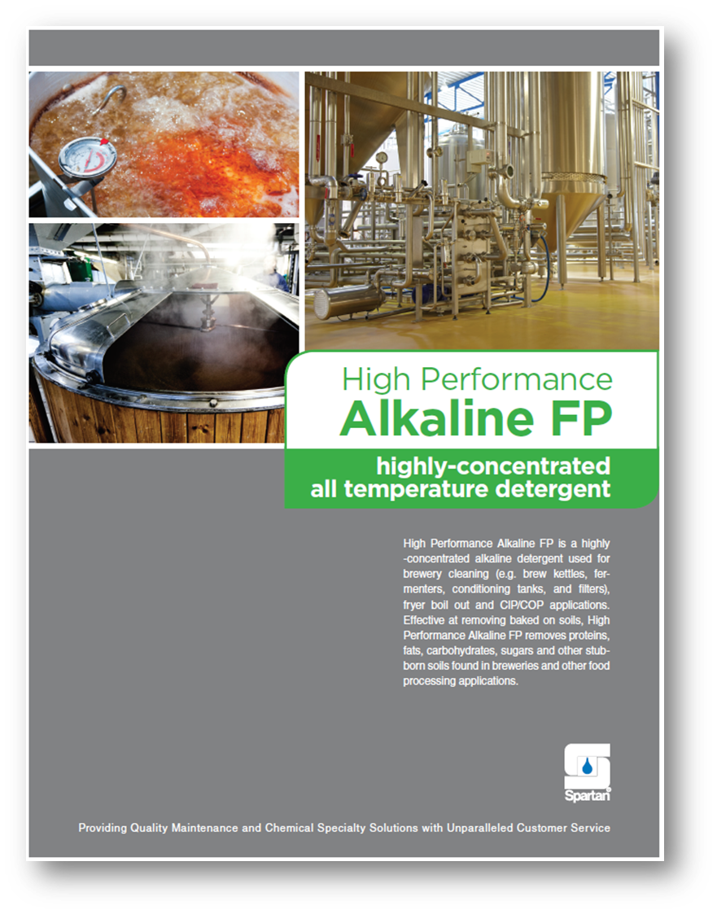

Slide 46
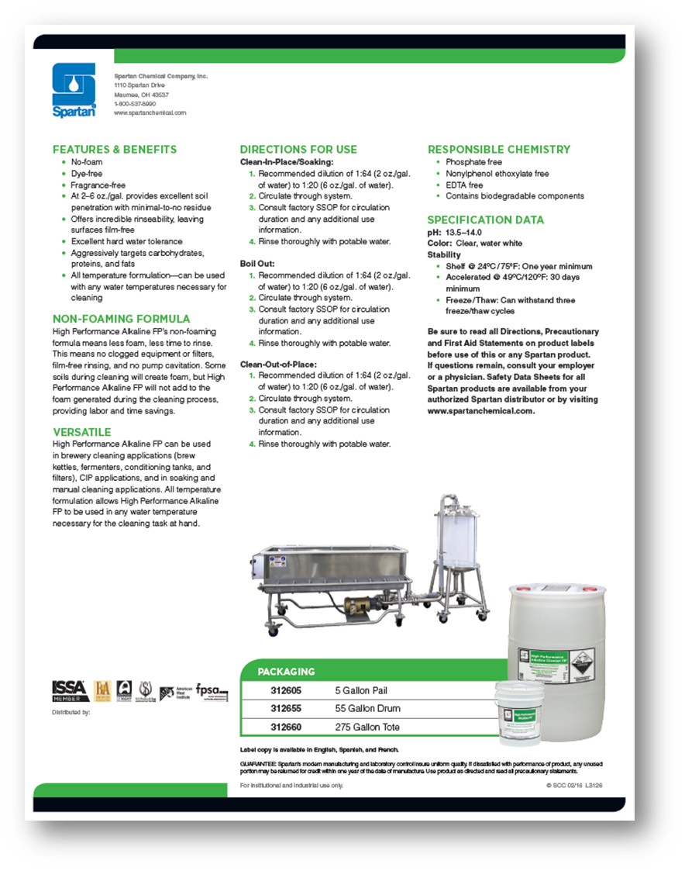

Slide 48
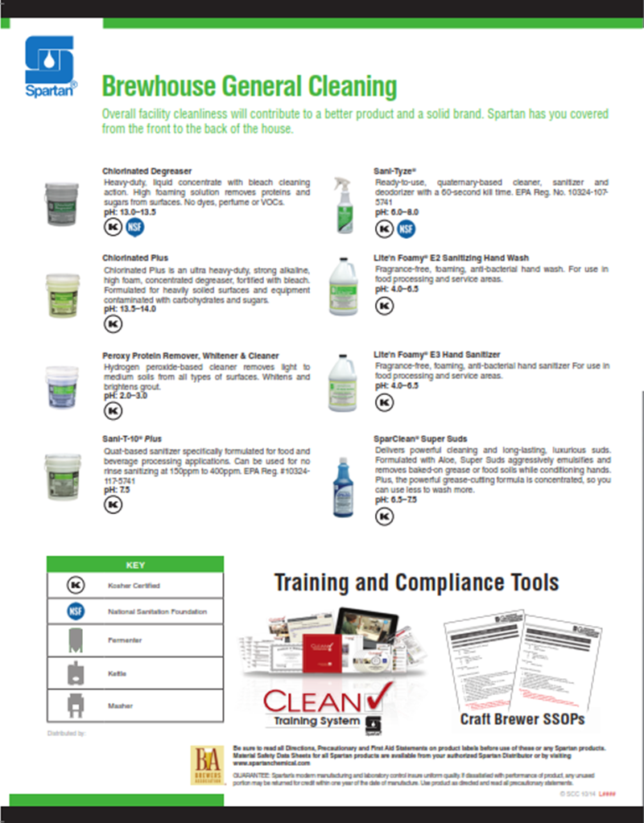

Slide 49
Food sanitation
BREwcheck
BrewCheck Selling Observations
Focus on Local Support/Delivery
Warehouse on wheels
Chemical cage area
GHS
Simplify Program Sale
Dealing with “Mixologists”
Investigate Brewer’s Guild
Great opportunity to network with other craft brewers
Distributor may want to join

Slide 50
Food sanitation
brewcheck
Market Segment Opportunity
13 sanitation companies exhibited at Craft Brewery Show
After the Sale Dispensing Considerations
Hydro dose
Transfer Cart

Slide 51
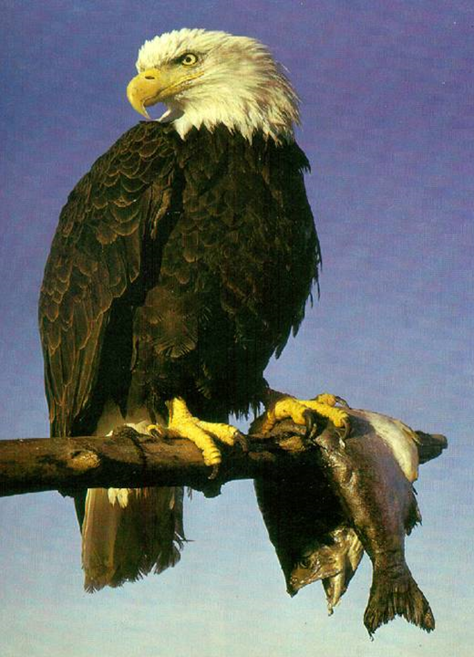

Slide 52
HAPPY HUNTING!!!
THANK YOU FOR YOUR TIME, INTEREST AND SUPPORT!

