Slide 1
Spartan Sales Pro® Upgrade
Presenter: Cali Sartor

Slide 2
Spartan Sales Pro®
Details
Completely redesigned based on analytics about how the previous app was used.
NEW mobile-optimized version that is designed to work with your smart phone. (Apple or Android)
Customizable option to include the distributor logo, distributor part number (if applicable), and only show the products that you stock in your warehouse.
Provides recommended solution bundles based on the customer’s critical business need: Sustainability, Cost Containment, Convenience (Operational Efficiency).
Utilizes the camera to quickly find out the competitive cross-referenced product.
Text and notification enabled

Slide 3
Spartan Sales Pro®
New User Interface - Mobile
Completely redesigned based on analytics about how the previous app was used.

Slide 4
Spartan Sales Pro®
New User Interface – Desktop

Slide 5
Spartan Sales Pro®
Mobile Optimization
NEW mobile-optimized version that is designed to work with your smart phone. (Apple or Android)

Slide 6
Spartan Sales Pro®
Distributor Customization - Mobile
Customizable option to include the distributor logo, distributor part number (if applicable), and only show the products that you stock in your warehouse.

Slide 7
Spartan Sales Pro®
Distributor Customization - Desktop

Slide 8
Spartan Sales Pro®
Recommended Solution Bundles – Mobile
Provides recommended solution bundles based on the customer’s critical business need: Sustainability, Cost Effectiveness, Convenience.

Slide 9
Spartan Sales Pro®
Recommended Solution Bundles – Desktop

Slide 10
Spartan Sales Pro®
Smartphone Optimized
Utilizes the camera to quickly find out the competitive cross-referenced product.

Slide 11
Spartan Sales Pro®
Text and notification enabled
Send proposed solutions via text
Receive notifications when proposals are shared

Slide 12
Spartan Sales Pro®
Progressive Web App (PWA)
No download required
Functions like a native app
Persistent login
Lazy load
Cached data
Device OS agnostic
Totally rad, dude

Slide 13
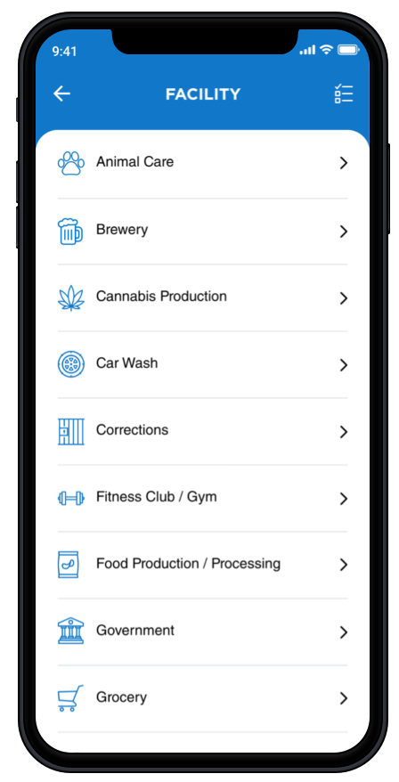
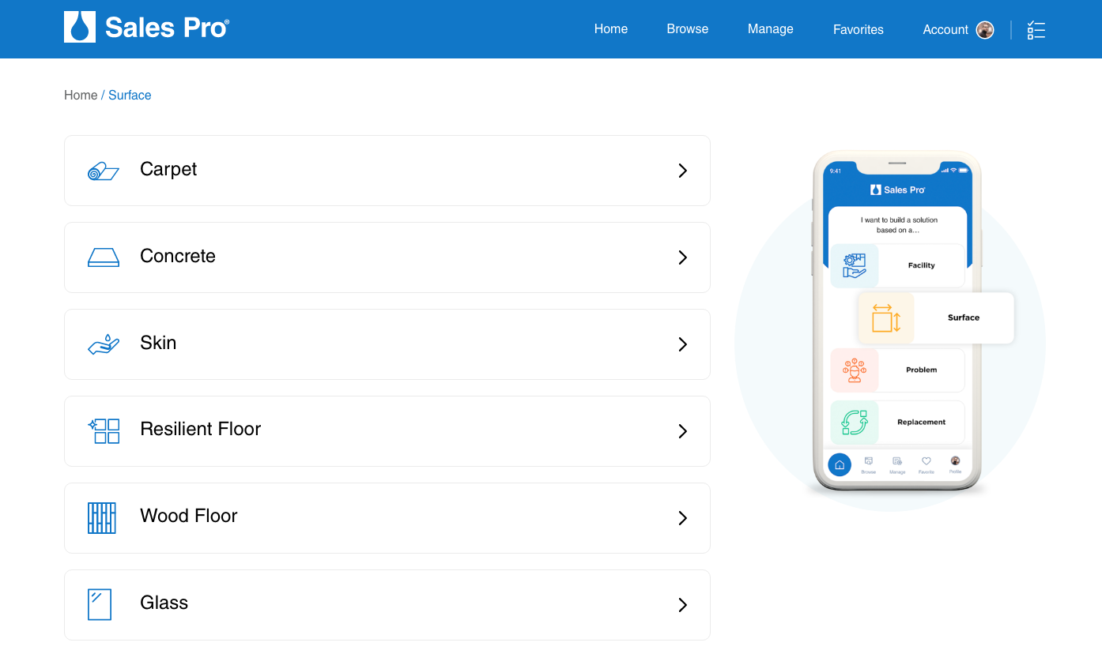
Spartan Sales Pro®
Timeline & Rollout
All current users will be automatically migrated to the update on login
App will be launched in Q1, 2022

