Slide 1
CompuClean®
Cloud-Based Facility Management Software

Slide 2
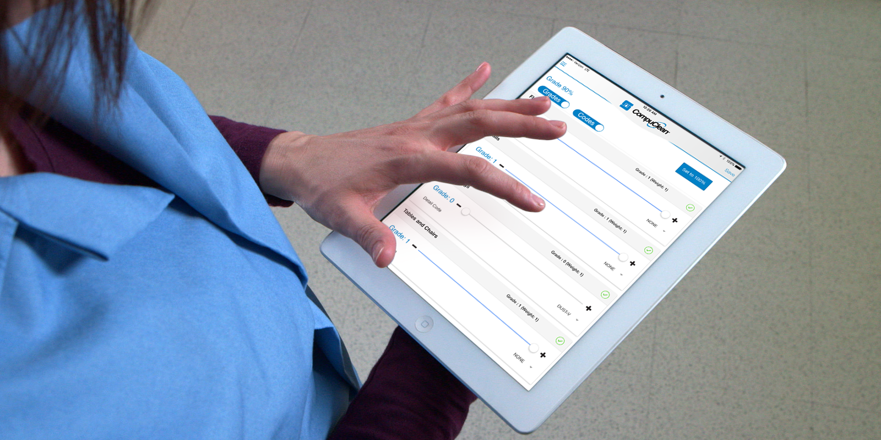
Managed Cleaning
BSCs, In-House providers and EVS departments must increase documentation and management of cleaning and sanitation.
Cleaning Process Documentation
Cleaning Process Validation
Managed and Communicated Work Assignments
Effective Staff Training

Slide 3
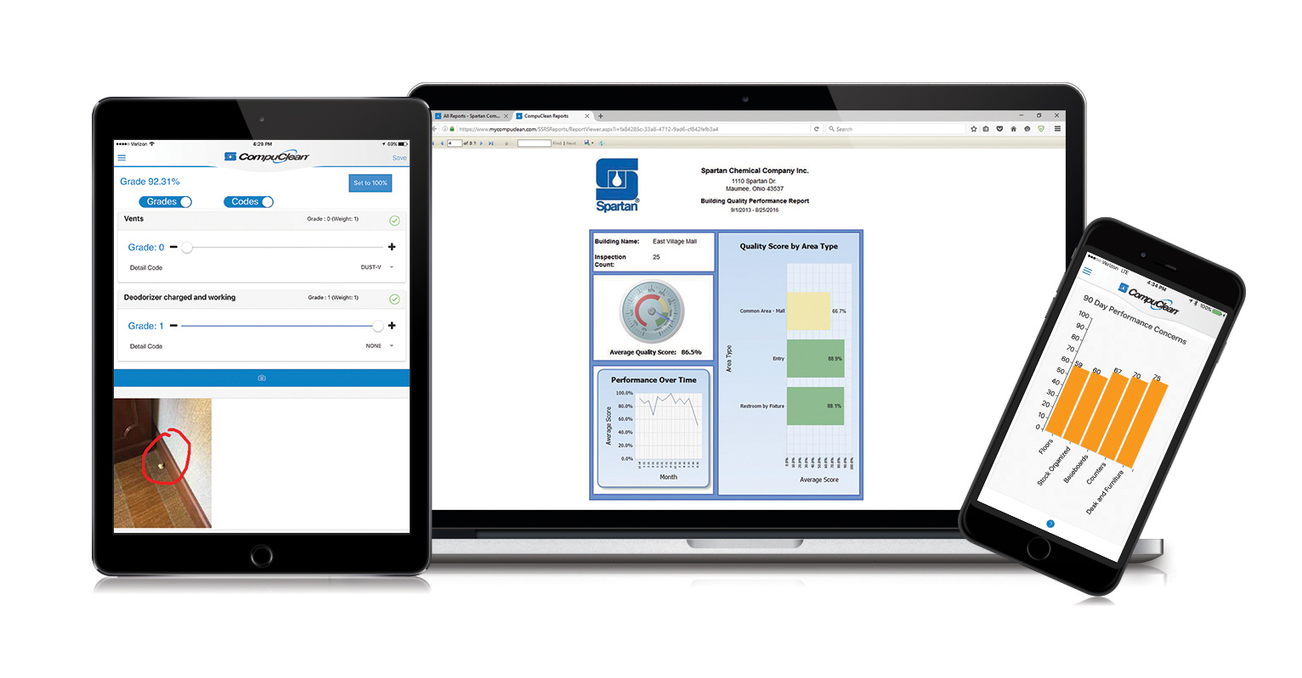
CompuClean is a complete cloud-based custodial data management solution
What is CompuClean?
CompuClean is owned, developed and supported by the Spartan Chemical Company Inc.
Available exclusively to Spartan customers
Supports English, Spanish and Portuguese
CompuClean Features:
Quality Assurance
Custom Workloading and Work Management
Real Time Work Logging
Inventory Management
Capital Equipment Management
Employee Training Tracking
Mobile Apps available for Android® devices and iPad, iPhone and iPod touch

Slide 4
Cloud Benefits
Hosted and managed by Spartan Chemical
Central location for storage and delivery of Compuclean data
Secure, reliable and redundant
Accessible anywhere on any browser enabled device
Desktop/Laptop
Smartphone
iPad/Tablet

Slide 5
PRICING AND REQUIREMENTS
Pricing All inclusive pricing
$420 per year for 1-4 users
$600 per year for 5+ users
Additional Requirements
Spartan purchases of $10,000 or more annually

Slide 6
COMPUCLEAN Target Markets
EDUCATION
HEALTHCARE
BSC
FOOD PROCESSING

Slide 7
CompuClean provides a unique barrier to exit
Benefits to Distribution
Features become a part of day-to-day operations
Systems are difficult to replace
Data is critical to operational success

Slide 8
CompuClean provides increased customer contact and interaction
Benefits to Distribution
Chance to learn about customer operations and systems
Participate in implementation process
Become a consultative partner for customer.

Slide 9
Documentation for Third Party Audits and Liability
Customer Benefits
Healthcare Joint Commission
Food Processing SQF, FDA, BRC Audits
Outbreaks in schools and public facilities

Slide 10
Automation and Communication
Customer Benefits
Keeps staff members aware of assignments
Text and email integration
Schedule jobs automatically
Reporting identifies trends and issues

Slide 11
Cost Effective
Customer Benefits
No special equipment required.
Low annual service fee
No cost per user
No cost for training and support

Slide 12
Industry Leading Support
Customer Benefits
Dedicated Implementation Team
Unlimited training and data import services
Annual upgrades and enhancements

Slide 13
Value vs. Competition
Software | Company | Cost | Notes
Cleantelligent | Cleantelligent | $225 per month, up to 3 users | Initial setup is a minimum of $2500. Online inspections and workloading with project tracking and scheduling, end user access for reporting and iOS and Android apps for offline use. Fees for support and data storage tiers.
CCAP | Hillyard | $50 per month for 1 user $30 per user for 5 | Workloading analysis is given as free service, based on a multiyear, full line commitment to Hillyard with adjusted pricing; cost listed is for access to third party Vektr, web-based inspection tool.
Orange QC | Orange QC | 1-2 users - $100 per month 3-10 users - $250 per month 11-25 users - $500 per month | Online inspection tool, web based, Android, iOS. Free support on phone and email
 | CompuClean (Spartan Chemical) | $600 per year, Unlimited Users $400 per year, 1-4 Users | Requires $10,000 in annual Spartan Chemical purchases. Complimentary upgrades support, training and unlimited data storage.

Slide 14
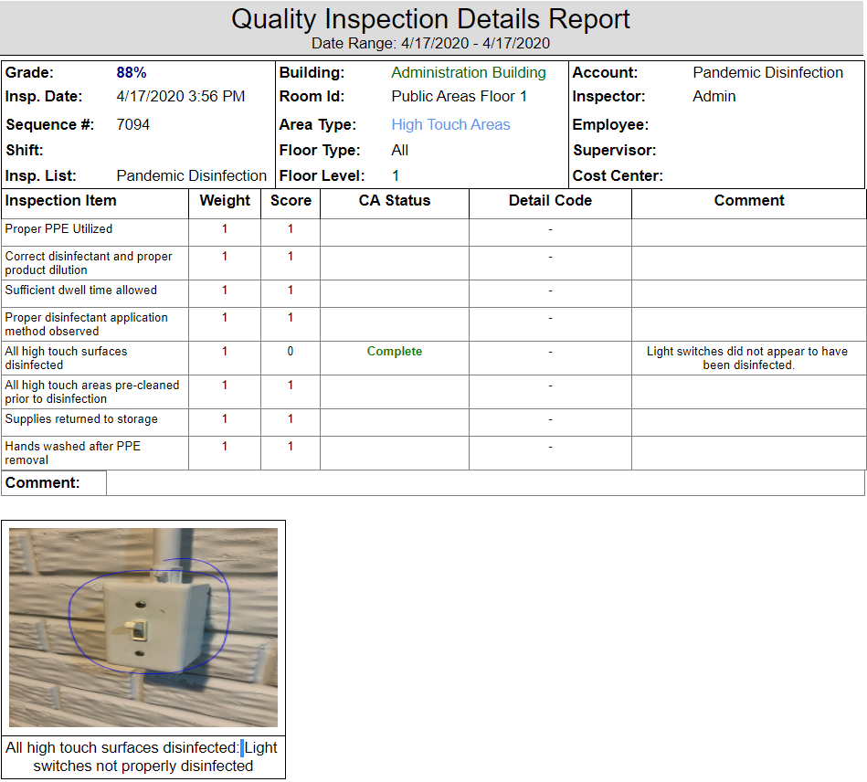
QUALITY ASSURANCE
Perform your own custom quality inspections
Track performance by building, employee, supervisor and more
Powerful quality reporting provides detailed results to help maximize the performance of your custodians.
Perform inspections online or offline with CompuClean Mobile App.
Capture pictures to fully document issues
Bar code areas for easy inspection creation.

Slide 15
QUALITY CORRECTIVE ACTIONS
Detailed, Auditable and Verifiable Tool for Correcting Quality Deficiencies
Initiate and assign a corrective action during an inspection
Document Correction taken
Fully Mobile Capable
Email and Text Alert Capabilities
Configurable to limit alerts
Corrections Verified and Tracked
Inspector finds issue and creates corrective action
Employee assigned to CA is notified via email or text
Employee makes correction and marks CA complete in App
Inspector verifies completion of CA and marks it in Mobile App

Slide 16
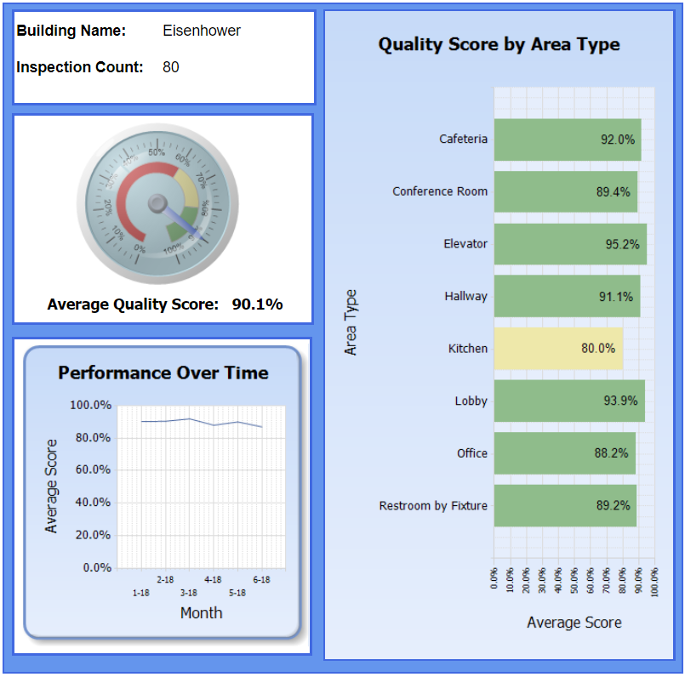
Building Quality Performance Report
One page overview of building quality performance

Slide 17
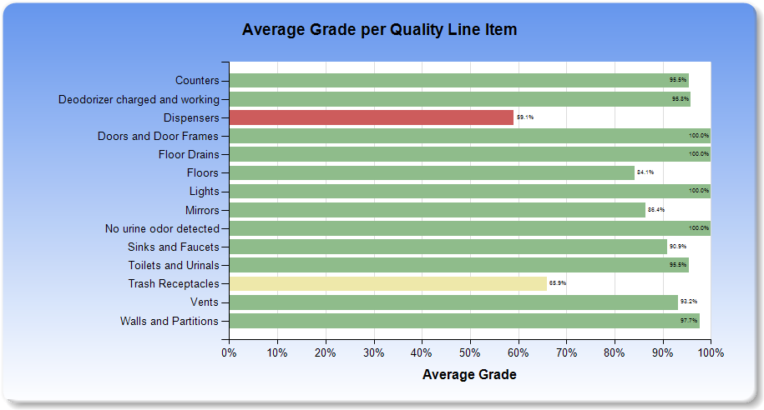
Quality By Line Item Chart
Provides performance metrics for all inspection items to help target training and identify areas for improvement..

Slide 18
Building Documentation
Provide Procedures, Assignments and Reference Materials to Staff with the CompuClean Mobile App
Custom CleanCheck Task Cards
Building Maps
SDS Sheets
Scope of Work
Driving Directions
Security and Contact Information
Work Assignments

Slide 19
Work Logging
Capture job completion in real time from CompuClean Mobile App
Document when work was done who did it and what was done
Quick and efficient process
Capture GPS coordinates
Verify that work is completed with daily logs
Provide visibility into employee progress

Slide 20
Work Management - Work Requests
Easily Track and Complete Requests from Building Occupants
Create Internal Work Requests and Assign
Online Request Portal
Allow Customers to Submit Requests Online
Branded to the customer
Fully Mobile Capable
Email and Text Alert Capabilities
Configurable to limit alerts
Work Completed and Documented
Customer Submits Request Through Portal
Manager is Notified , Processes Request and Assigns it
Assigned Employee Notified, Completes work
Manager and Customer are Notified of Work Completion

Slide 21
Work Management: Recurring Projects
Create, schedule and complete recurring projects
Periodic floor care
Summer deep cleaning
Interim maintenance
Document project steps and estimate time
Determine frequencies for projects for each area in your facility
Automatically schedule next instance upon completion
Full mobile app integration
Email and text alert capabilities
Configurable to limit alerts
Weekly upcoming project email alerts
Projects Completed and Documented
Manager creates project tasks
Determine which types of space to perform project in and how often
Assign projects to employees or teams
Assignees are notified of upcoming projects via text or email
Employee completes project and marks it in Mobile App
Manager can manually or automatically reschedule

Slide 22
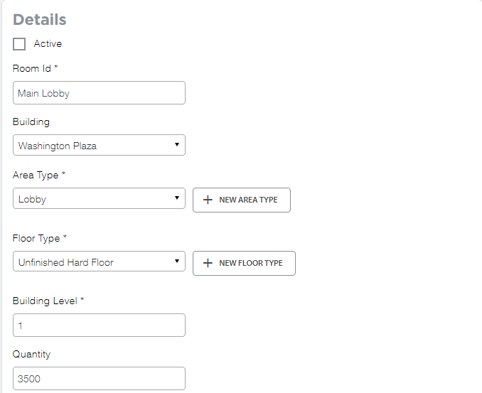
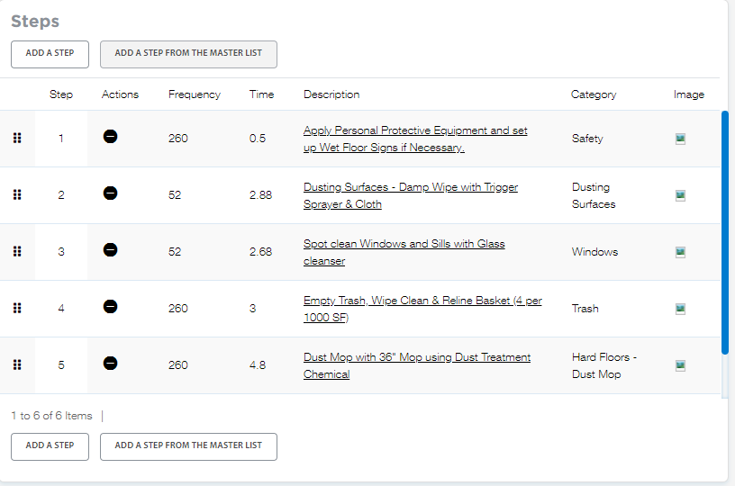
WORK MANAGEMENT - WORKLOADING
How is it cleaned?
How long does it take?
Who is responsible?
Industry standard ISSA 612 based workloading
Input and create cleaning tasks for any type of space
Assign employees to areas to generate work assignments
Justify staffing levels, balance work assignments and standardize cleaning processes
Advanced reporting provides detailed labor information and training aids.

Slide 23
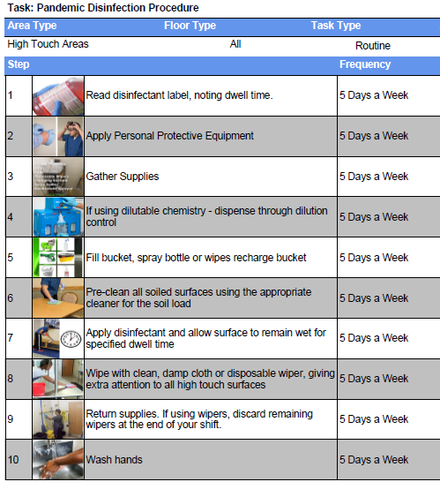
CUSTOM CLEANCHECK REPORT
Formats workloading tasks into a handy reference card that can be integrated into your training process.

Slide 24
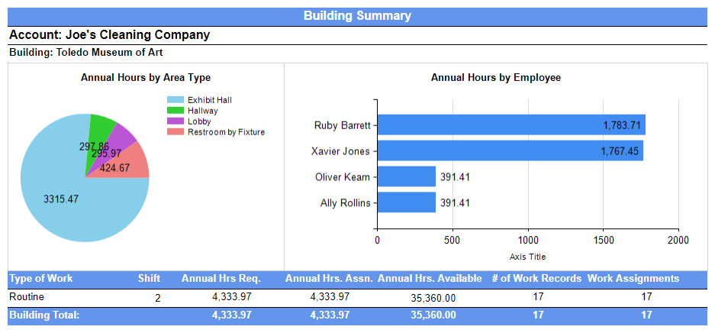
Work Information Report
Provides an account level and building level breakdown of work requirements with charts

Slide 25
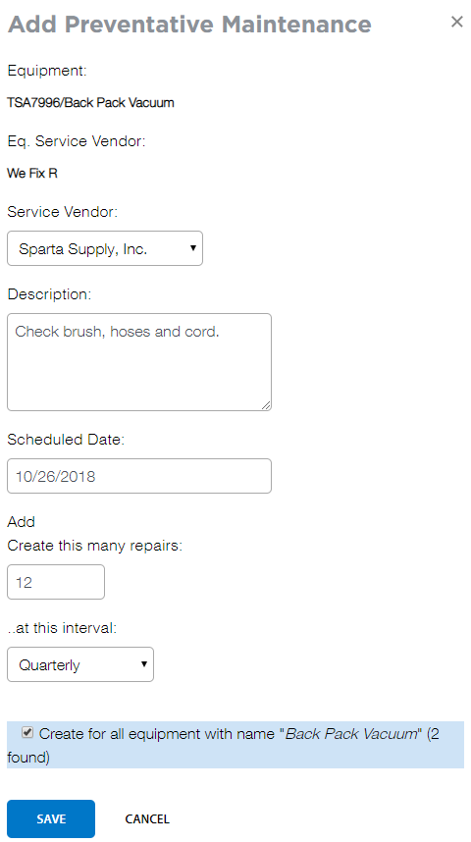
Capital Equipment
Create and maintain a detailed listing of all your equipment
Track warranty information, depreciation and manuals.
Create a preventative maintenance schedule and track associated costs.
Document repairs
Budget and forecast equipment
Replacement and maintenance costs

Slide 26
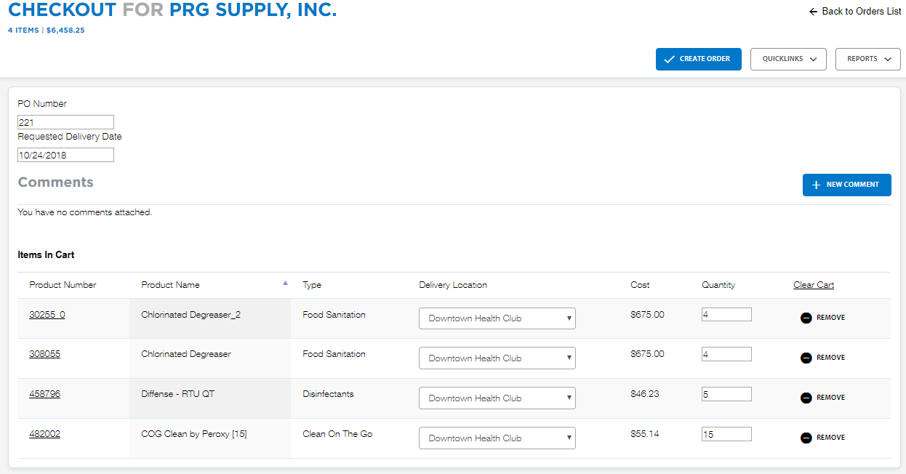
Inventory Management
Easily track inventory movement from vendors and internally
Add any type of product and multiple vendors
Track inventory requests from building managers
Document usage for buildings and track discrepancies
Perform audits to identify loss and shrinkage
Track Green Product usage
Manage SDS for products

Slide 27
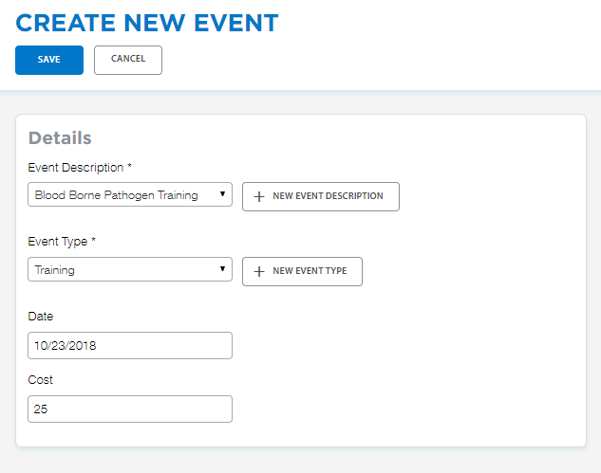
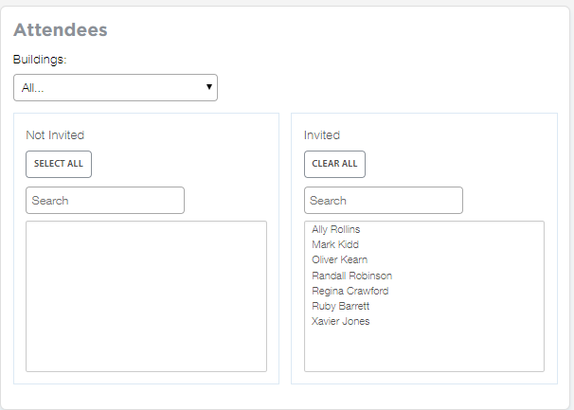
Personnel Management
Maintain a list of all employees
Track employee events including training, absences, disciplinary actions and more
Document training costs
Identify employees who have attendance or disciplinary issues.
Streamline planning for training and compliance.

Slide 28
WHY COMPUCLEAN?
Integration into customer’s daily operations
Account retention – Sticky Business
System Selling with other Spartan value-added tools
CleanCheck
Dispensing systems
Be the first to show your premier accounts this technology
Continue to provide value to the customer

Slide 29
SELLING RESOURCES
Overview Video
www.spartanchemical.com
Solutions<<CompuClean
https://vimeo.com/136855573
Literature
Spartan Regional Managers
Online Presentations

Slide 30
TRAINING AND SUPPORT
Complimentary upgrades as they are released
Access to Telephone Support including 1 on 1 online instruction
Training and implementation assistance
Dedicated telephone support
CompuClean Seminars
Pay travel and lodging costs only
Personalized online training
Custom training and implementation

Slide 31
TO GET STARTED WITH COMPUCLEAN
Contact your Spartan Regional Manager, email us or call the CompuClean Helpdesk.
Spartan Chemical Co., Inc.
1110 Spartan Drive
Maumee, Oh 43537
Phone: (419) 897-5551
Fax: (419) 897-9862
Toll Free: 1-800-537-8990
compuclean@spartanchemical.com

