Slide 1
Clothesline Fresh Laundry Care
The Process, Products, Markets, & How to Sell

Slide 2
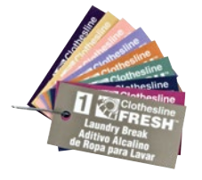
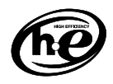
The Clothesline fresh advantage
Clothesline Fresh
The Spartan Advantage:
First Industrial Laundry line with High-Efficiency (HE) rated formulations.
Safer Choice Certified Products
6 products with EPA’s Safer Choice certification
Responsible Chemistry
Whenever possible, Clothesline Fresh formulations use raw materials listed with CleanGredients.
No phosphates, silicates, harsh solvents, alkylphenol ethoxylates, nitrilotriacetic acid (NTA), or toxic or persistent components or by-products.
All Temperature Formulations
Color and Number Coded Labels and Line Tags

Slide 3
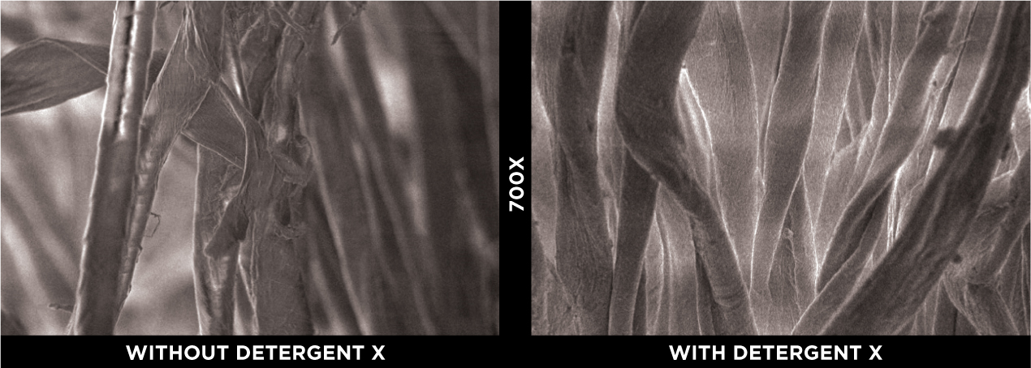
The Clothesline fresh advantage
Clothesline Fresh
The Spartan Advantage:
Proven results in all facets of the laundry industry.
12 years in the market, consistent year after year growth.
Success in every type of laundry account.
Bringing innovative solutions to the market.
The fabric protectant found in Detergent X is an advanced Copolymer of Hydrolyzed Wheat Protein and Silicone.
The fabric protectant found in Softener X is an innovative Quaternised Hydrolyzed Wheat Protein and Silicone Copolymer.
Close-up image of fiber damage (fibrillation) to linen from repeat laundering without a fabric protectant.
Fibers are intact, unbroken, and fuller due to the fabric protectant polymer in Detergent X.
Scanning electron microscope images of 50/50 cotton poly blend linen washed 20x each

Slide 4
Understanding the wash process

Slide 5
The products

Slide 6
Classification based on wash cycle function
Laundry Products

Slide 7
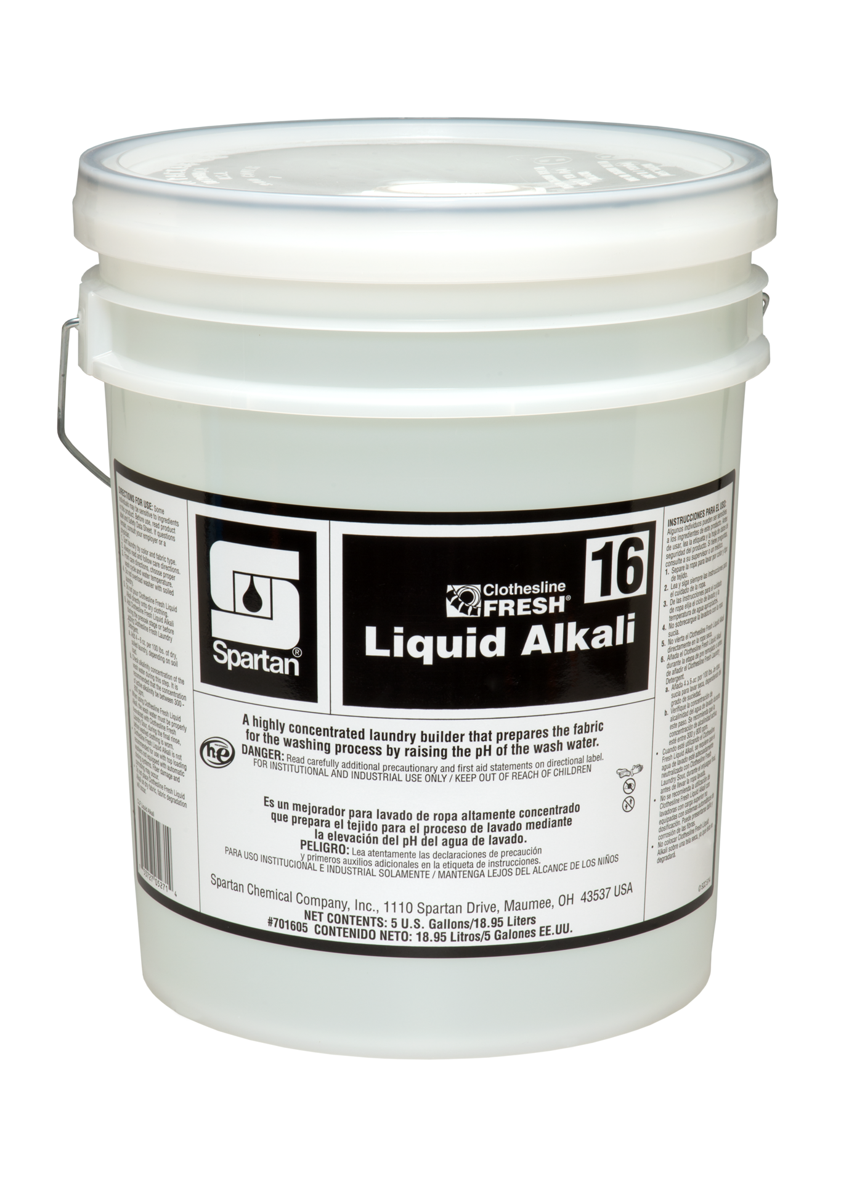
Builders
Laundry Products
Builders
Builder change the quality and properties of water, specifically pH (alkalinity) and hardness.
Raises the pH of the wash water.
“Breaks up” acidic soils by saponifying fats, oils, and greases allowing them to be emulsified by detergents.
Conditions the water so that the detergents work more efficiently.
Allows the matrix of the fabric to open up for a complete clean.

Slide 8
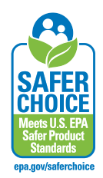
Non-built detergents
Laundry Products
Non-Built Detergents
Detergents work to loosen, lift and emulsify soils from linen and suspend them in the wash water.
All Temperature Formulations.
Disperses rapidly in cold water!
Innovative Polymeric Technology
Dispenser Friendly Viscosity
Can be used in Homestyle, OPL, and Commercial Laundry Machines.

Slide 9
Non-built detergents
Laundry Products
Non-Built Detergents
Work to loosen, lift and emulsify soils from linen and suspend them in the wash water.
All Temperature Formulations.
Disperses rapidly in cold water!
Innovative Polymeric Technology
Dispenser Friendly Viscosity
Can be used in Homestyle, OPL, and Commercial Laundry Machines.

Slide 10
Built Detergents
Laundry Products
Built Detergents
Built Detergents combine the attributes of a Builder and a Non-Built Detergent into a single standalone product.
XHWAD was designed to handle the hardest and worst water conditions.
Solvent enhanced, Detergent SE, was formulated to offer superior removal of fats, oils, and greases in a variety of applications.

Slide 11
Bleaches
Laundry Products
Bleaches
Bleach (weather Chlorine or Peroxide based) works by oxidizing the molecular bonds of stains to render them invisible upon visible inspection.
Bleach is not a substitute for good detergency and alkalinity!
Bleach DOES NOT Clean!
Temperature matters with Bleach performance.

Slide 12
Sours
Laundry Products
Sours
Sours neutralize residual levels of alkalinity and treat what & mineral quality issues.
Final pH range of 5.5 – 6.5 is ideal and important for linens that will have prolonged skin contact.
Laundry Sour is a “buffered” laundry sour.
Xtreme Laundry Sour is our Rust Controlling Sour.
Sour/Soft combines regular laundry sour with fabric softener.

Slide 13
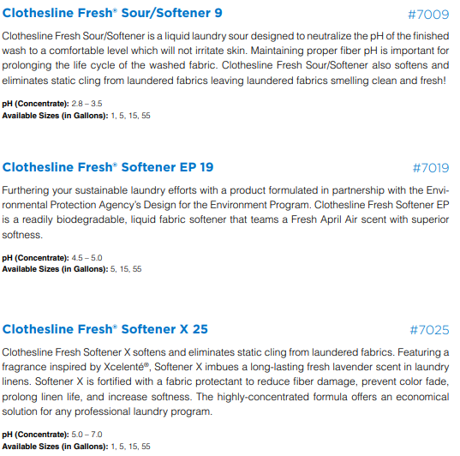
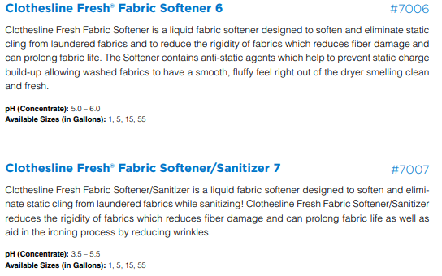
Softeners
Laundry Products
Softeners
Fabric Softeners reduce fabric rigidity, control static, provide lubricity, and impart a pleasant fragrance to the linen.
Fabric Softener has a Breezy Linen fragrance.
Softener EP has a Spring Shower Fresh scent.
Softener X has an Xcelente inspired fragrance and fabric protectant.

Slide 14
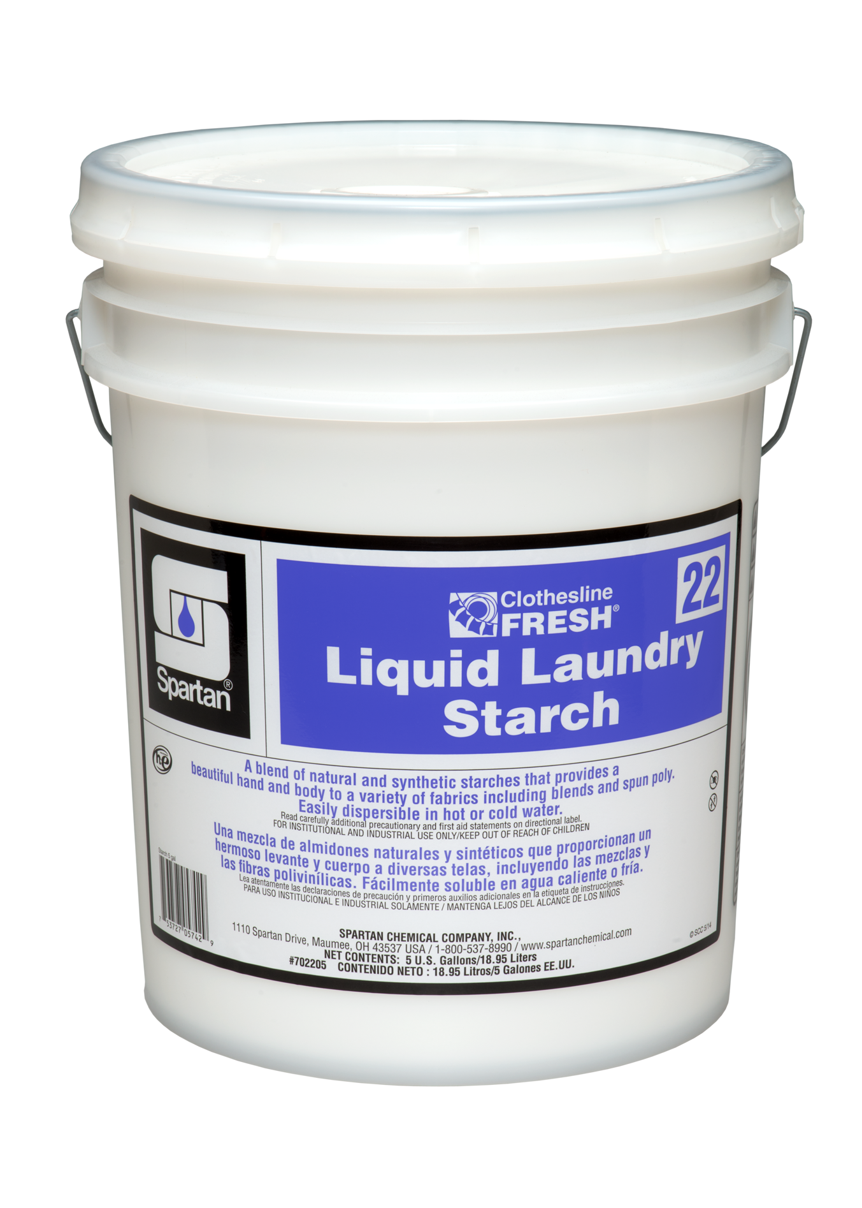
Additional Additives
Laundry Products
Additives
These additional products don’t “fit” into a traditional category, but serve an important role in certain laundry situations.
Anti-Chlor is a reducing bleach that is used in commercial laundries and in healthcare laundries.
Liquid Laundry Starch provides a barrier coating which provides fabric rigidity and stain protection.

Slide 15
Spotters
Laundry Products
Spotters
An effective spotting or pre-treatment program can reduce rewash by up to 50% according to the American Linen Institute.
All Purpose Spotter, Alkaline Spotter, and Enzyme Spotter will attack a variety of stains with adequate contact time.
Rust & Iron Remover and Iodine & Betadine Remover will instantly remove those types of stains.

Slide 16
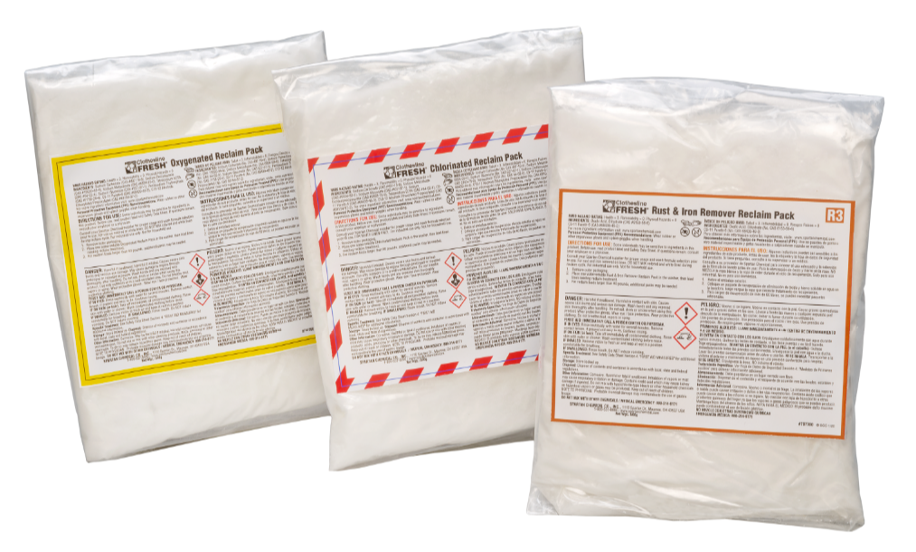
Reclaim packs
Laundry Products
Reclaim
Reclaim Packs are meant be used as a means of last resort to bring stained linen back into rotation.
Each will be an individually packaged, water soluble pouch.
CLF Chlorinated Reclaim Pack R1
CLF Oxygenated Reclaim Pack R2
CLF Rust & Iron Reclaim Pack R3
10 – 500 gram pouches
10 – 500 gram pouches
15 – 300 gram pouches
Clothesline Fresh® Chlorinated Reclaim Pack R1
Concentrated, water-soluble laundry stain treatment packet for white linens
Clothesline Fresh® Oxygenated Reclaim Pack R2
Color-safe, concentrated, water-soluble laundry stain treatment packet
Clothesline Fresh® Rust & Iron Reclaim Pack R3
Concentrated, water-soluble laundry stain treatment packet for rust and iron stain removal

Slide 17
Laundry market

Slide 18
Verticals within
Laundry Market
Healthcare
BSC
Car Wash
Hospitality
Food Processing
Linen Rental Companies
Day Care
Food Service
Industrial Plants
Long Term Care

Slide 19
How to sell

Slide 20
Section 1:
Situation
Section 2:
Problem
Section 3:
Implication
Section 4:
Need-Payoff

Slide 21
Situation questions
Section #1

Slide 22
Examples
Situation
Exercise- Planning Situation Questions
Potential Buyer Problem (that you can solve)
Situation Information Needed Before Investigating Problem:
Situation Questions to Ask
What current products are you using?
Who Makes the ultimate buying decision?
Are you on a cold or hot water system?
How many loads are you doing a day?
How many pounds?
Alternative Source of Information
Visual Inspection

Slide 23
Problem questions
Section #2

Slide 24
Defined
problem
Examples
What is your reclaim percentage? National Average 5%
What is your biggest staining issue? Depends on Market Segment
How is your employee turnover? Leads to training issues
How often are you placing orders? How much inventory do they have to keep on hand.
How satisfied are you with the response time of your current provider? Lends to understanding current service expectations
How much do you spend on freight?
Are you adding anything to your washers manually? Safety and Labor
Do you receive detailed service reports?

Slide 25
implication questions
Section #3

Slide 26
Defined
implication
Examples
How much does your current reclaim effect your linen budget?
How has your linen quality affected customer satisfaction?
How does your re-wash affect your labor costs?
Is there a safety concern with manually adding product to machines?
How does your inventory levels affect your current budget?

Slide 27
Defined
implication
Rough Linen
Customer Complaints
Lost Business
Staining Issues
Clear Problem
Desire for Solution
Explicit Need

Slide 28
Need-payoff questions
Section #4

Slide 29
Defined
Need-payoff
Examples
How much would could we save you if we cut your rewash x%?
How much linen could be saved if we could get 50% of our reclaim back?
How could our squeeze tube free pumps improve your service issues?
How will increasing ordering frequency and eliminating freight costs impact your bottom line?
Why is that important to you?
What other benefits could you foresee by improving your overall linen quality first time through the washer?

Slide 30
We have the solution for any application!
Clothesline fresh

