Slide 1
The Chemistry of Cleaning
The Science Behind What We Sell
Notes:
We offer chemical solutions to a host of cleaning and maintenance problems. Often times the underlying chemistry, or rather the actual science that goes into these solutions, is overlooked or taken for granted. We like to joke that we are on the cutting edge of low technology, but there is quiet a bit of real science that goes on in all of those quarts, gallons, pails and drums that you sell. I’m hoping that in the next 30 minutes or so, I can add to our product knowledge as well as give you some technical confidence so that when you are in front of a customer you will be well armed if and when you get asked some technical questions.
I’m not saying you can’t or shouldn’t call us in the lab, we welcome and ask you to reach out whenever you have a question about the products or need some help…but I think you being well informed will add real credibly out in the field.

Slide 2
The Role of Cleaners
Chemistry of Cleaning
Cleaners are designed to remove specific types of soil loads through chemical interactions.
Emulsification
Soil Suspension
Anti-Redeposition
Neutralization
Saponification
Descaling
When designed and used properly, cleaners help to take the work out of cleaning, i.e. We Make Clean Simple.
Notes:
So what is a cleaner? Well, cleaners are designed to remove specific types of soil loads through chemical interactions. Some of the most important ones that we will be dealing with and discussing today are emulsification, soil suspension and anti-redeposition along with chemical neutralization; specifically saponification and descaling. When designed and used properly, cleaners help to make cleaning easier, weather it be less effort or time spent cleaning. Or to put it more eloquently, like our corporate slogan…We Make Clean Simple.

Slide 3
The Role of Cleaners
Chemistry of Cleaning
Other notable functional properties of our products:
Disinfection and Sanitization
~40 Disinfectants and sanitizers produced and sold by Spartan
Film Formation
19 floor finishes produced and sold by Spartan
Abrasion
Many polishes, like SparCreme, work by abrasion
Hydrophilic/Hydrophobic surface modification
Hydrophilic Surface Modifications (Sheeting): Rinse Aids in our warewash line.
Hydrophobic Surface Modifications (Beading): Drying Agent, Clearcoat Protectant, and Weather Shield in our car wash line.
Notes:
Our discussion today will focus on cleaning; but I’d be remiss if I didn’t touch on some of the other notable functional properties of our products.
1st, with our increased focus and push into healthcare, both acute and long term care, Disinfection and Sanitization is vital. The processes of Reducing or destroying or irreversibly inactivating infectious fungi and bacteria are utilized in approximately 40 of our products that play a large roll in many of your regions. We are introducing 2 more disinfectants today and Jason is always more than happy to discuss these with you.
Film Formation, Basically the entire science behind how and why our floor finishes work, which I’m sure Becky, could spend hours discussing with any of you.
Abrasion, is basically a fancy term for sanding, which is how many polishes like SparCreme help to clean/shine.
Surface Modifications are ways that some of our chemicals can temporarily alter how a surface interacts with water. This helps us in several of our product lines.
Hydrophobic, or water hating, surface modifications are what we use in our Xtreme Car Wash line, specifically Drying Agent, Clearcoat Protectant and Weather Shield rely on this property to make water break and bead up so that it can be easily blown off of a vehicles surface. The surface essentially repels the water so that it beads away and easily forced off the surface.
Hydrophilic, or water loving, surface modifications are what we use in SparClean Warewash to speed up the drying process with our Rinse Aids by creating that sheeting effect we have all witnessed. The surface of the dishes become so water loving that the water spreads out to a very thin layer, or sheet, that can dry extremely fast

Slide 4
Chemistry basics
The ABC’s of Cleaner Chemistry
Notes:
Now, for the basics of cleaner chemistry.

Slide 5
Knowing The ABC’s of cleaner chemistry
Chemistry Basics
A
Active Agents
Surface active agents, Surfactants, provide many of the functional properties to cleaners.
Surfactants provide:
Wetting (Surface Tension Reduction)
Detergency & Emulsification
Lubricity
Bubble formation
Types of Surfactants:
Anionic ( - )
Nonionic
Cationic ( + )
Notes:
A is for Active Agents, or more specifically Surface active agents, or surfactants. These provide most of the functional properties of the cleaners we make and sell. These can also be referred to as emulsifiers or detergents. Surfactants provide wetting, we have all heard to the expression, make water wetter. Well that’s what your surfactants are doing, reduce the surface tension of the water so that it can spread and speed up cleaning. This helps to provide detergency and emulsification. In many formulations the surfactants also provide for bubble formation or foam, but there are classes that do not foam as well. Surfactants also provide lubricity.
From a high level perspective surfactants are divided up into three categories based on their ionic charge. Negatively charged surfactants are referred to as anionic, and are great for hard surface cleaners and general purpose cleaning as well as personal care cleaners. No net ionic charge, or nonionic surfactants are used in a variety of cleaners like Laundry, degreasers, and all purpose cleaners, and are chosen because they can be mixed with a variety of other chemicals without fear of chemical charge interactions happening that would salt out some of the ingredients. Cationic, or positively charged surfactants are most common in disinfectants and sanitizers due to the positive ionic charge has a negative impact on bacteria. Cationic can also be blended with nonionics for some interesting degreasing properties. We see these types of cationic/nonionic blends in G.S. Industrial, Micro Muscle, CBP, and some of the car wash products.

Slide 6
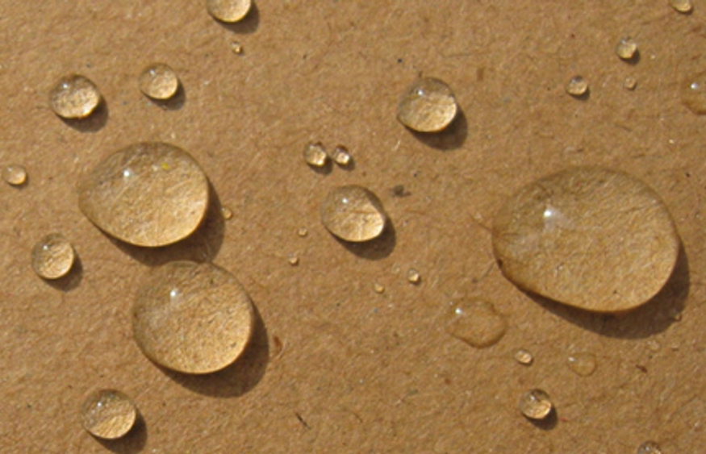
Demonstration opportunities
Chemistry Basics
Oil and Water Emulsification Demo
Cardboard Demo for Wetting
Cardboard Demo with Bleach

Slide 7
Knowing The ABC’s of cleaner chemistry
Chemistry Basics
B
Builders
Builders enhance the cleaning properties of surfactants by changing the pH of the cleaning solution.
Builders provide:
Chemical Neutralization of Soils
pH stability
Raise or Lower pH
Bubble Enhancement
Corrosion Inhibition/Protection
Types of Builders:
Acids
Caustics
Phosphates
Silicates
Notes:
B is for Builders. They enhance the cleaning properties of surfactants by changing the pH of the cleaning solution, whether that is to be utilized in the cleaning process or to provide formulation stability during the manufacturing process. Builders can also be added to provide corrosion inhibition or protection for some products, and can also be added to either increase foam or decrease it.
Phosphates and Silicates are often added to help with corrosion and to help control water mineral content.
Acids and Caustic when added together to a formula provide a buffer to stabilize the pH of the formulation during the production process, that prevents us from having to make unnecessary and costly batch adjustments that would significantly slow down production.
In terms of cleaning though, we most often use acids or caustic to significantly change the pH of a cleaner so that we can take advantage of the pH of the cleaner and use it against a particular soil, to chemically neutralize it and make it easily to remove or clean.

Slide 8
Manipulating the pH scale to our advantage
Chemistry Basics
Notes:
We should all be familiar with the pH scale. If you aren’t, don’t say anything, or else you will have to go back through RM training with Schauff, and I doubt any of you want to do that ;)

Slide 9
Manipulating the pH scale to our advantage
Chemistry Basics
Chemical Neutralization of Soil
Cleaning happens when you target the pH of the soil needing to be removed with a cleaner of the opposite pH, creating a chemical reaction that results in a salt that is easily rinsed away with H₂O.
Saponification: Neutralization of acidic soils with alkaline cleaners
Descaling: Neutralization of alkaline soils with acidic cleaners
Notes:
When I say take advantage of a cleaners pH to attack a given soil, we are talking about chemically neutralizing it. Meaning we use Alkaline, high pH, cleaners to attack acidic soils such as fats, oils, and greases. We do this all of the time in Food Processing with Caustic Cleaner, HP Alkaline, things like that. We take soils which have a low pH, and we combat them with high pH cleaners, they chemically neutralize to create water soluble or rinseable salt like compounds. This process is called saponification.
When we have alkaline soils like mineral scale, that tends build up in showers and bathrooms or on the inside of dish machines, we use acidic cleaners to neutralize these soils to make them easy to remove. Think of our acid toilet bowl cleaners or High Acid FP or SparClean Delimer. This process is called descaling.
Cleaning through chemical neutralization generally requires extremes in pH for both the cleaner and soil alike. But what happens when the pH of the soils is closer to neutral? This is where our all-purpose cleaners or general purpose cleaners come in handy. These rely on other factors, not just brute force alkalinity or acidity. You can see this when you are dealing with cleaning up salt during the winter, products like TriBase, Damp Mop, Xcelente, or really any of our other neutral pH cleaners for that matter do a much better job of dissolving the salt than what a high ionic strength cleaner would do. There is just more room for a neutral cleaner to dissolve and disperse the salt type soils than would be in high electrolyte cleaners.

Slide 10
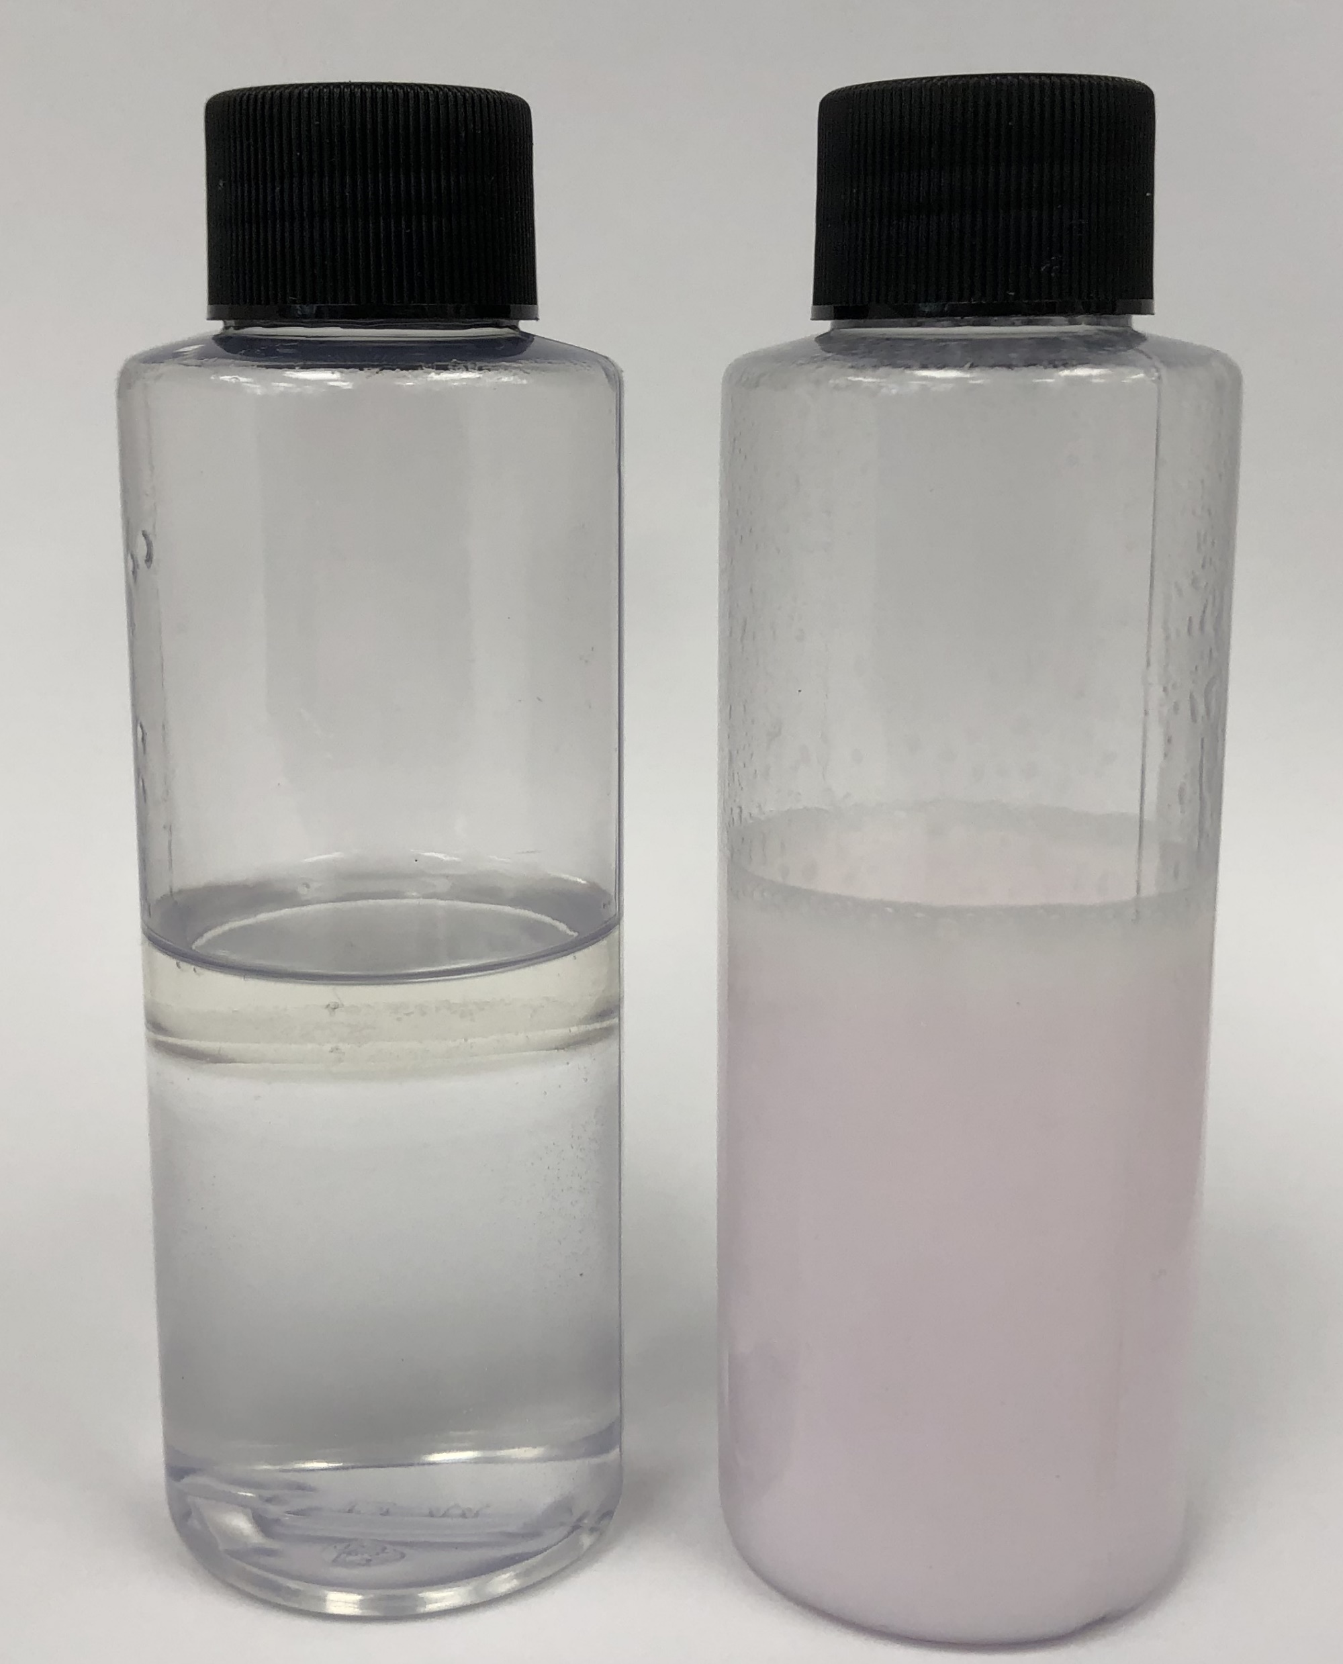
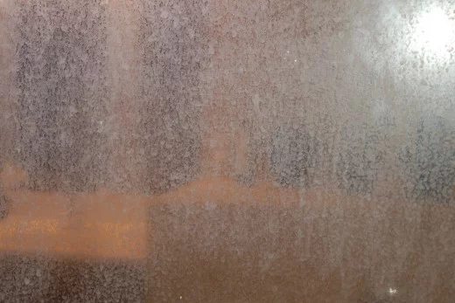
Demonstration opportunities
Chemistry Basics
Saponification Demo with Caustic Cleaner FP
Descaling Demo with High Acid Cleaner FP

Slide 11
Knowing The ABC’s of cleaner chemistry
Chemistry Basics
C
Chelating Agents
Chelants are chemicals that improve the efficiency of surfactants by protecting them from water impurities.
Chelants provide:
Water Conditioning
Metal Ion Binding
Enhancement for Disinfecting Agents
Anti-Precipitation
Notes:
C, is for Chelating Agents. Chelants, aka water conditioners or water softeners, improve the efficiency of surfactants by protecting them from water impurities. Anionic and Cationic surfactants, because they have a charge, can see their efficiency greatly reduced if a counter ion, or opposite charge, binds to them. In these situations the surfactant salts out and is useless. To prevent this, we add chelants which act like magnets and pull the metals out of solution or prevent them from binding to the surfactants in our cleaners and disinfectants. Chelants also help to prevent precipitation of some soils. We can also use them to prevent the minerals in water from causing problems with what we are cleaning, like in Laundry when we use a built detergent to prevent linen from greying due to hard water.

Slide 12
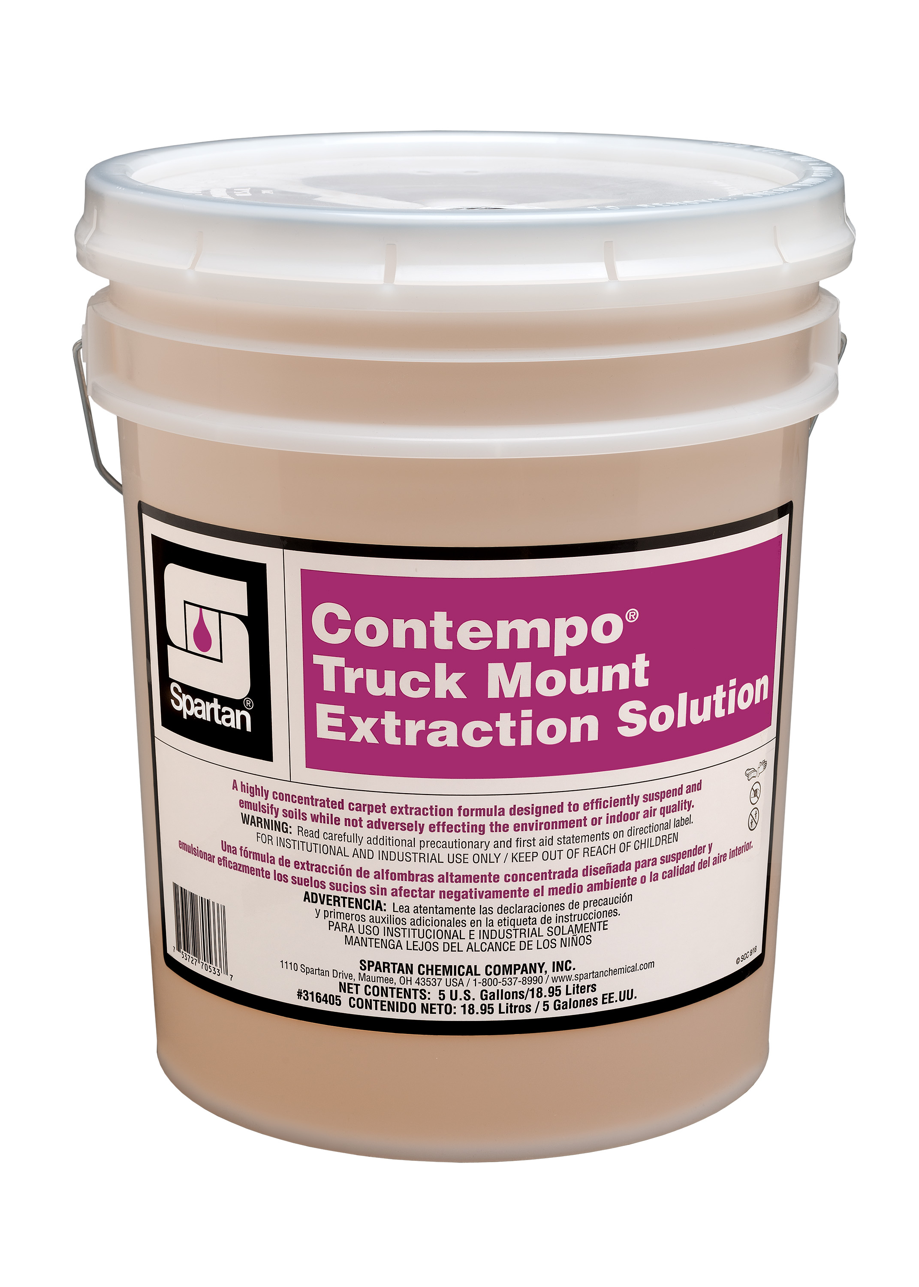
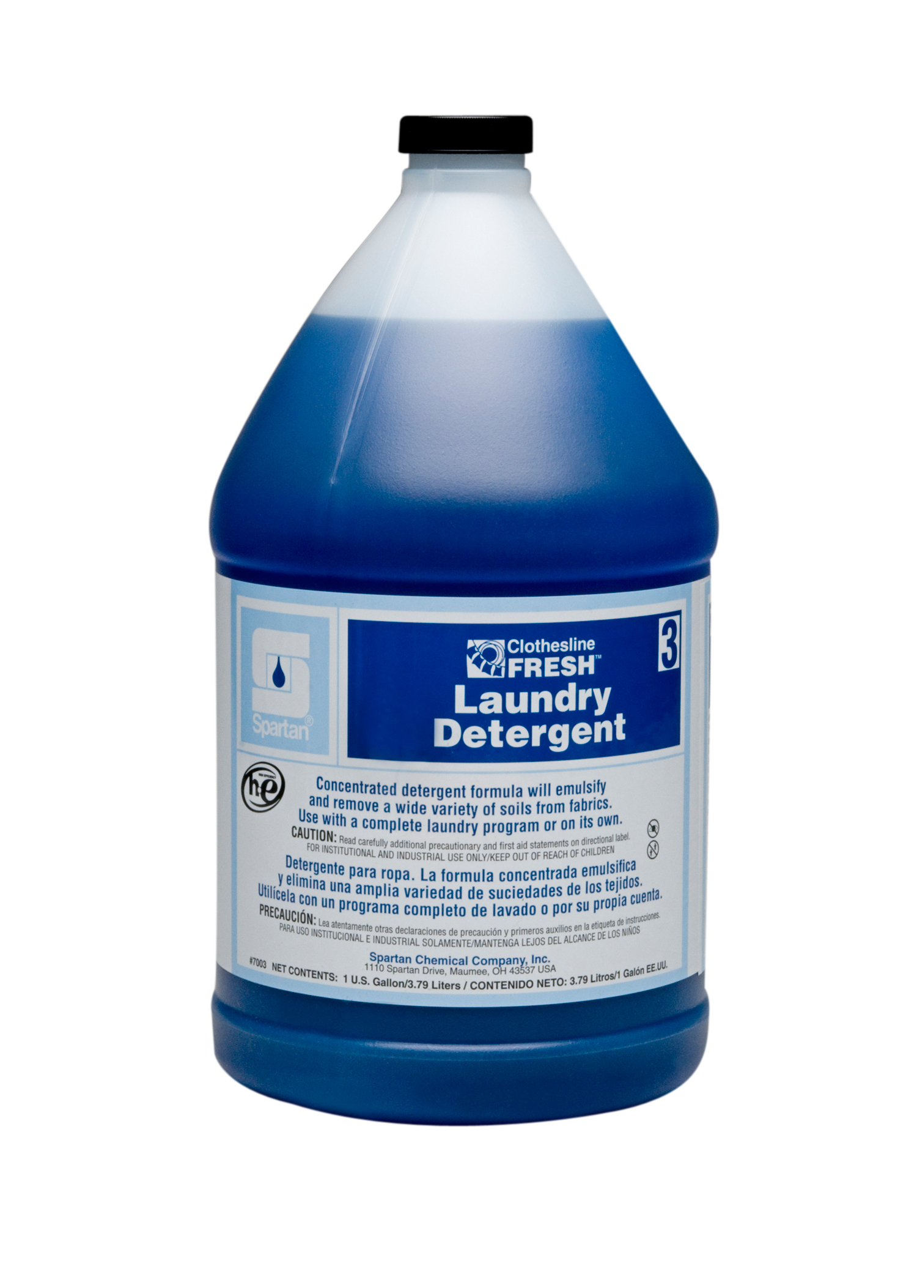
Knowing The ABC’s of cleaner chemistry
Chemistry Basics
D
Dispersants
Dispersants are ingredients that work in synergy with surfactants by keeping soils suspended in solution.
Dispersants provide:
Anti-redeposition
Enhanced Detergency and Emulsification
Notes:
D is for Dispersants, these are ingredients that work in synergy with surfactants by holding soils in suspension, allowing them to be washed or rinsed away. A great example of this is what separates laundry detergent from a dish soap, both have a high amount of surfactants and can remove soils rapidly. But a laundry detergent has added ingredients to keep the soils suspended, or dispersed in solution so they won’t redeposit on the fabric. A new product that is built entirely around the notion of anti-redeposition and dispersion is the Contempo Truck Mount Extraction Solution, its sole purpose and design is to suspend dirt and soil in water so that it can be extracted off of carpet without the soil falling back on the carpet

Slide 13
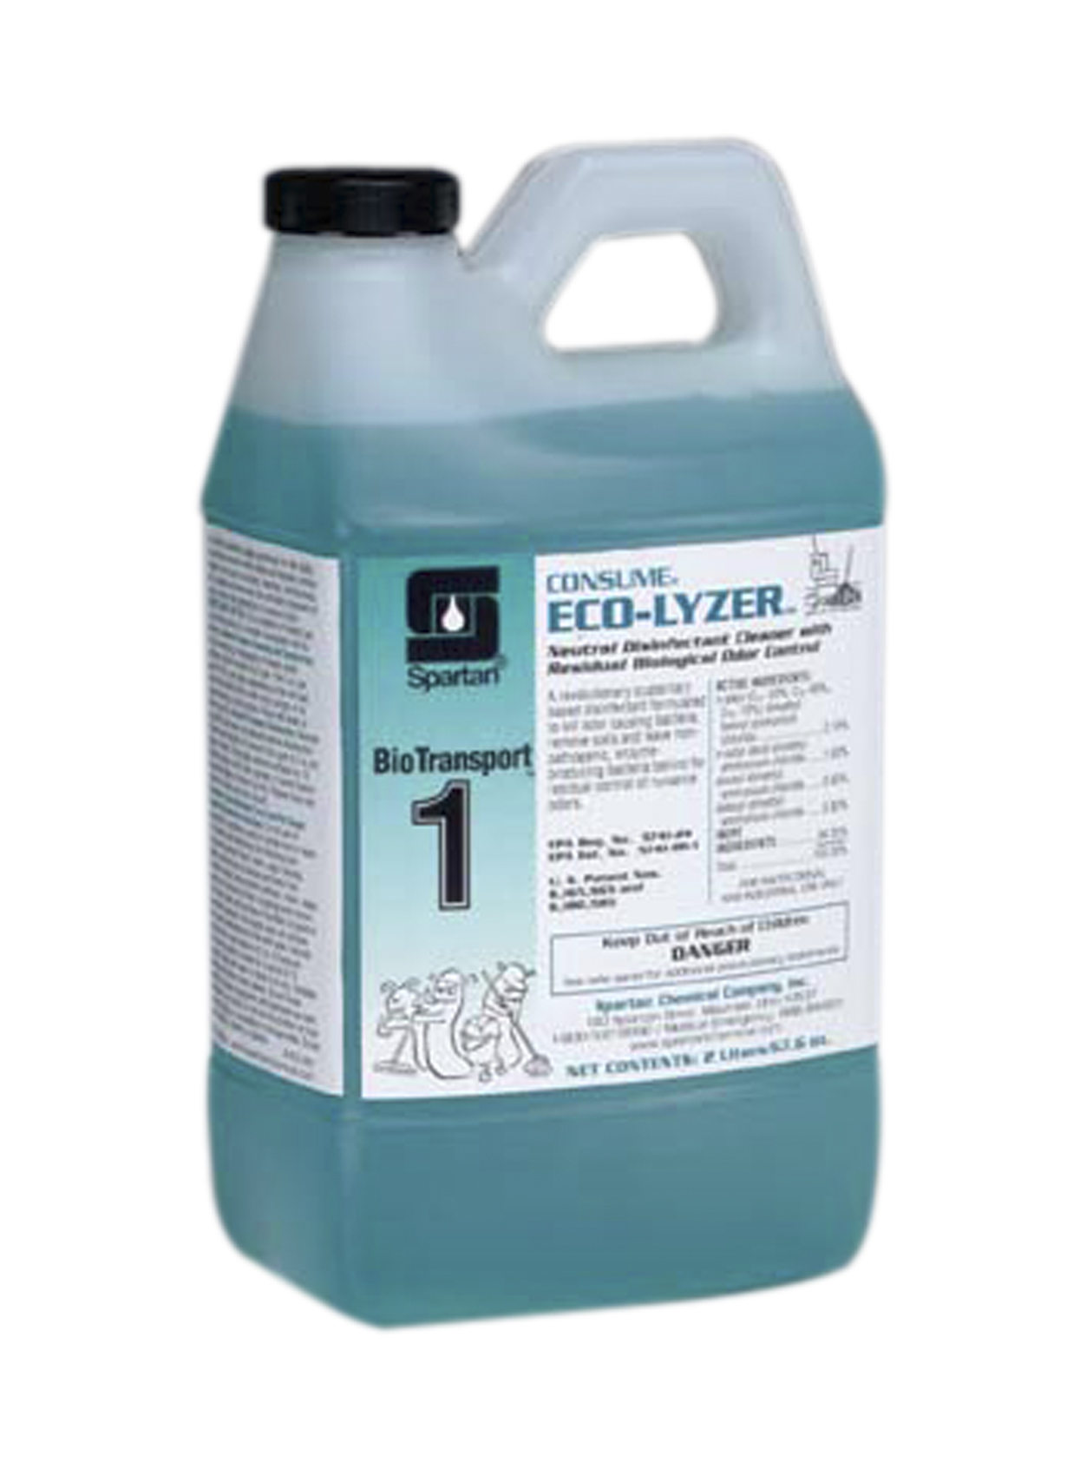
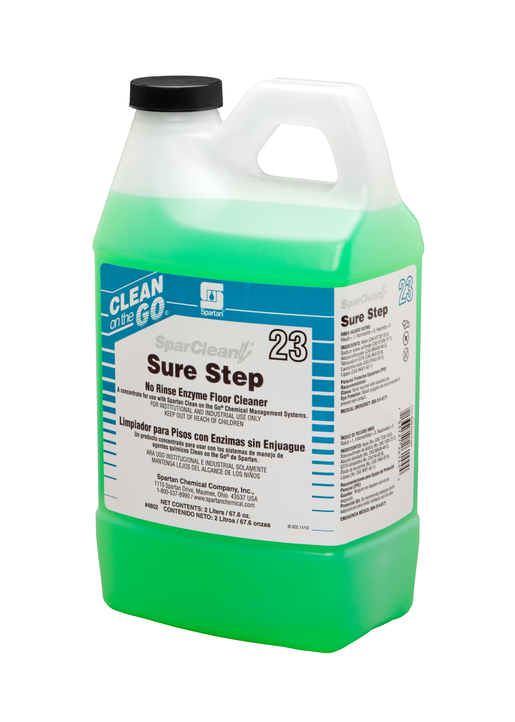
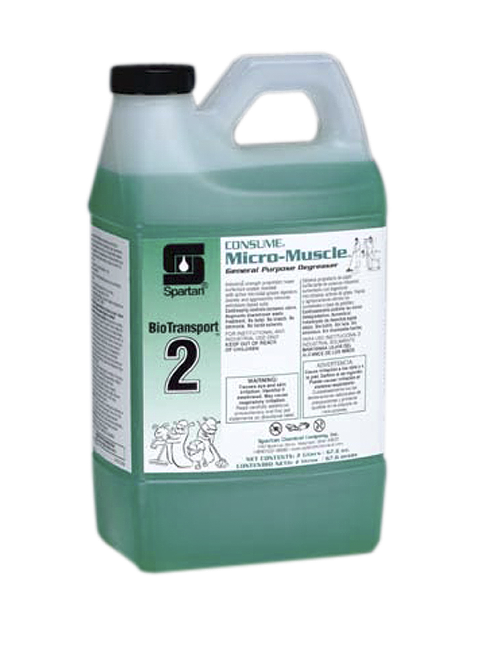
Knowing The ABC’s of cleaner chemistry
Chemistry Basics
E
Enzymatic Activity
Enzymes work by breaking down specific organic soils into smaller parts.
Enzymes can be added directly into a formulation as a base raw material, or they can be produced naturally by microorganisms.
Enzyme Activity provides:
Management of Organic Soils
Odor Control
Stain Fighting
Notes:
E is for enzymatic activity. We take advantage of this in two different types of fashions, directly and indirectly. We use direct enzymatic activity in products like Sure Step and Silverware Presoak in the SparClean line as well as Enzyme Detergent and Spotter in Clothesline Fresh. This is where we add enzymes directly into the formulation to aid in the breakdown of soils and speed up the cleaning process. We use indirect enzymatic activity in the Consume Product line, where the true active ingredient, bacteria produce enzymes to help them breakdown and consume soils to help manage organic waste and help with odor control.

Slide 14
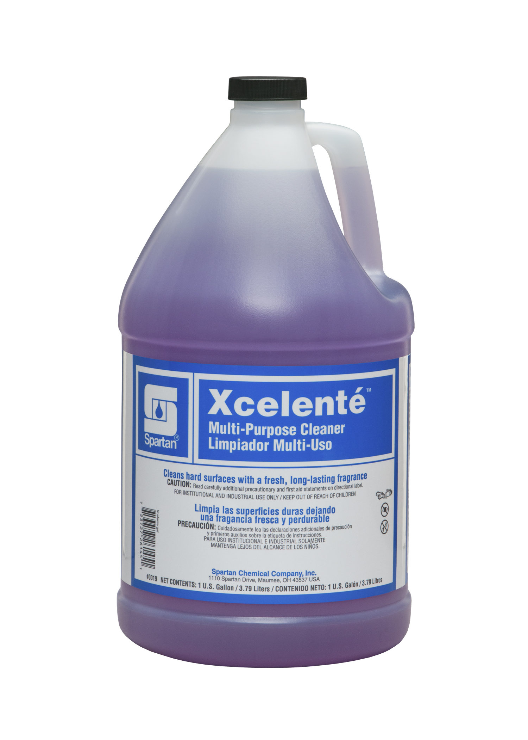
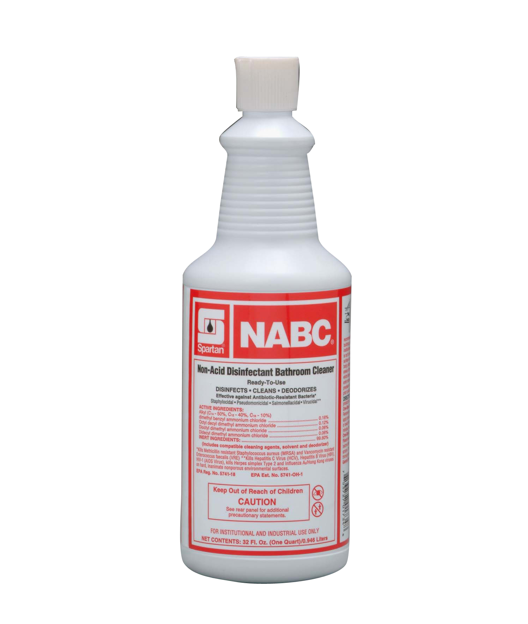
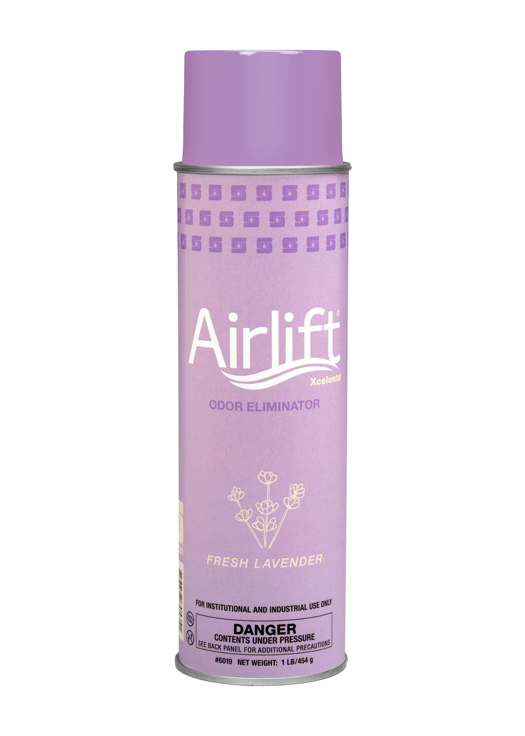
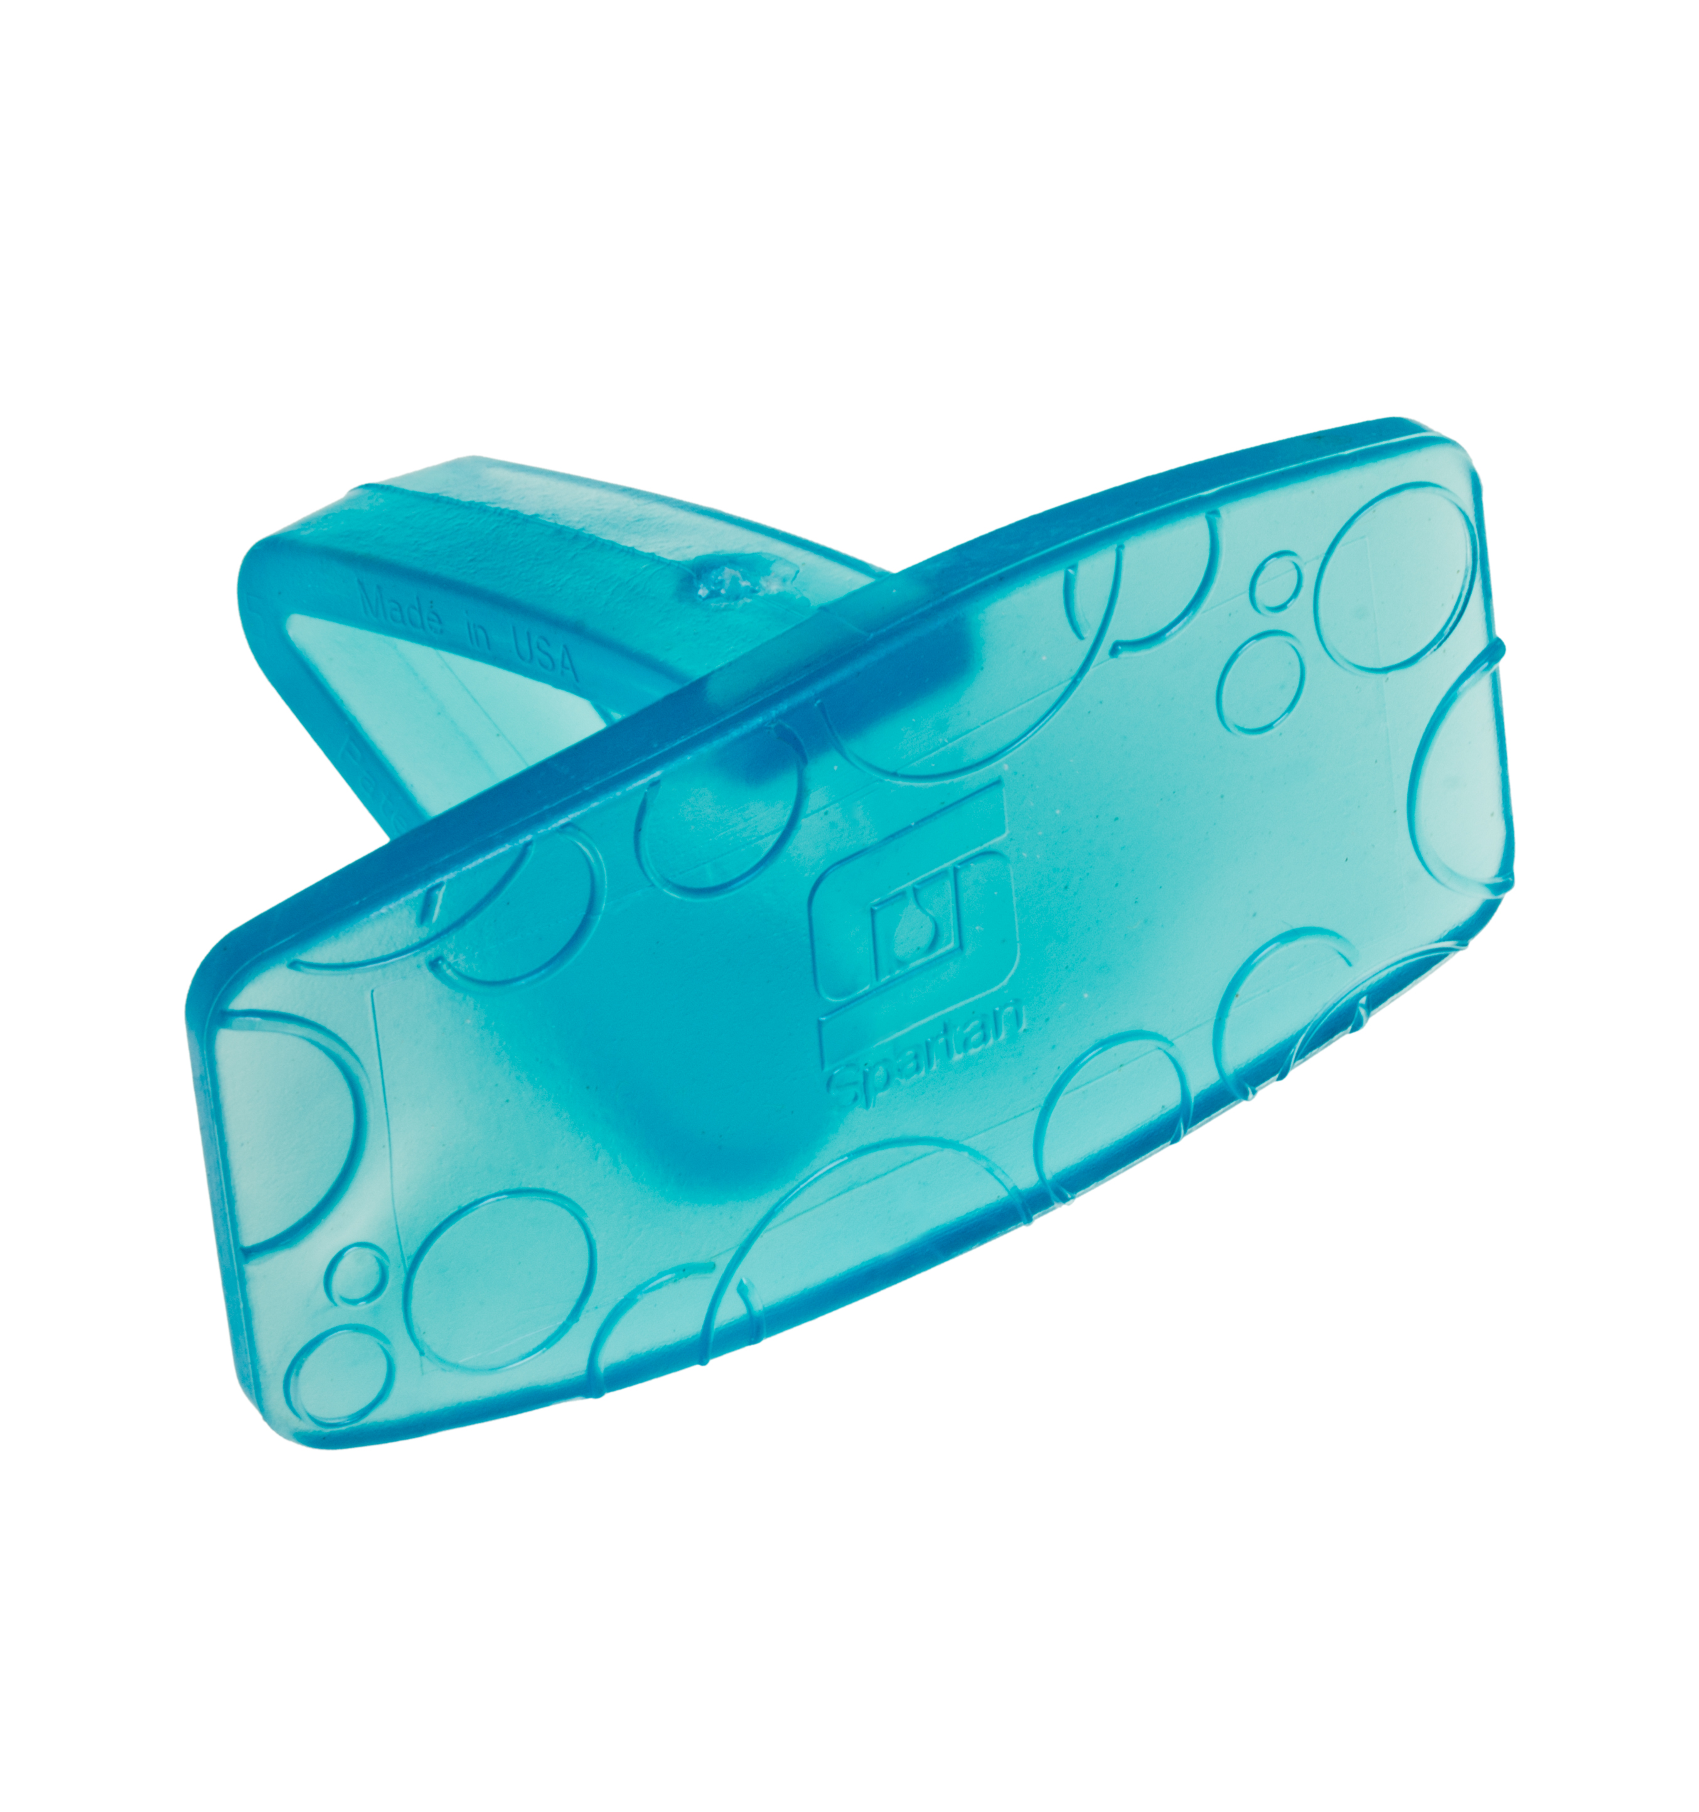
Knowing The ABC’s of cleaner chemistry
Chemistry Basics
F
Fragrance
Fragrances make cleaners more pleasurable to use. They help to create and reinforce the perception of “clean” in the environment. Along with a products color, fragrance creates an identity for a product.
Fragrances provide:
Odor Control
Product Identity
User Perception
Notes:
F, is for fragrance, and is usually the portion of a product that Marketing is most interested in. Fragrances are added to cleaners to make them more pleasurable to use, and help to create and reinforce the perception of clean. Along with color, fragrance creates a products Brand identity. Think of NABC, that signature fragrance has created a brand that has spawned numerous products for us in many different product types for over 30 years, as recently as last year we introduced another NABC branded product. Pretty strong identification and brand recognition for a fragrance and product that was first introduced in 1981. We are seeing this all over again with Xcelente and with us going all in on Lavender. Introduced 5 years ago, with the introductions of 3 more products we now have 8 total Xcelente branded/fragranced products.

Slide 15
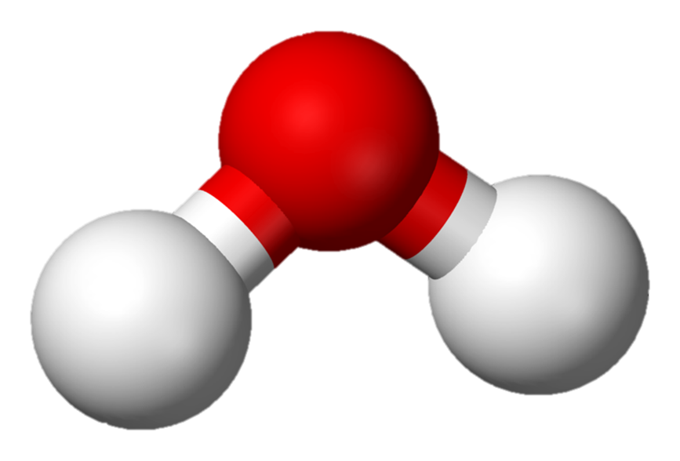
Knowing The ABC’s of cleaner chemistry
Chemistry Basics
S
Solvents
Solvents are a broad range of ingredients that provide many functional properties to cleaners.
The Universal Solvent
Solvents provide:
Wetting
Faster Drying
Oil Solubility
Film Formation
Soil Penetration
Water
Notes:
S is for Solvents, and it’s a very broad range of ingredients that provide almost as many functional properties as surfactants. Solvents help provide wetting in a similar fashion as surfactants. Many help speed drying by increasing the evaporation of a cleaning solution (though many of those contribute to VOC content). They help with oil solubility and soil penetration, like butyl in SC-200 or Detergent SE. In floor finishes they help with film formation. Lets not forget that water is a polar solvent, considered the universal solvent. Our most used raw material, and our ability to augment its cleaning ability in a variety of different ways is essentially what you sale and what makes this a profitable company.

Slide 16
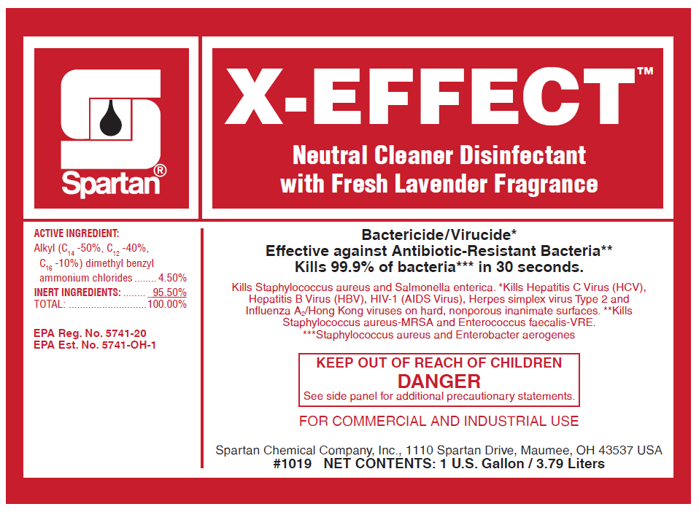
Dilution ratios, percentages, and PPM
Math 101
Dilution Ratio and Ounces per Gallon
For a given ratio, divide 128 by the ratio to yield ounces per gallon.
Example: 1:20, 128 / 20 = 6.4, round to 6 ounces per gallon of water for proper dilution.
Percentages and PPM
Percent = Parts per 100
PPM = Parts per Million
0.01% = 100 ppm
0.1% = 1,000 ppm
1.0% = 10,000 ppm
10.0% = 100,000 ppm
Percent and ppm are just different ways to
express concentration
Active Ingredients in a product given in %.
4.5% vs. 45,000 ppm
Active Ingredients at use dilution given in ppm.
703 ppm vs. 0.0703%
Notes:
Before I close, I would like to touch a couple of math lessons as it relates to our industry. We get calls from DSR’s often about this, and RM’s from time to time if I’m being honest.
The first is dilution ratio. We should all know that if we want to figure out how many ounce we need we simply divide 128 by the dilution ratio. SO if we wanted to know how much BH-38 we needed per gallon for a 1:20 dilution to be used in an auto scrubber we would take 128 divide by 20 and round to the nearest whole number and we get 6 ounces per gallon of water.
That’s the easy one. What we get the most calls on is what is the difference between % and ppm. Which is kind of a trick question because they are represent the same thing, concentration. They are just used in different situations. Often times you will see % when listing the concentrations of active ingredients on a label but ppm’s are used when discussing concentration at dilution. When the numbers get really large, its just easier to speak and reference things in terms of Percentages, conversely its easier to express or reference really low numbers in ppm. I always go to base numbers to keep it straight, if I have 1% of something, that also means I have 10,000 ppm of that something. If I have 10% then I have 100,000 ppm of that thing.
If you would ask Jason or I how many ppm of sodium hydroxide is in a 0.5% solution of Caustic cleaner, its easy enough to figure out as 5,000 ppm.

